Slide 1
China's One Child Policy
Jakub Pospíšil
Cevro Instutute

Slide 2
The Beginning
In the 1950´s China's population was around 400 million people
In the 1980´s the population was 800 million
The law gained effect on the 1st of January 1980 - ended in 2015
Why did the Chinese government came up with this policy?
they were afraid that the government would not be able to pay pensions
Government of the People's republic of China was also scared of the overpopulation in urban areas and the inability to cope with it efficiently

Slide 3
The Ground Rules
Every family can have a maximum of one child
For every other child parents had to pay a huge fine, which they in most cases could not afford or take yours kids life (abortion)
murder of the second kid was not something extraordinary
cultural ground rules
Boy better than a girl
he is a better and stronger worker
he will carry on the family name
that is why a lot of Chinese girls were put up for an adoption

Slide 4
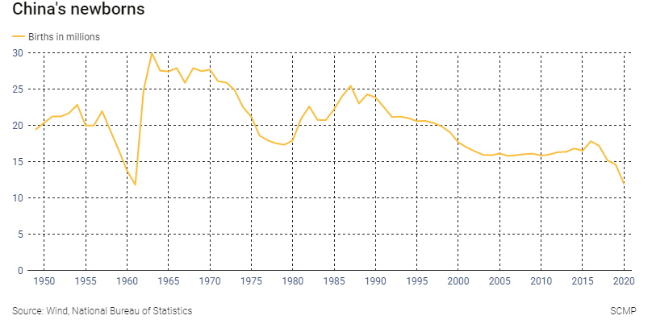

Slide 5
Exceptions
Twins, triplets
using supplements to enhance the chance of having multiple babies at once as it did not count as another baby
in rural areas
if your first kid was a girl you can have a second kid
that appealed to farmers, fisherman and certain minorities (someone could even have 3 kids)
in urban areas
if both of the parents do not have any siblings, they were eligible to have two kids
2012
cities such as Bejing (1982) Shanghai (1990)
people did not know about it to make a differnece
Notes:
Bejing and Shanghaij - because of the olding population in the cities which are very importatnt to the economy

Slide 6
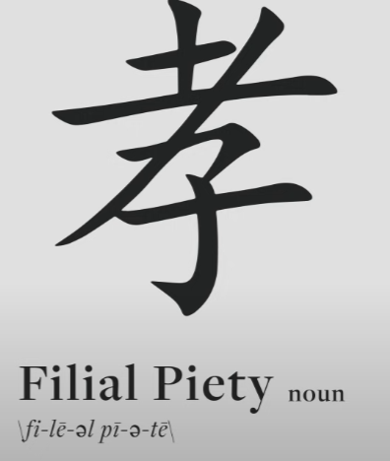
Problems with the One Child Policy
aging of the population
less innovation
dependence of parents and grandparents on the offsprings
Family in China has always been the most important and sacred
stagnation of economy
lots of family shops
Notes:
FILIAL PIETY - a noun that describes loyalty and service to parents and other ancestors

Slide 7
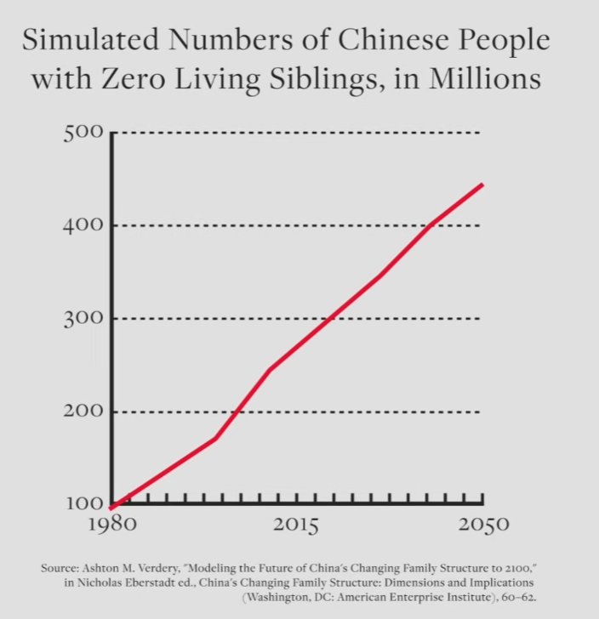
Problems with the One Child Policy
Notes:
FILIAL PIETY - a noun that describes loyalty and service to parents and other ancestors

Slide 8
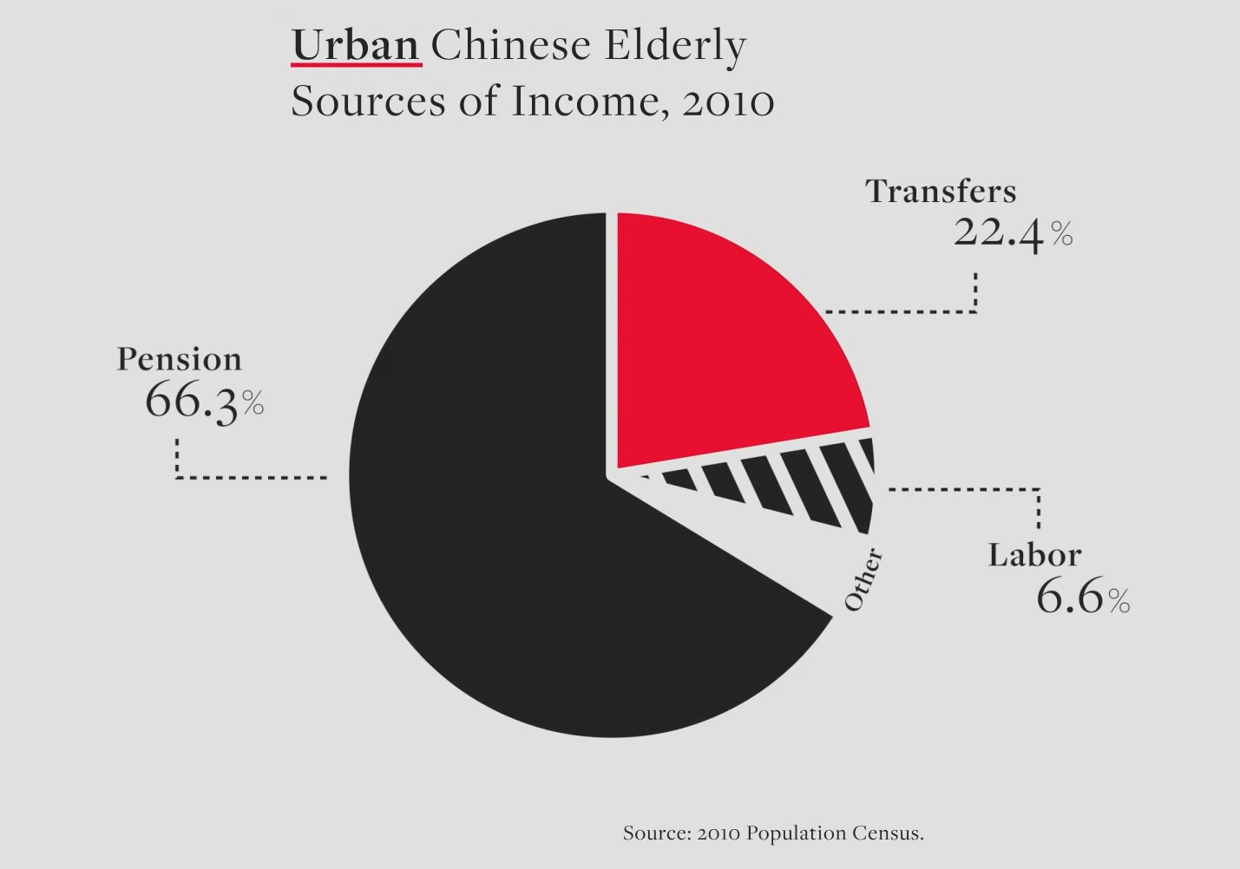
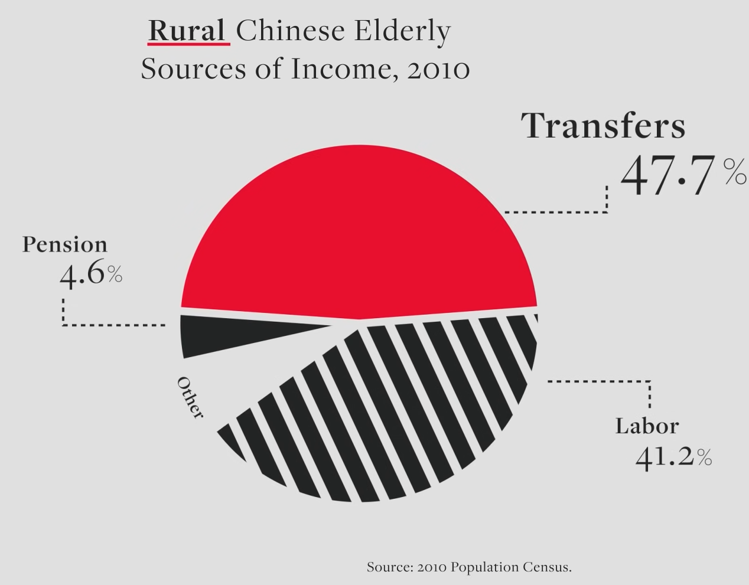
Problems with the One Child Policy
Notes:
FILIAL PIETY - a noun that describes loyalty and service to parents and other ancestors

Slide 9
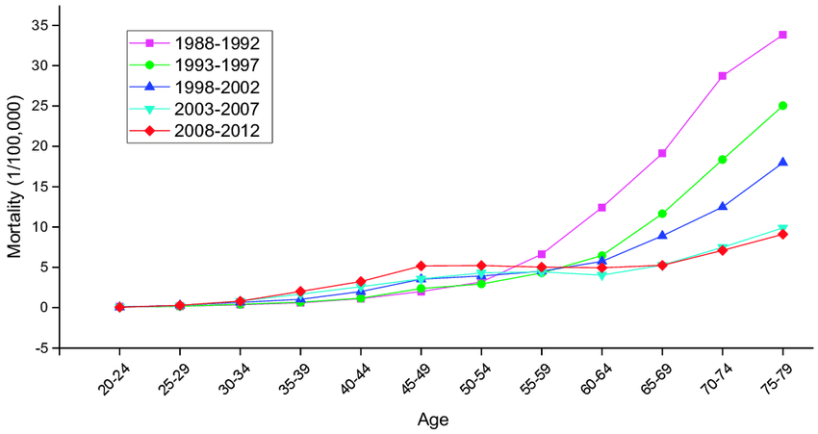
Notes:
here we can see, how people are dyying less which means that children have a lot on their shoulders
inovation in medicine

Slide 10
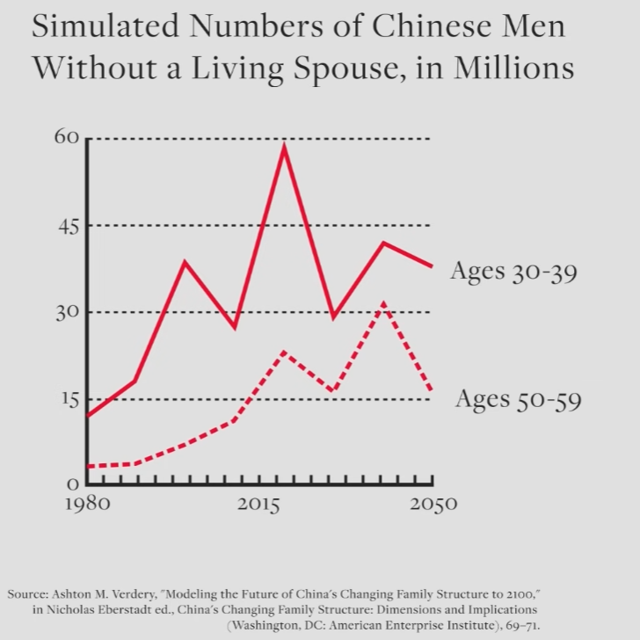
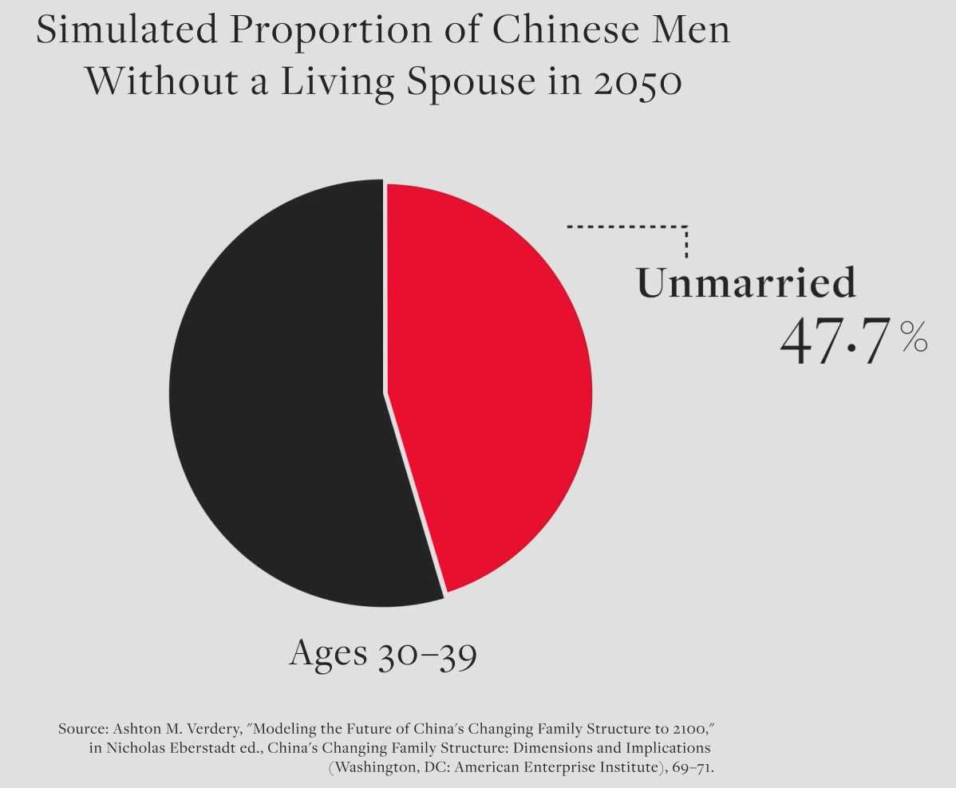
Girls were unwanted
There is not enough women for the population of men, not enough women to have kids and to balance the society

Slide 11
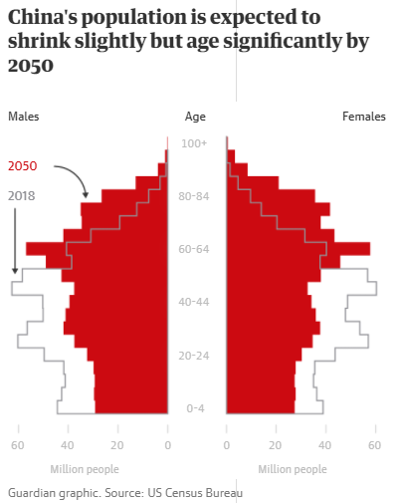
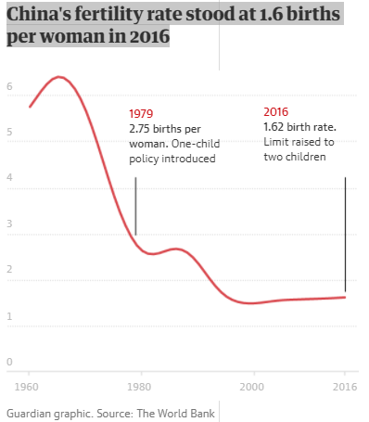

Slide 12
Aftermath
in the year 2016 there were 33.56 million more men than women
400 million births had been prevented by the policy
by 2050 33% of the population will be aged over 60
people are not motivated to have another child - mostly in cities as there is so heavy workload on the parents and immense pressure on the kids to do well in school
“China should have stopped the policy 28 years ago. Now it’s too late,” says Yi Fuxian, a senior scientist at the University of Wisconsin in Madison
In the year 2018 the birth rate was 15,23 million people - lowest birth rate since the founding of the People's Republic of China

Slide 13
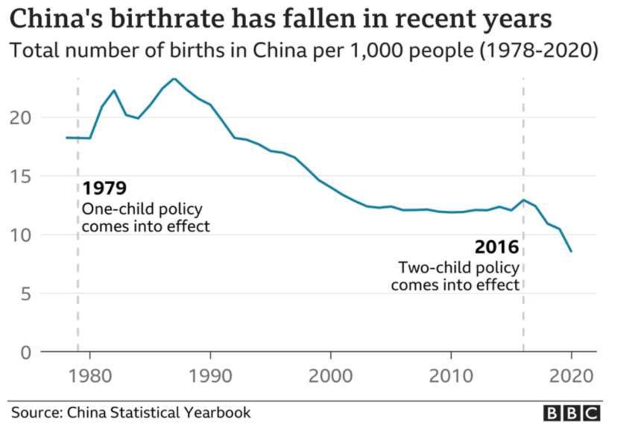

Slide 14
Sources
MULLEN, Andrew. China’s one-child policy: what was it and what impact did it have? [online]. 1.6.2021 [cit. 2022-03-26]. Dostupné z: https://www.scmp.com/economy/china-economy/article/3135510/chinas-one-child-policy-what-was-it-and-what-impact-did-it
FENG, Emily. China's Former 1-Child Policy Continues To Haunt Families [online]. 4.7.2021 [cit. 2022-03-26]. Dostupné z: https://www.npr.org/2021/06/21/1008656293/the-legacy-of-the-lasting-effects-of-chinas-1-child-policy
China allows three children in major policy shift [online]. 31.5.2021 [cit. 2022-03-26]. Dostupné z: https://www.bbc.com/news/world-asia-china-57303592
HEYES, Adam a Somer ANDERSON. One-Child Policy [online]. 24.8.2021 [cit. 2022-03-26]. Dostupné z: https://www.investopedia.com/terms/o/one-child-policy.asp
RODRIGUES, Jason. How China's one-child policy ended in failure: Reports from the archive explain how China implemented its controversial policy to control population growth [online]. 29.11.2015 [cit. 2022-03-26]. Dostupné z: https://www.theguardian.com/world/from-the-archive-blog/2015/oct/29/china-one-child-policy-failure-archive-1979-2016
Can China recover from its disastrous one-child policy? [online]. 2.3.2019 [cit. 2022-03-26]. Dostupné z: https://www.theguardian.com/world/2019/mar/02/china-population-control-two-child-policy
The Effects of China’s One-Child Policy [online]. [cit. 2022-03-26]. Dostupné z: https://www.britannica.com/story/the-effects-of-chinas-one-child-policy
FARLEY, Maggie. Loophole Lets More Chinese Have 2 Children [online]. 20.11.1997 [cit. 2022-03-26]. Dostupné z: https://www.latimes.com/archives/la-xpm-1997-oct-20-mn-44772-story.html

