Slide 1
Terrorism
and
security problems
in
Southeast Asia
Terrorism
SE Asia General Information
Southeast Asia Security
The growing terrorist threat in Southeast Asia
Question and Answer
Presentation by:
Shahzad Aryobee

Slide 2
TERRORISM
Terrorism has evolved from its historic origins from the French Revolution into a form of specialized crime today.
Terrorism, however, is neither compelled by passion or need;
it is sometimes defended for political reasons and is sometimes supported by governments.
Its motivations and underpinnings are egotism, intolerance, lack of dialogue and inhumanity, greed, and unaccountability¹.
Notes:
1. 1 Medhurst, Paul. Global Terrorism. United Nations Institute for Training and Research Programme of Correspondence Instruction. New York, NY (c) 2000. p 1.

Slide 3
TERRORISM (Continue)
Common roots of terrorism:
Civilizations or culture clashes, globalization, religion, conflicts, but depends on regional conflicts, such as:
Israeli with Palestinian
Kashmir issue between Pakistan and India
The conflict in Iraq, Suria and other surrounding area
Terrorism in Afghanistan began after the invasion of Russia.
More personal or individual-based reasons for terrorism are:
Frustration, deprivation, negative identity, narcissistic rage, and/or moral disengagement.
Notes:
1. 1 Medhurst, Paul. Global Terrorism. United Nations Institute for Training and Research Programme of Correspondence Instruction. New York, NY (c) 2000. p 1.

Slide 4

TERRORISM (Continue)
Five Types of Terrorism Identified in the Glob.
State-Sponsored terrorism, which consists of terrorist acts
on a state or government by a state or government.
Dissent terrorism, which are terrorist groups which have
rebelled against their government.
Terrorists and the Left and Right, which are groups rooted in political ideology.
Religious terrorism, are terrorist groups which are extremely religiously motivated and
Criminal Terrorism, which are terrorists’ acts used to aid in crime and criminal profit.
Terrorism, involvement of an act of violence, an audience, the creation of a mood of fear, innocent victims, and political goals or motives.

Slide 5
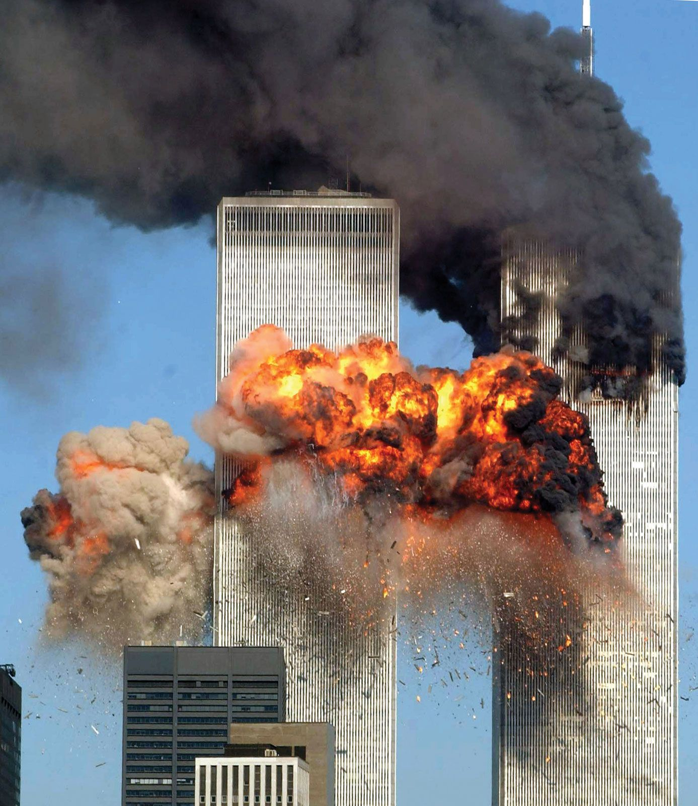
DEFINING TERRORISM
After the events of September 11th, 2001, on September 12th, 2001, UNSC officially decreed, for the first time, that acts of international terrorism are threats to international peace and security. “to promote social progress and better standards of life in larger freedom, and for these ends … to unite our strength to maintain international peace and security.”
With the diverse membership of the General Assembly, the consensus is an issue and an obstruction in directing the international community in the effort to combat terrorism.

Slide 6
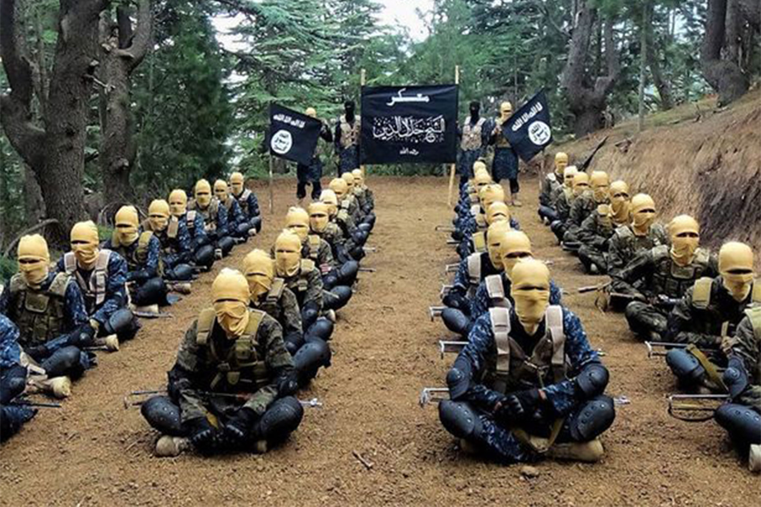
TERRORISM AND THE NATURE OF THREAT EXAMPLE of AFGHANISTAN
When ISIS-K and the Taliban nature of threat.
The Al-Qaeda and Taliban

Slide 7
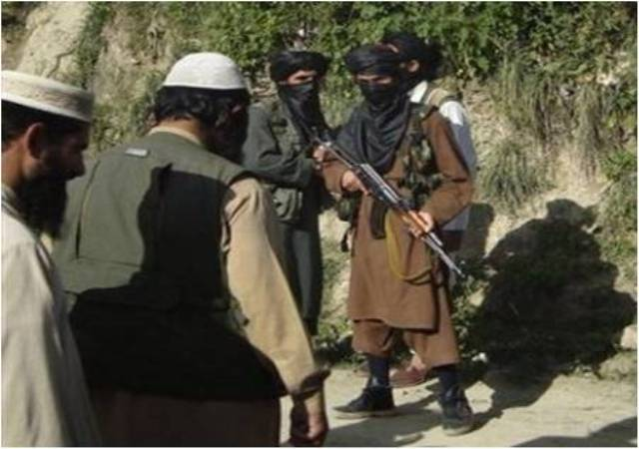
TERRORISM AND THE NATURE OF THREAT EXAMPLE of AFGHANISTAN
Before the Taliban and Daesh were cooperating to fight against the government, Daesh emerged again to fight against the Taliban government when the Taliban took over the country.
Al Qaeda is not dead in Afghanistan and it can re-emerge everywhere.
Al Qaeda, the Haqqani Network, or Daesh and of course, these are strategic threats in the country. In the North-Eastern provinces of Afghanistan, Daesh fighters were composed of ETIM of China, IMU of Uzbekistan, and Jundullah of Tajikistan.

Slide 8
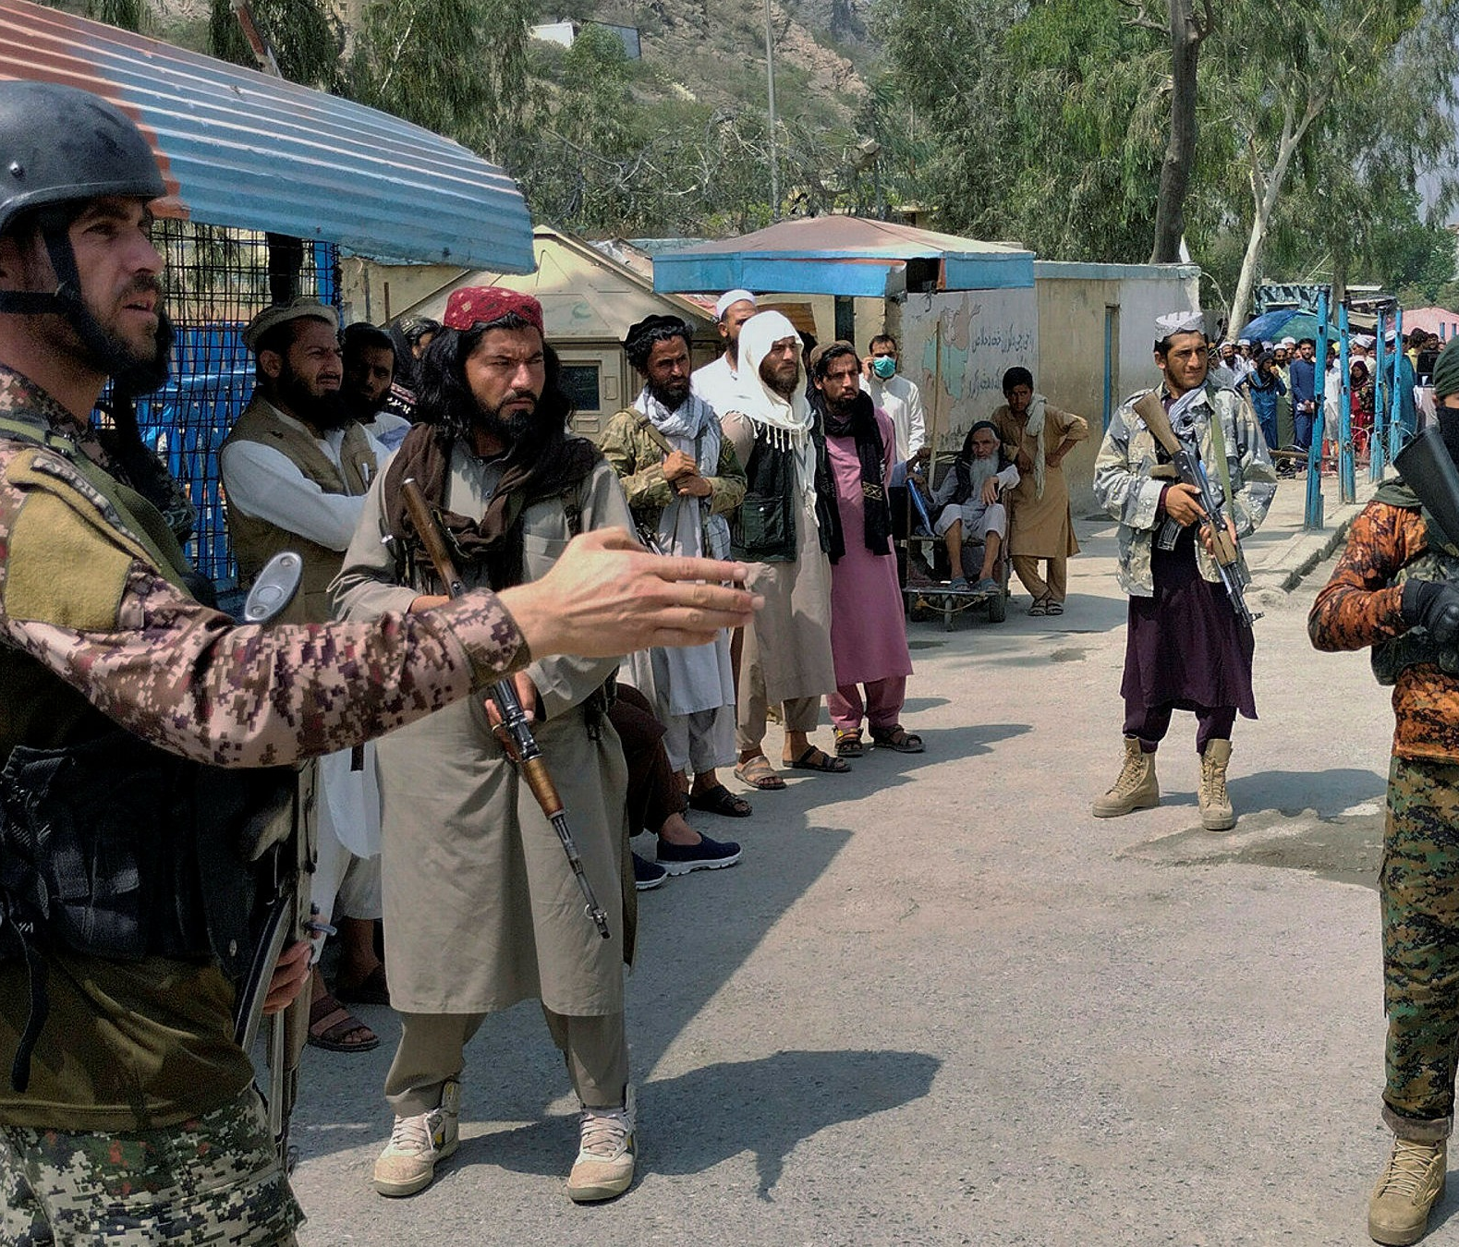
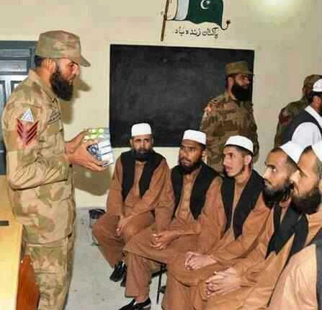
Pakistani Terrorist Groups and Networks
Recent TLBN development and Pakistan ISI.
Pakistan's ISI and its proxies war to Afghanistan.
Withdrawal of US forces
Pakistani terrorist groups seek to join merge the TLBN with the Haqqani network and AQ for joint activities.
Recently, LET, JEM, Tanzeem Al-Badr, and other Pakistani terrorist groups have established large new camps in Pakistan to train by name of ISIS-k.
Pakistani terrorist groups, including TTP, LET, LEI, JEM, JUA, TAB, LEJ

Slide 9
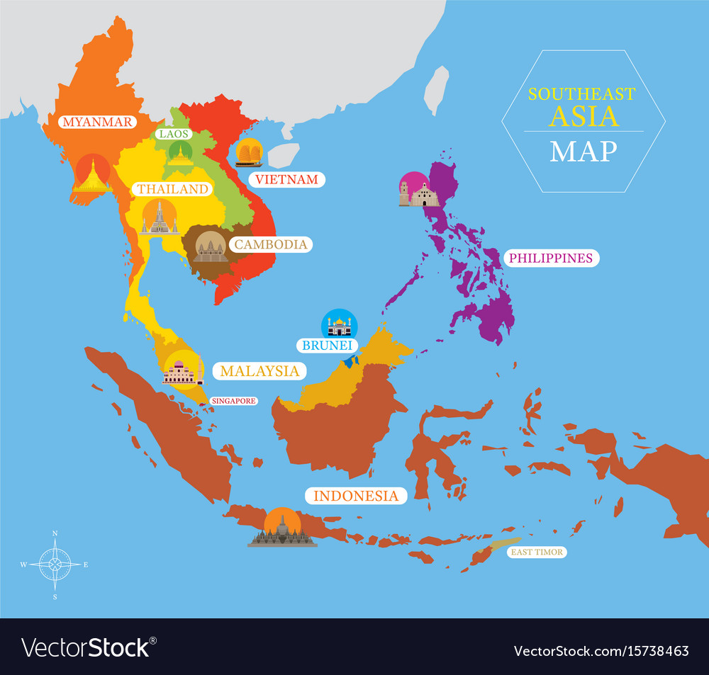
Southeast Asia
GENERAL INFORMATION:
Area: | 4.5 million km²
Population: | 661.5 million (2020) (UN)
Ethnical Groups: | Indigenous (Southeast Asians); Austronesian, Negrito, and Tai peoples; East Asians; South Asians
Southeast Asia Countries: | is composed of eleven countries of impressive diversity in religion, culture and history: 🇧🇳 Brunei, 🇲🇲 Burma (Myanmar), 🇰🇭 Cambodia, 🇹🇱Timor-Leste, 🇮🇩Indonesia, 🇱🇦Laos, 🇲🇾Malaysia, 🇵🇭the Philippines, 🇸🇬Singapore, 🇹🇭Thailand 🇻🇳Vietnam.
Religions: | Hinduism, Islam, Christianity, Buddhism, Sikhism, Jainism, Zoroastrianism, Irreligion (Wikipedia)

Slide 10
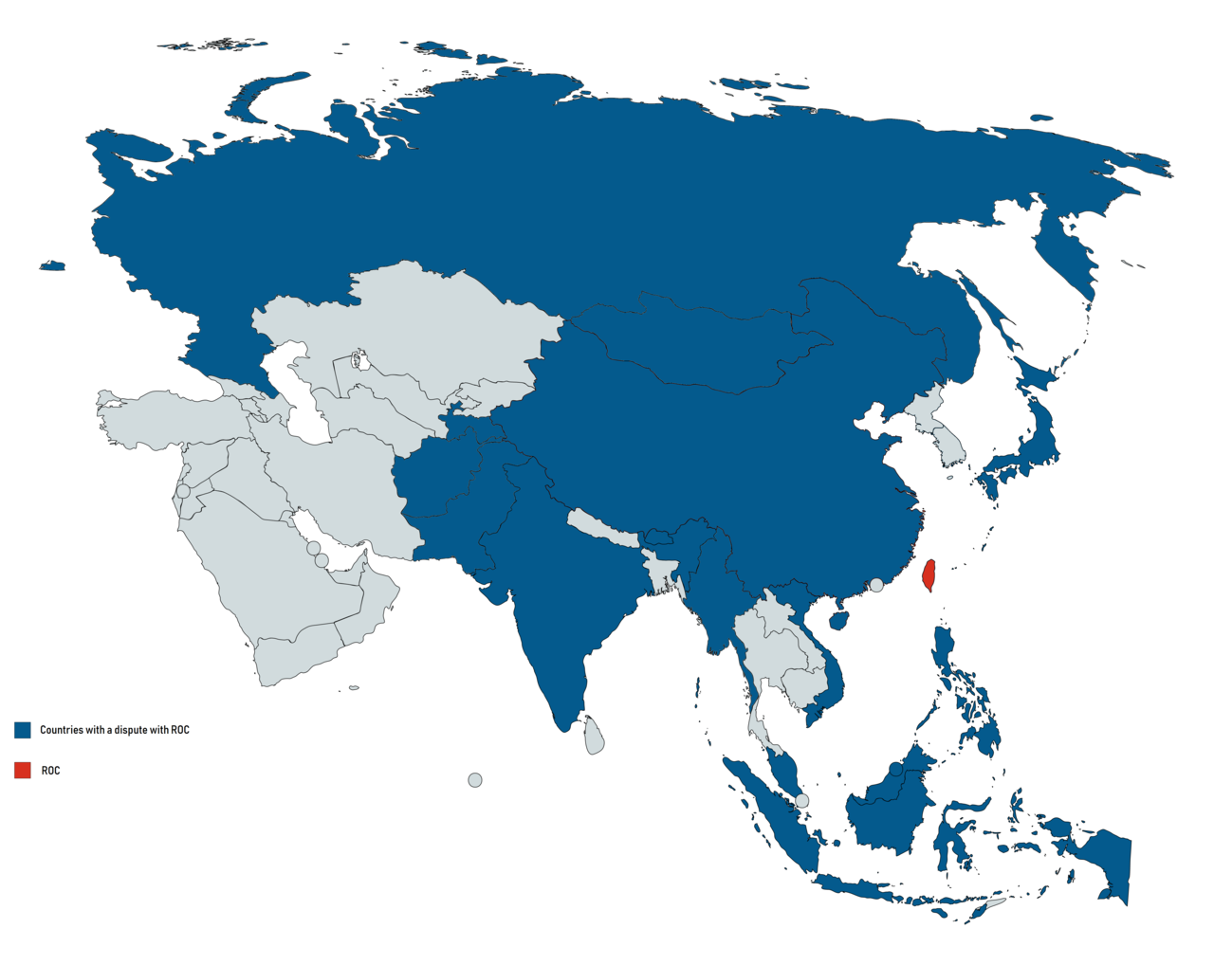
Southeast Asia Security
Southeast Asia has faced conventional security threats such as territorial disputes and arms races have subsided in the last two decades.
At the same time, the region is increasingly confronted with non-conventional security risks emanating from international terrorism and organized crime, separatism and piracy, irregular migration, environmental issues, energy shortages, economic crises and epidemics such as HIV/AIDs and SARS.

Slide 11
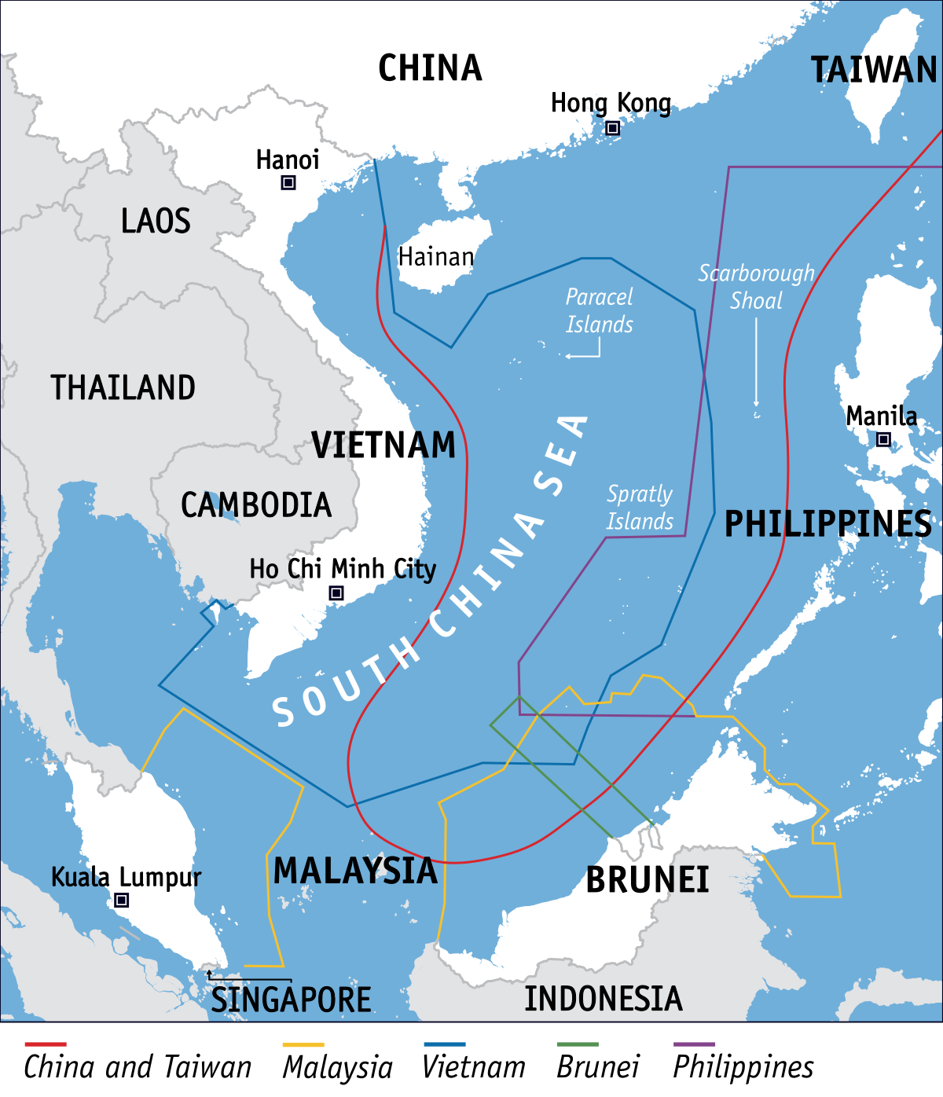
Southeast Asia Security (Continues)
The still most contested issue in Southeast Asia is the demarcation of maritime borders in the South China Sea, where at least six claimants – China, Taiwan, Vietnam, the Philippines, Malaysia and Brunei have occupied atolls and islets in the Spratly archipelago and erected military installations.
The South China Sea is believed to be rich in natural gas, oil and fish, although there are conflicting estimates about the size of the deposits.

Slide 12
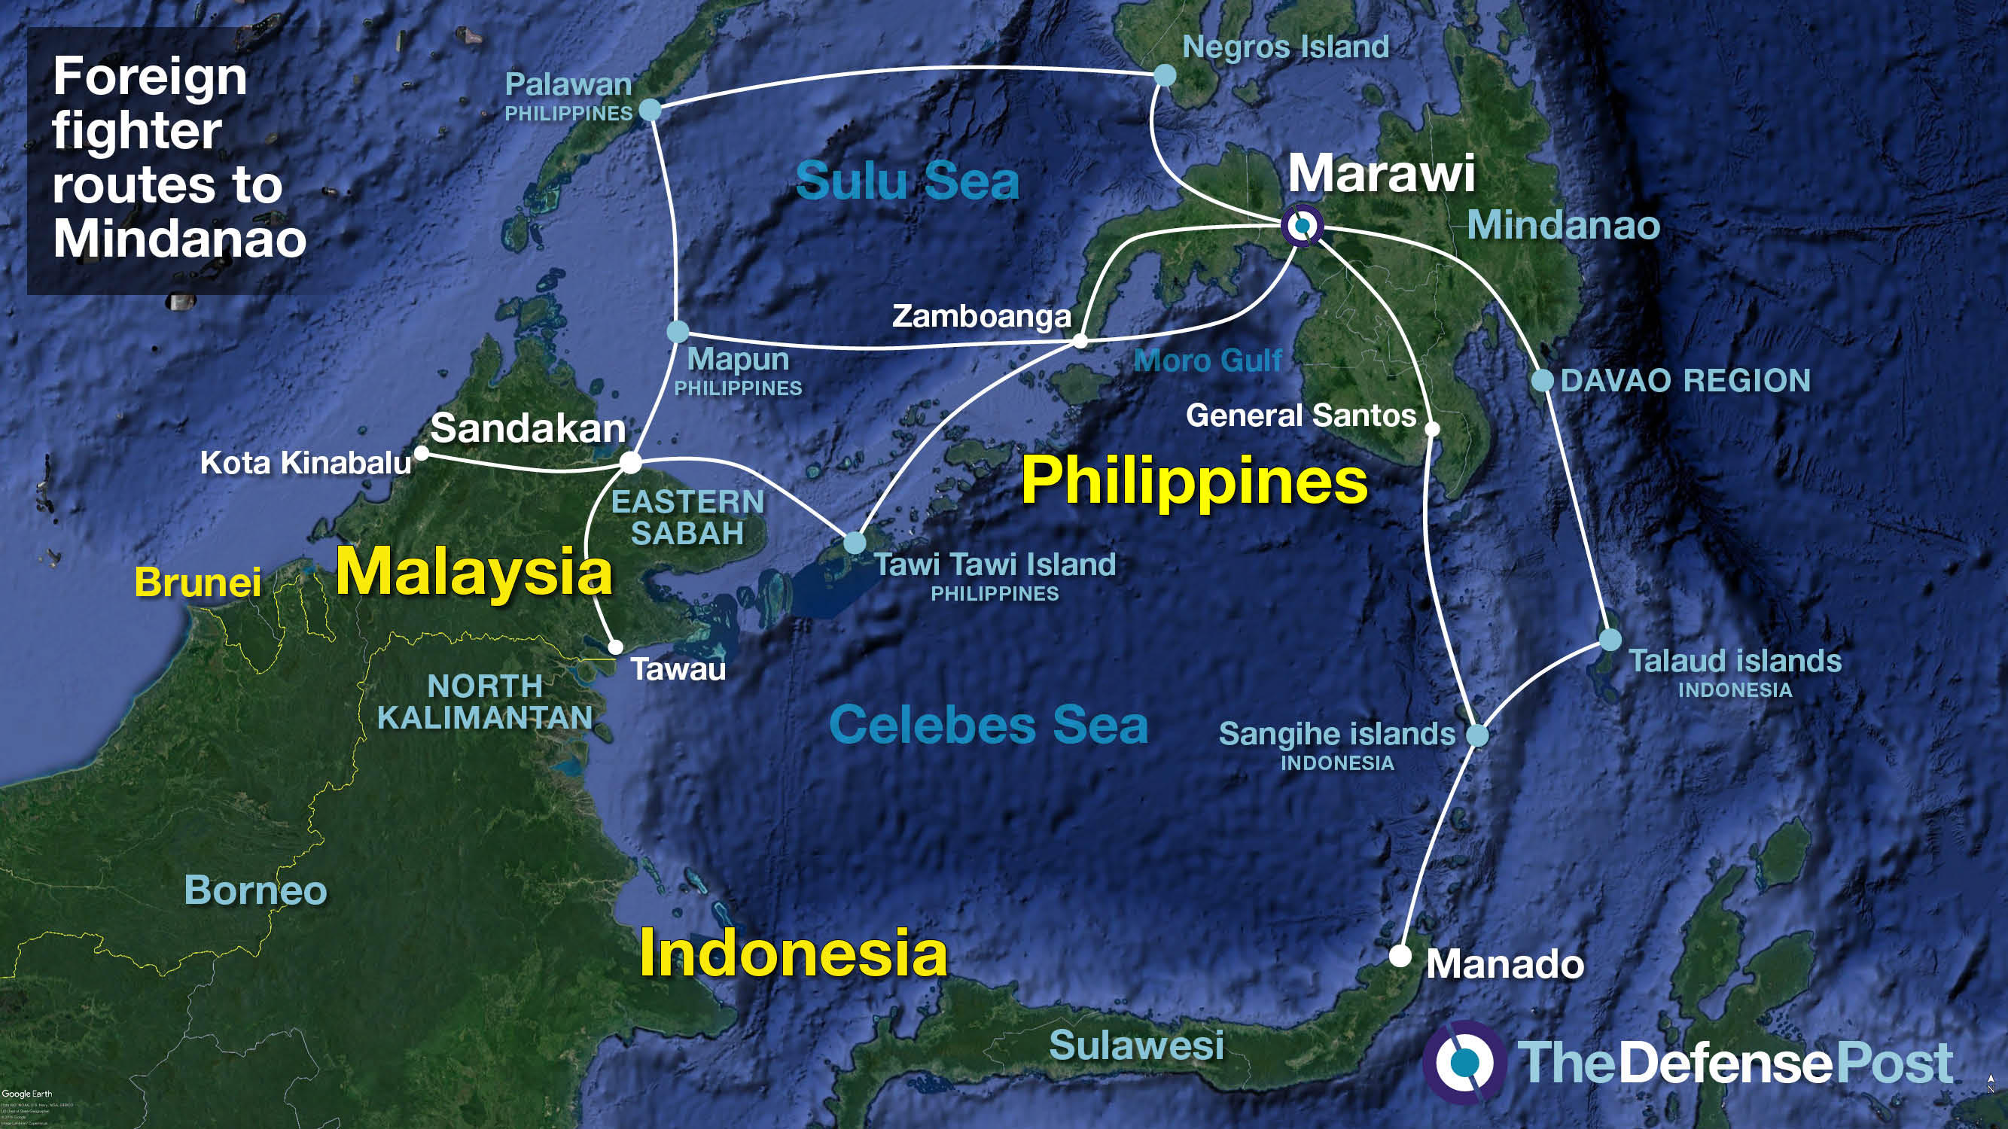
Southeast Asia Security (Continues)
ASEAN identified FTFs in Southeast Asia, FTFs resort to more illicit travel by exploiting the seas.
The archipelagic geography and high maritime traffic make border security a constant challenge. This challenge provides a conducive environment for the clandestine movement of people and goods. Illicit maritime activities are a longstanding problem in the region and might worsen over time.
In 2020, the Tri-Border Area comprising the Sulu/Celebes seas between Indonesia, Malaysia and the Philippines has been in the spotlight for terrorist activities.
In Nov Philippine special forces intercepted Abu Sayyaf Group terrorists during a sea battle.

Slide 13
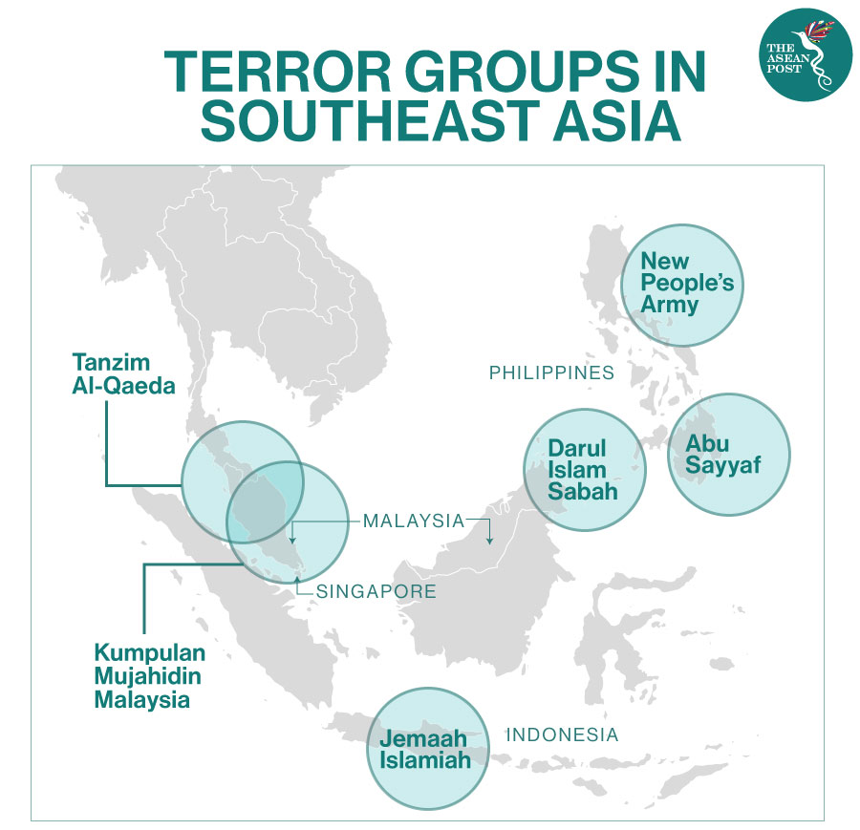
Southeast Asia Security (Continues)
The Straits of Malacca and Singapore have seen security incidents in the past. While no terrorist attacks had occurred there, there were instances of smuggling planned and actual terrorist travel.
In 2015, Singapore authorities stopped some Indonesian men who traveled from the Riau Islands to Singapore via ferry. These men were on a journey to Syria to join ISIS. Also, Singapore's National Maritime Sense-Making Group – through data analytics – detected a possible ISIS supporter on board a tanker.
In 2017, Indonesian authorities stopped an ISIS-linked terrorist cell in the Riau Islands. This cell had planned to launch a rocket attack on Singapore, possibly from a boat near the coastline.
The Straits of Malacca and Singapore have seen more piracy incidents – robbery and theft against ships.

Slide 14
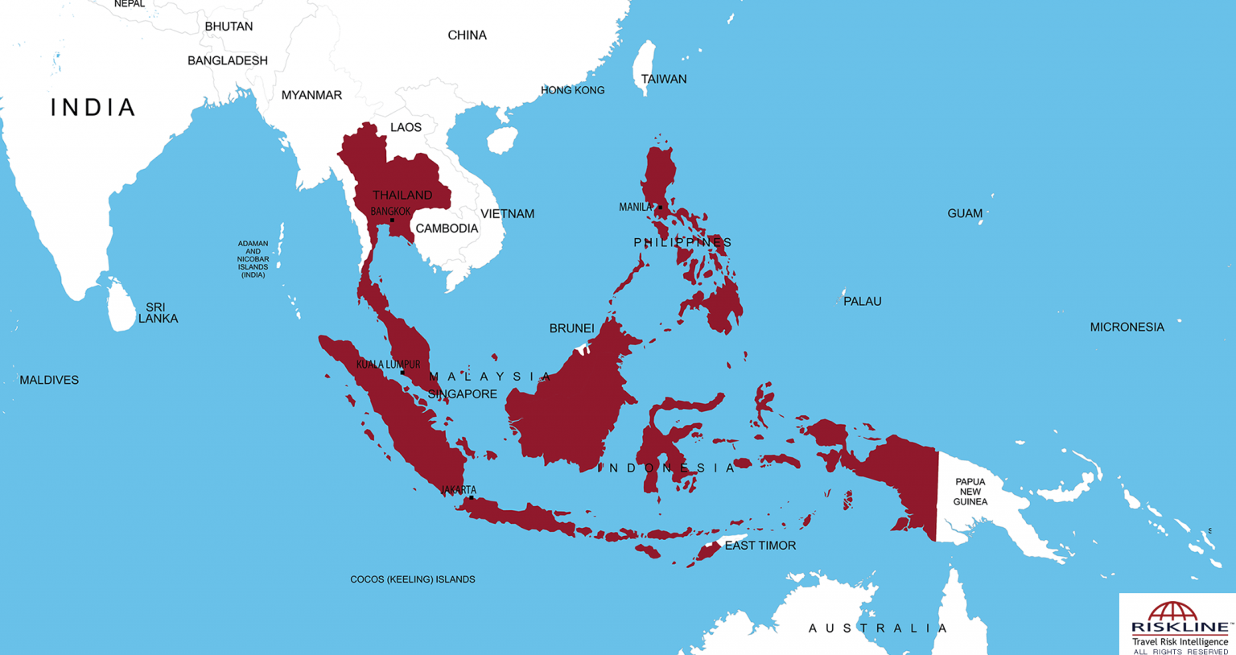
The growing terrorist threat in Southeast Asia
The threat from IS-inspired and IS-linked terrorism in Southeast Asia is expected to remain high in the medium- and long-term, as more IS fighters flee the Middle East and consolidate themselves with existing networks.
In addition, the interest of IS in expanding their presence in the region is certain to embolden local militants, leading to increasing levels of radicalization.

Slide 15
The growing terrorist threat in Southeast Asia
These developments will make it harder for domestic security agencies to monitor the activities and movements of radicals, given their limited capabilities and resources.
Thus, further terror attacks remain likely in the region as IS-linked groups continue to pose a significant security challenge.

Slide 16
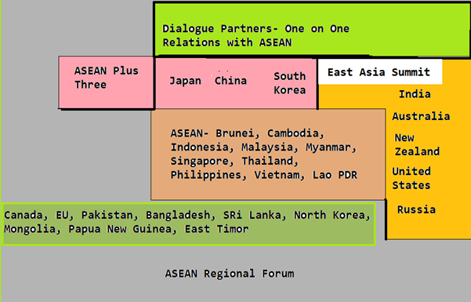
Security in the Southeast Asia
ASEAN as a regional institution is also faced with several non-traditional security threats in the forms of climate change, cross-border insurgency and international terrorism, illegal movement of people, trafficking

Slide 17
Thank you for the attention
Any Question

Slide 18
Resources
https://www.unodc.org/documents/e4j/18-04932_CT_Mod_01_ebook_FINALpdf.pdf
https://cdn.peaceopstraining.org/theses/jackson.pdf
https://www.britannica.com/topic/terrorism/Types-of-terrorism
https://www.un.org/counterterrorism/
https://en.wikipedia.org/wiki/Southeast_Asia
https://www.swp-berlin.org/publications/products/projekt_papiere/R_land_Southeast_Asian_Security_Challenges_ks.pdf
https://asean.org/
https://theaseanpost.com/article/combatting-terrorism-amid-pandemic
https://www.reuters.com/article/us-asean-singapore-defence-idUSKBN1FQ1NJ

