Slide 1
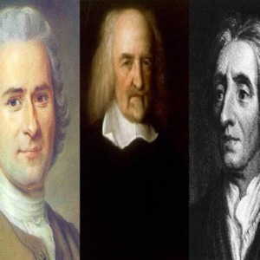
Social Contract Theory - Summary
Birth of Liberalism and Human Rights
State of Nature: humans are free & equal
Law of Nature. How to learn and implement it?
What is Human Being? What is Society?
What is Rule, Governance, Politics?
Natural Rights Doctrine
Transformation of the Rule/State
Transformation of Legitimacy of Power
Birth of Civil Society, Public Opinion

Slide 2
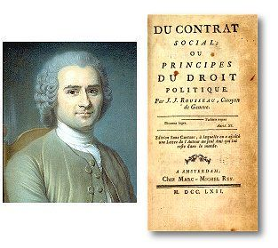

Slide 3
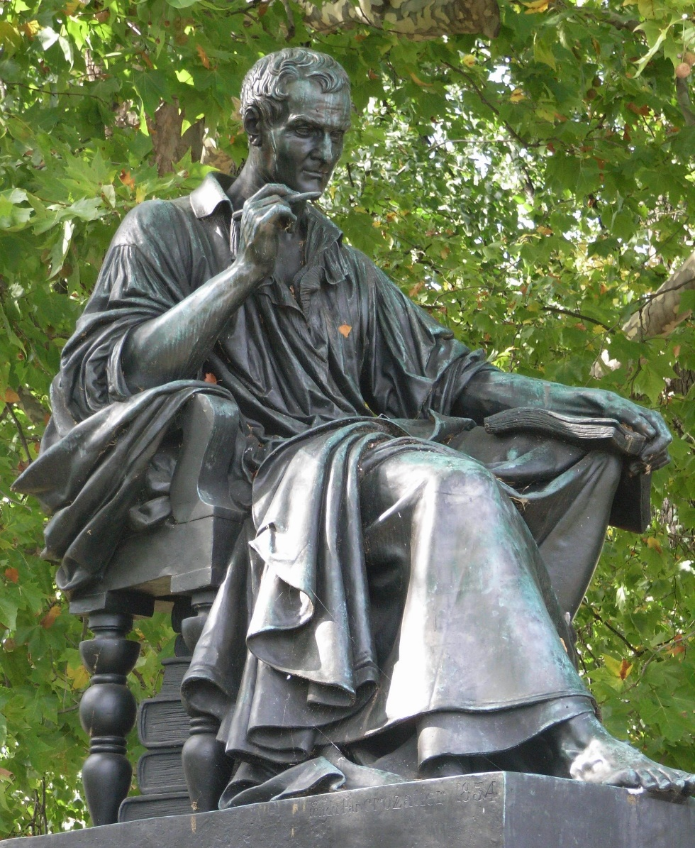
Rousseau Jean Jacques 1712 – 1778
Geneva, Maverick, on the run
Pantheon in Paris (1794)
State of nature as normative guide, critique of society, civilization as decadent
Fault of ownership x savage
Morality as natural, innate
Instinct/emotions as its source
Marxism, romantics, environmentalism …

Slide 4
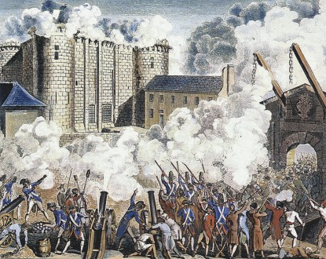
French revolution 1789
Declaration of Independence 1776
Declaration of the Rights of Man and of Citizens 1789 (Lafayette, Sieyés, Mirabeau)
Declaration of the Rights of Woman and of the Female Citizens (Olympe de Gouge)
Napoleon: Code Civil 1804
Habsburgs: ABGB 1811
Codex Maximilianeus Bavaricus Civilis, 1756
Universal Delaration of Human Rights 1948

Slide 5
„ Until the end of the second world war and revolution in the mass media, these models of democracy clearly distinguished Anglo-American tradition from continental Europe“ (Giovanny Sartori).
Rationalistic Democracy Empirical Democracy
Enlightenment - Normative Empirical - Pragmatic
Ideas Facts
Deduction Induction
Idealism, Utopian Realism
What is Democracy? Making Democracy Work?
Principals, Values Procedures
Intellectuals/Writers Politicians
Revolution – a New Beginning Evolution – Hereditary Right
Break with the Past Continuity
Legal State (Rechtstaat) Rule of Law
Code Law Case Law
Private & Public Law Common Law & Equity
Volk/People - Singular We the People - Plural
Representation Leadership
Parliamentary System Cabinet/Presidential System
Proportional System Majority System
Neo-Corporativism/Centralisms Pluralism/Lobbing Regulation
Intellectually Appealing Unappealing
Less effective More effective

