Slide 1
AFGHANISTAN
General Information
History
Long War
Terrorism
Current Situation
Presentation by:
Shahzad Aryobee

Slide 2
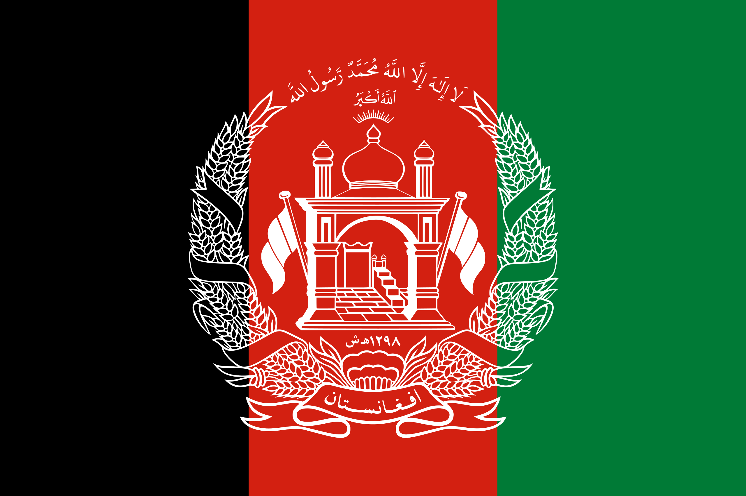
Afghanistan
GENERAL INFORMATION:
Area: | 652,237 sq. km
Population: | 35.53 (according to 2017 WB)
Official language: | Pashto/Dari
Political system: | Islamic republic/Islamic Emirate?
Administrative divisions: | 34 Province
Religions: | Suni Muslim (84%), Shia Muslim (15%), others (1%)

Slide 3
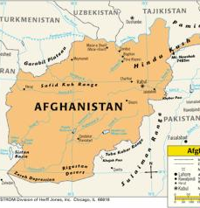
LOCATION, POPULATION AND ETHNIC GROUPS
Afghanistan is a land-locked country which is situated in heart of south-central Asia. The capital of Afghanistan is its largest city, Kabul. Afghanistan is bounded to the east and south by Pakistan, to the west by Iran, and to the north by the Central Asian states of Turkmenistan, Uzbekistan, and Tajikistan. It also has a short border with Xinjiang, China, at the end of the long Wakhan Corridor.
Current population estimates are therefore rough approximations, which show that Pashtuns comprise above 50 percent, Tajiks are about 20 percent, while Hazara are about 8 percent, Uzbek are about 7 percent, the rest Turkman, Aimak, and other ethnic groups each account for small portions of the population.

Slide 4
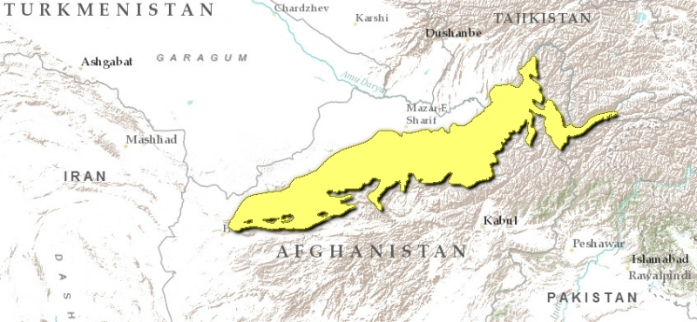
PLACES, REGIONS AND PHYSICAL SYSTEM
Afghanistan lies at the crossroads of three major regions.
South Asia - Pakistan and India lie to the east
Southwest Asia/Middle East - Iran, Iraq, and the Persian gulf lie to the west.
Central Asia - five republics of the former Soviet Union lie to the north: Turkmenistan, Uzbekistan, Tajikistan, Kyrgyzstan, and Kazakhstan.
Afghanistan is mainly mountainous with steep isolated valleys. The Hindu Kush Mountains extend northeast to southeast through Afghanistan. The Paropamisus lie in the Northwest.
Several peaks rise to an elevation of over 20,000 feet.

Slide 5
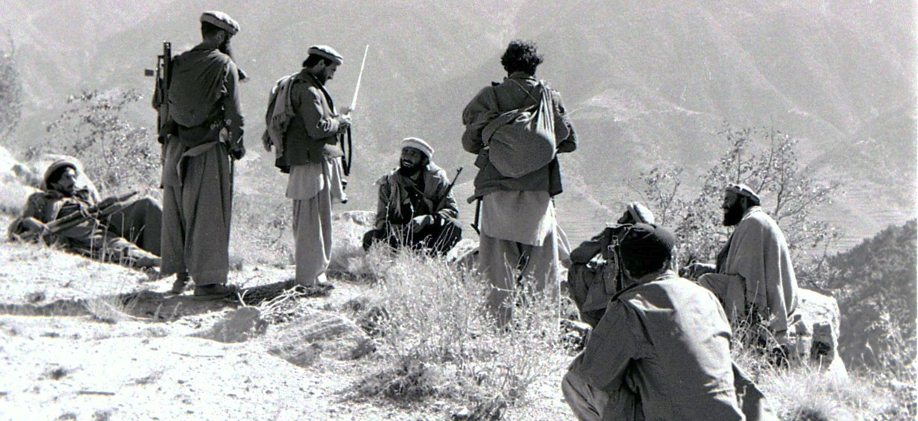
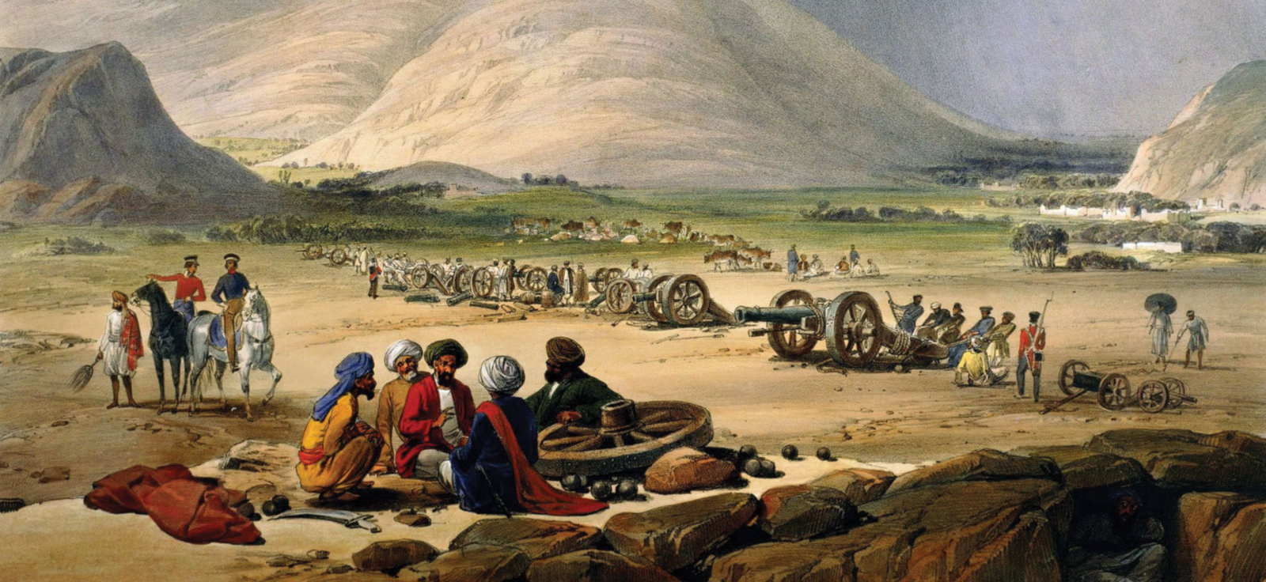
HISTORY
Afghanistan has had a long history of internal and external conflicts, including two wars:
The First Anglo-Afghan War also known by the British as the Disaster in Afghanistan was fought between the British Empire and the Emirate of Afghanistan from 1839 to 1842.
Since the fall of the royal system in 1973, Afghanistan has faced repeatedly failure or at least crisis of political leadership.
Second an invasion by the Soviet Union in 1979. Since the Soviets left in 1989, Afghanistan has experienced many internal conflicts over control of the country.

Slide 6
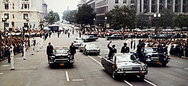
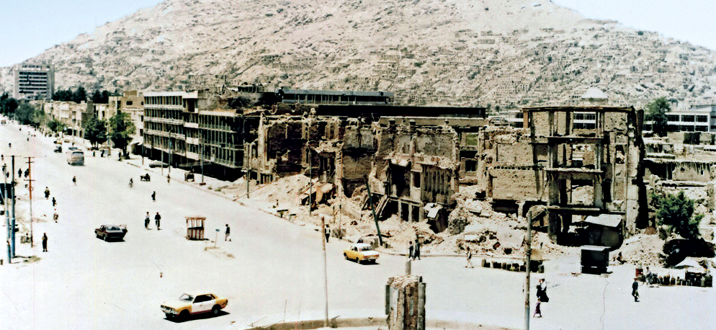
HISTORY
Modern Afghanistan became a pawn in struggles over political ideology and commercial influence. In the last quarter of the 20th century, Afghanistan suffered the ruinous effects of civil war greatly exacerbated by a military invasion and occupation by the Soviet Union. In subsequent armed struggles, a surviving Afghan communist regime held out against Islamic insurgents and, following a brief rule by mujahideen groups, an austere movement—the Taliban.
By 1998, first time the Taliban were in control of almost 90% of Afghanistan.
The Taliban regime collapsed in December 2001. Soon thereafter, anti-Taliban forces agreed to a period of transitional leadership and an administration that would lead to a new constitution and the establishment of a democratically elected government.

Slide 7
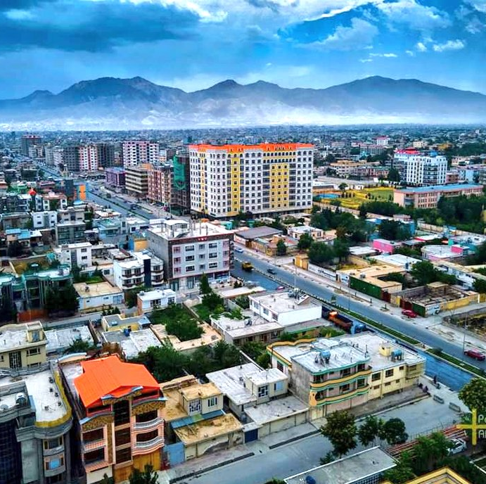
HISTORY
Even since 2002 after the end of Afghanistan’s isolation and excessive foreign grants, funding and investment in building institutions, strange things that happened in Afghanistan.
The most significant change; Taliban's takeover of Afghanistan, the national flag changed from black, red and green to white.
These significant changes were hard to imagine until three months ago.

Slide 8
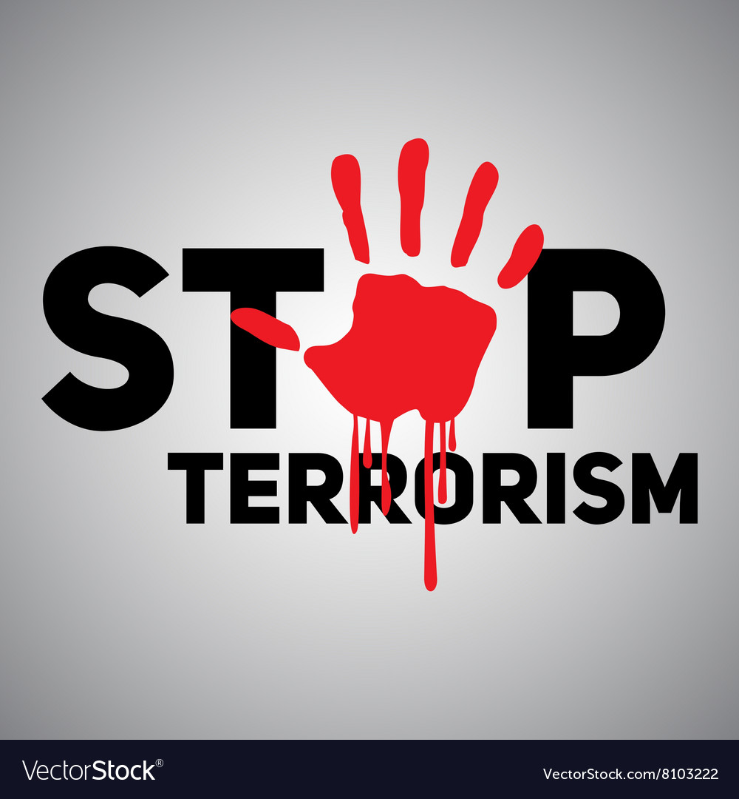
TERRORISM
The most common roots of terrorism in the region are in Pakistan. Further some more terrorism causes are including civilizations or culture clashes, globalization, religion, conflicts such as Israeli with Palestinian, Kashmir issue between Pakistan and India, the conflict in Iraq and in Afghanistan started from the invasion and occupation of Russian. More personal or individual-based reasons for terrorism are frustration, deprivation, negative identity, narcissistic rage, and/or moral disengagement.
There are Five Types of Terrorism Identified in the Glob.
State-Sponsored terrorism, which consists of terrorist acts on a state or government by a state or government.
Dissent terrorism, which are terrorist groups which have rebelled against their government.
Terrorists and the Left and Right, which are groups rooted in political ideology.
Religious terrorism, are terrorist groups which are extremely religiously motivated and
Criminal Terrorism, which are terrorists’ acts used to aid in crime and criminal profit.

Slide 9
TERRORISM AND THE NATURE OF THREAT IN AFGHANISTAN
Afghanistan has entered again to a critical time in its history. To study the ongoing conflict, the last over twenty years of war and strategically analysis the security threats, security situation and nature of threat in Afghanistan, there are three umbrella terrorist organizations operating and active in Afghanistan:
The Taliban, 2. Al-Qaeda and 3. Daesh (ISIS):
Taliban are the main umbrella organization in Afghanistan that provides an ecosystem for Daesh and Al Qaeda. Part of the Taliban a threatening group is the Haqqani Network, which receive all kind of support and undertaking operation in close cooperation of ISI Pakistan. Taliban cooperate…

Slide 10
TERRORISM AND THE NATURE OF THREAT IN AFGHANISTAN
with Daesh when they have joint objectives in operation in some part of the country but fight each other as well where they have competing objectives. Daesh has strong international network and have experts that brings technology and training from outside, uses the breeding ground that the Taliban provide, and pursue their objectives. Furthermore, numerous other small groups are active in various part of the country, which most of them are connected the terror groups are operating and active inside Pakistan.
To see and analysis these terror groups from every aspect the relationship between the Taliban and Al-Qaeda are stronger than the relationship between Daesh and the Taliban. Al-Qaeda promote the objective, recruit and brings international terrorist expertise for the Taliban, and the Taliban provide them space for planning attacks abroad. It needs to be noted that Al Qaeda is not dead in Afghanistan and it can re-emerge every-where. Al Qaeda, the Haqqani Network, or Daesh and of course these are strategic threats in the country. In North Eastern provinces of Afghanistan there are Daesh fighters who were composed of ETIM of China, IMU of Uzbekistan, and Jundullah of Tajikistan.

Slide 11
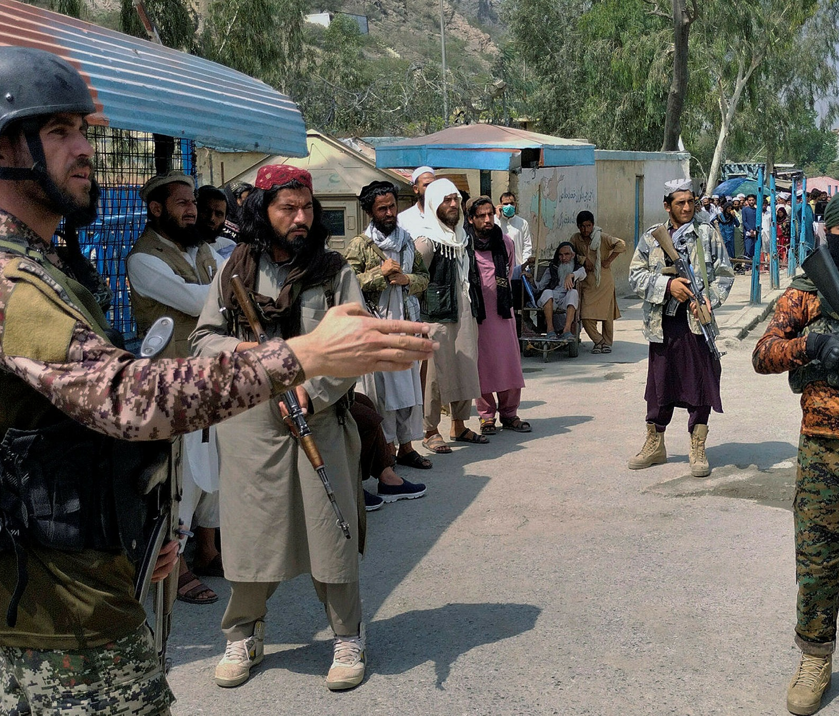
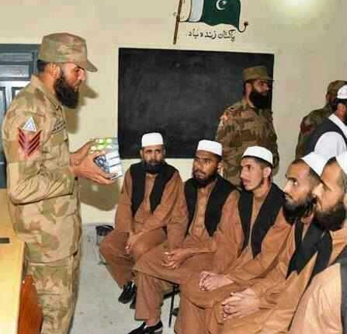
Pakistani Terrorist Groups and Networks
Recent TLBN development and control over Afghanistan have been fully supported by Pakistan ISI.
Until now, Pakistan's ISI was dispatching its proxies to Afghanistan in an unorganized manner.
Withdrawal of US forces from Afg provided TLBN and their Pakistan supporters time to strengthen their network.
Pakistani terrorist groups seek to join merge the TLBN with the Haqqani network and AQ for joint activities.
Recently, LET, JEM, Tanzeem Al-Badr, and other Pakistani terrorist groups have established large new camps in Pakistan to train by name of ISIS-k.
Pakistani terrorist groups, including TTP, LET, LEI, JEM, JUA, TAB, LEJ

Slide 12
Last twenty years in Afghanistan spent and loses
Troops
Civilians
The U.S. spent $145 billion (security forces, civilian government institutions, economy, and civil society).
The Department of Defense has also spent $837 billion on warfighting,
2,443 American troops killed
1,144 allied troops killed
20,666 U.S. troops injured.
At least 66,000 Afghan troops killed.
More than 48,000 Afghan civilians killed
at least 75,000 have been injured since 2001
(likely significant underestimations) Data from SIGAR report
Other countries were also part of the foreign troop presence in the country, including other members of the NATO alliance.
But the US had by far the biggest single contingent.
The UK and Germany - who had the largest numbers of troops in Afghanistan after the US - spent an estimated $30bn and $19bn respectively over the course of the war.

Slide 13
Who to blame for the swift collapse of the democratically elected Afghan Government after 20 years of war, spend and loses?
United States President Joe Biden,
Former President Donald Trump,
Ambassador Zalmai Khalilzad,
Pakistan's military,
The exiled Afghan Government,
The Taliban,
Or the other members of the international community, who now appear to have walked away.
Afghans are now experiencing one of the worst humanitarian and economical crises in the world.
Who is responsible for the current humanitarian and economic crisis in the country?
It is clear that Pakistan fueled the war in Afghanistan and played a double game and had a duel policy with the Afghanistan and IC.
Pakistan’s intervention severely ruined the country's government system, the Afghan National Army, and achievements of the last twenty years.
At the same time, the so-called Doha agreement between the United States and the Taliban paved the way for the Taliban to gain false credibility and legitimacy and pernicious effect on the Afghan Government and military.
Finally, immediate and irresponsible withdrawal announcements caused the catastrophe, which impacted millions of people to suffer and undergo sacrifices.

Slide 14
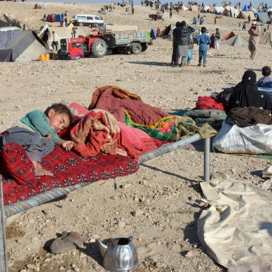
Current Situation
It has been more than a month and a half since the Taliban took over power in Afghanistan. The situation in Afghanistan become extremely worrying and is in highly critical.
Unemployment has risen,
Hunger has become very frustrating.
Various statistics show that more than 90% of people struggle with hunger.
The poverty rate is spiraling, the basic public services are almost close to collapse and at the same time, Afghanistan faces a severe drought –
The second to hit the country in four years. Many people have already run out of food items while the winter is approaching.

Slide 15
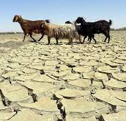
Current Situation
As per the UN-OCHA reports, recurrent natural disasters, chronic poverty, drought and the COVID-19 pandemic have left more than 18 million people in Afghanistan in need of humanitarian assistance. The recent escalation in conflict and the resulting upheaval have exacerbated needs and further complicated an extremely challenging operational context.

Slide 16
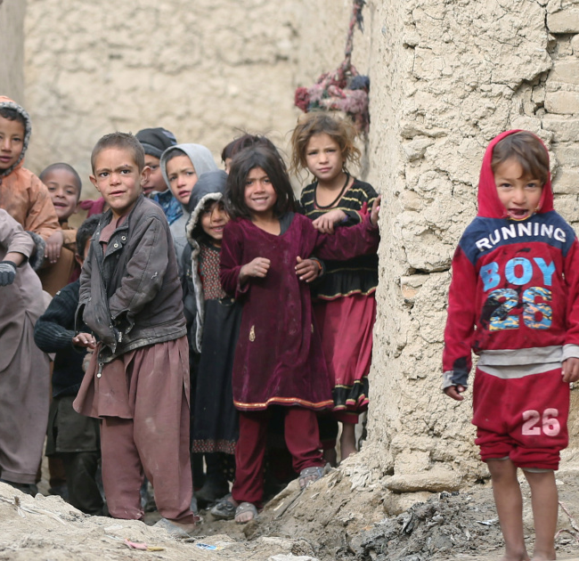
Current Situation
The UNICEF reported that the humanitarian situation in Afghanistan has deteriorated in recent months due to the conflict with the political power shift, COVID-19, and drought. Even at the onset of 2021, nearly 10 million children need humanitarian assistance.

Slide 17
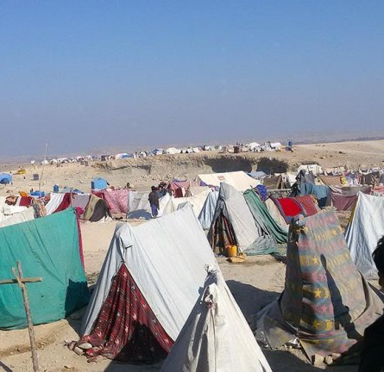
Current Situation
Due to an escalation of conflict across the country, many people were displaced in Kabul and other large cities, seeking safety from the conflict and other threats. In addition, UNHCR published a report that the newest wave of conflict has forced more than half a million people from their homes so far in 2021. The crisis is taking a heavy toll on women and children, who make up 80% of Afghanistan's internally displaced people. Alongside homelessness and the threat of violence, displaced Afghans are facing drought, food scarcity, COVID-19 and a health system at breaking point.

Slide 18
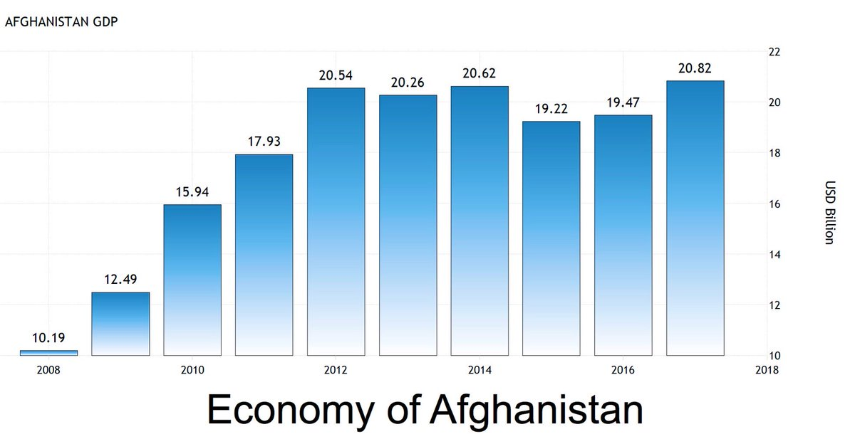
Current Situation
ICRC officials warned of a collapse of the health system in Afghanistan and more than 2,000 health facilities have been closed. Afghanistan is also in dire need of medicines.
A Norwegian aid agency reported that Afghanistan's economy is on the verge of collapse.
In addition, the European Union reported that Afghanistan's economic and social systems are on the brink of collapse and warns that a humanitarian catastrophe could occur if economic problems are not appropriately addressed.

Slide 19
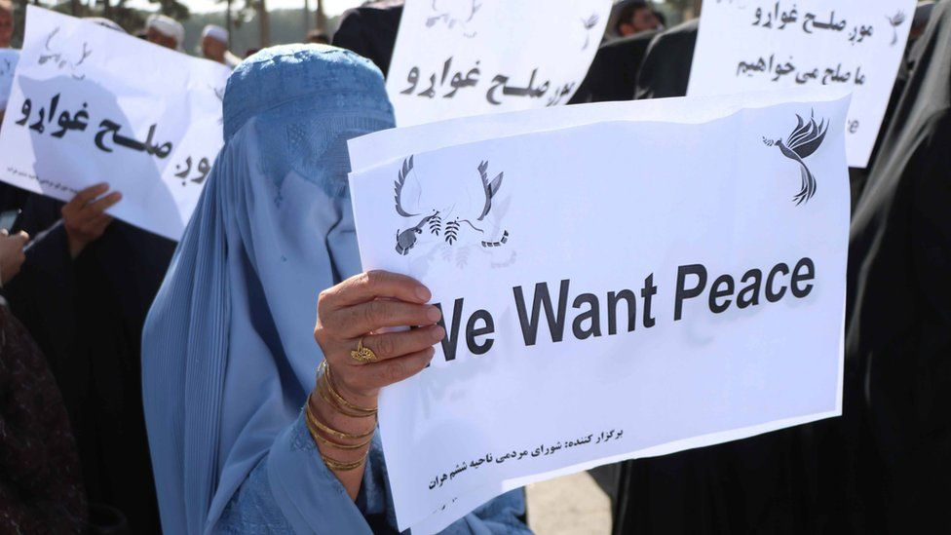
Peace is the main demand of Afghanistan's people, which the people of Afghanistan suffering for several decades.
• Failed….. because has no clear nation-building strategy in Afghanistan, but the nation-building process has suffered dramatically.
• Reasons…. Foreign interference, ideological, cultural and intelligence aggression was seen as a major obstacle to the unity of the Afghan nation.
Result: In view of this fact, failed to build the fundamental of nation-building in Afghanistan..

Slide 20
Thank you for the attention
Any Question

