Slide 1
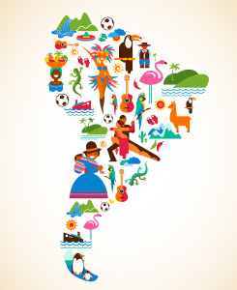
Media in Latin America
Leonor Ramos
30/11/2021

Slide 2
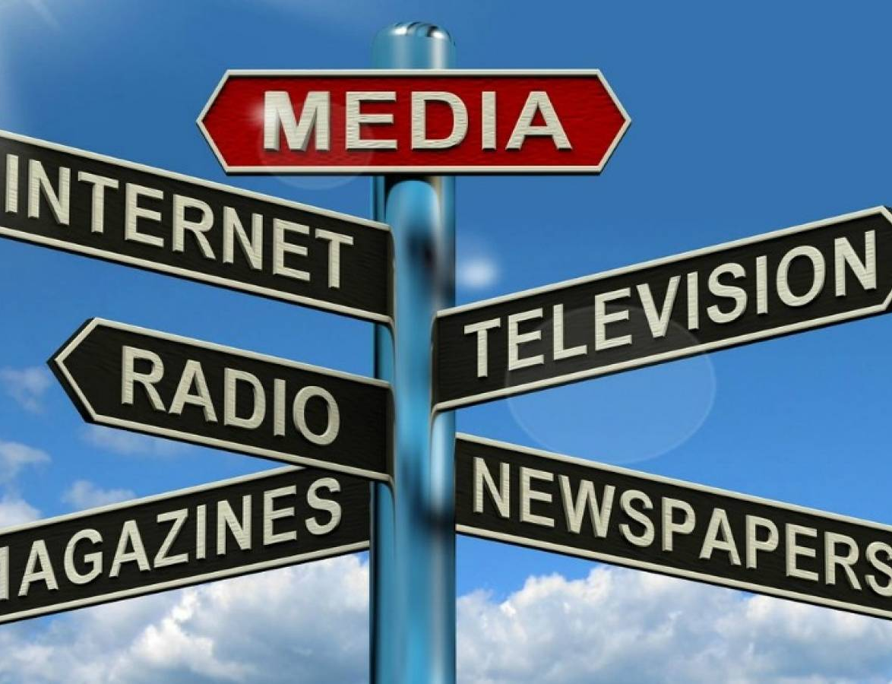
Introduction
Mass media influences how facts are viewed and debated in a society, contributing to crafting its public opinion. Independence and pluralism of media, freedom of opinions and views, including criticism of people in power, are the safeguard of a healthy democratic system.

Slide 3
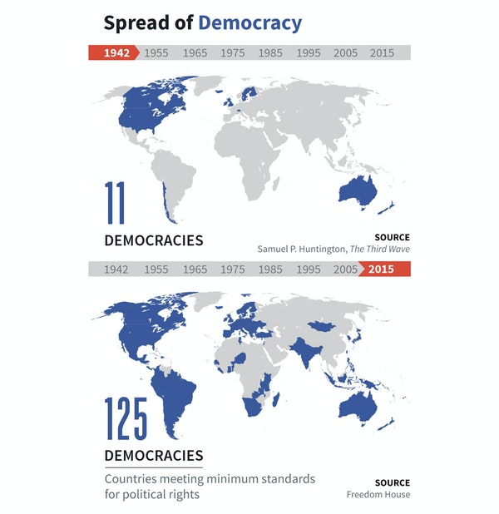
A background on latin America's transitional process
Latin America represents the strongest evidence for the argument that the world has been experiencing a steady progress towards democratic government, accompanied by market economies and supported by free media. Since the 1970s, when the Portuguese and the Spanish left the continent, there has been occurring a wave of democratization – the so-called third wave of democratization – seen on almost every country of the continent.

Slide 4
Mass media in Latin America's recent past
Having been under the power of the colonizing countries for so long, most of these countries had already a history of intermittent military interventions and coups, which together with poverty, lack of respect of human rights, discrimination and an arbitrary exercise of power made their transition into democracy a complex process.
With such a background of military regimes until the 1980s on this area, media was controlled by the government:
CENSORSHIP + NO PRIVATIZATION OF TV CHANNELS + POPULAR RESISTANCE HELPED BY ALTERNATIVE MEDIA (PAPERS, VIDEOS, RADIO STATIONS)

Slide 5
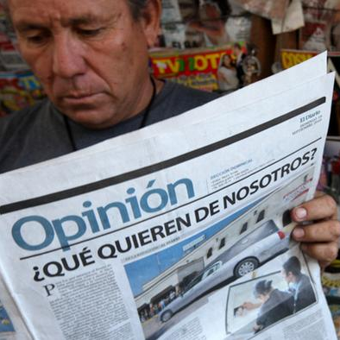
WHO OWNS THE MEDIA?
The ownership of media in Latin America is an issue that has been discussed for a long time. This is a very important question because the population needs to be able to know and understand whose interests are behind the news they watch, read and listen to, so it needs to be possible to evaluate the information’s reliability. And how will people do this if they don’t know who provides the information? Or how can journalists do a proper job if they don’t know who they are working for?

Slide 6
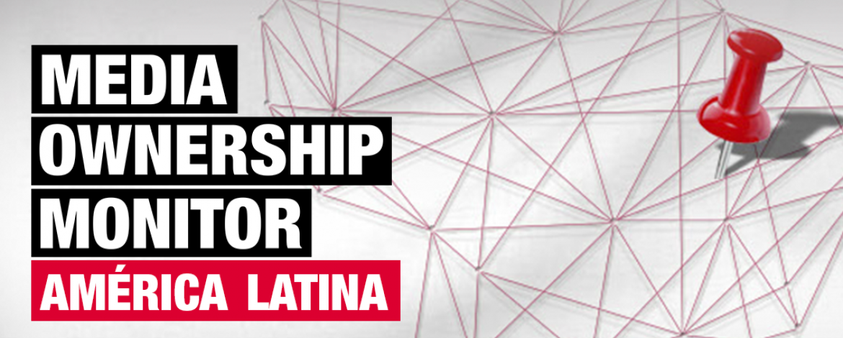
The media ownership monitor (MOM)
The Media Ownership Monitor (MOM) is a global initiative and a mapping tool that provides to the public accessible and updated research on this ownership issue. It provides the opportunity of enforcing democratic values and a good governance, since decisions are likely to be of higher quality and a better reflection of the needs and wishes of the people if they have access to truthful information, where views and opinions are freely shared.

Slide 7
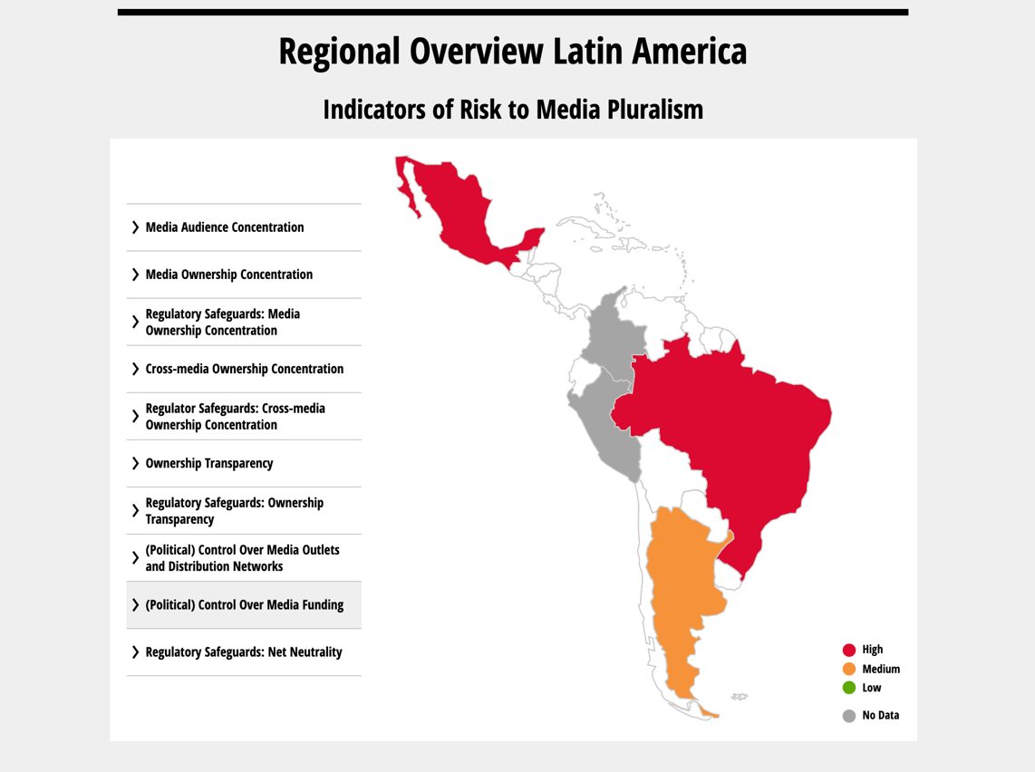
The media ownership monitor - overview
According to several indicators of risk of media pluralism, Argentina, Brazil, Colombia, Mexico and Peru were submitted to the Media Ownership Monitor (between 2015 and 2019) and these were the results on a few indicators, like political control over media funding.

Slide 8
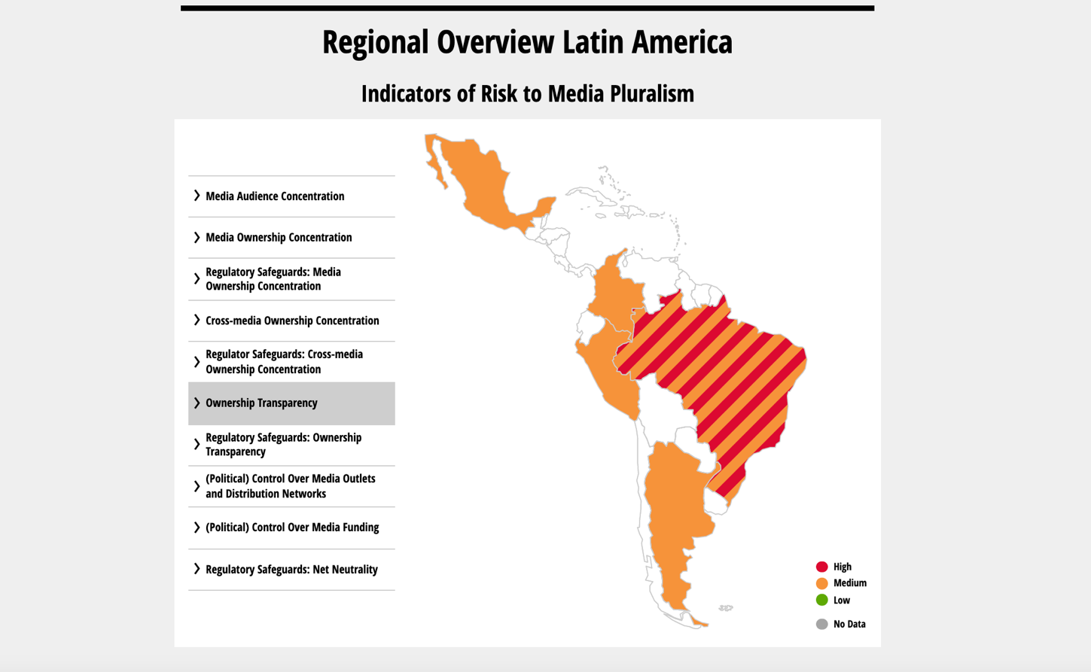
The media ownership monitor – overview
Regarding ownership transparency, in most countries there’s a medium risk to media pluralism. This means that it is not completely clear for the population in general who owns and controls media outlets and, consequently, the information that come from these media might be manipulated according to what the governments or elite groups want and have in mind.

Slide 9
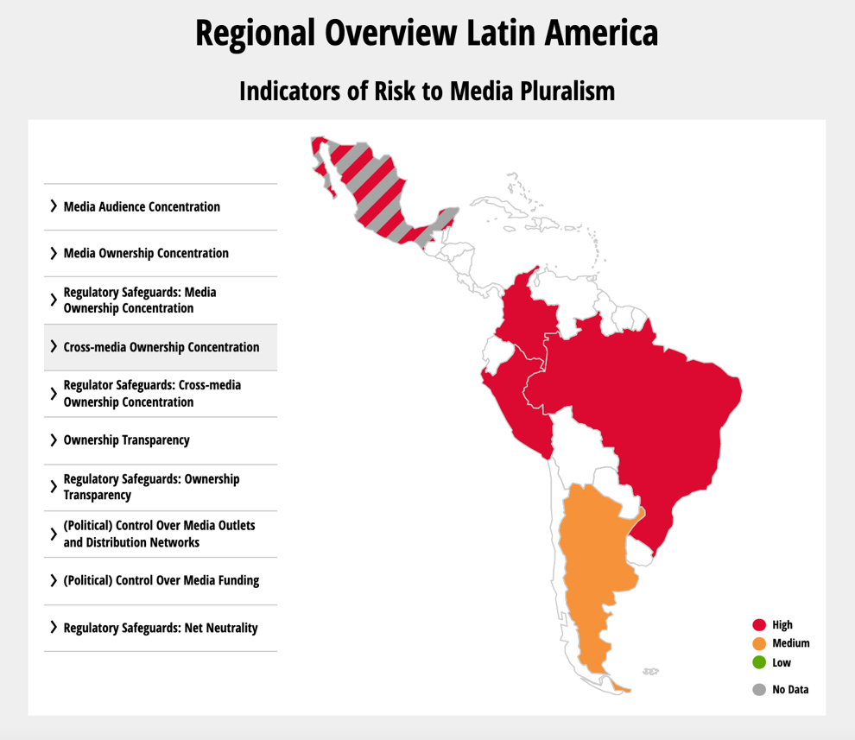
The media ownership monitor - overview
Like in the previous categories, concerning ownership concentration, we can also conclude that this too constitutes a risk for media pluralism. This means that most media are under the control of the corporate sector and business families who are linked to economic and political elites and use their ability to influence public opinion.
Following that, concentration of ownership can limit a journalist’s ability to hold those on power accountable and prevent them from showing the real interests, power and challenges that are behind media to the people.

Slide 10
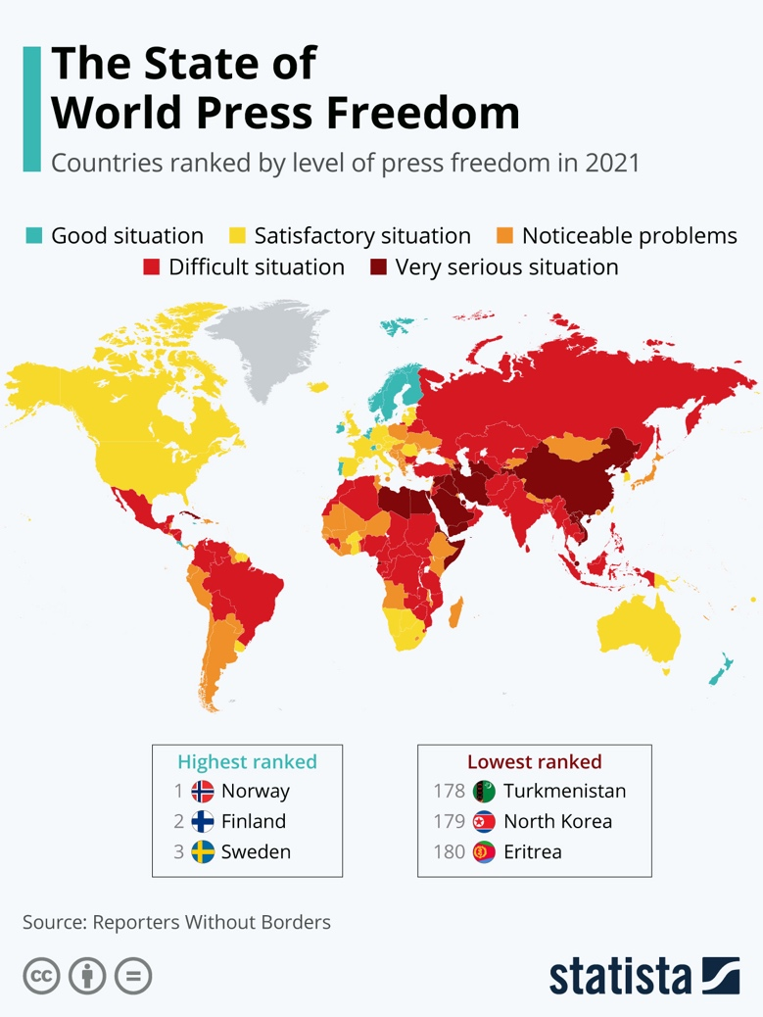
Freedom of speech, media and information
Freedom of speech, media and information are all necessary so that the various forms of media can operate freely in society without government control, restriction or censorship. A free press is fundamental to a democratic society. The press provides the platform for a multiplicity of voices to be heard, which means there’s a high need of preserving these rights and freedoms, so society can keep functioning as a free space where everyone’s opinion has a place.

Slide 11
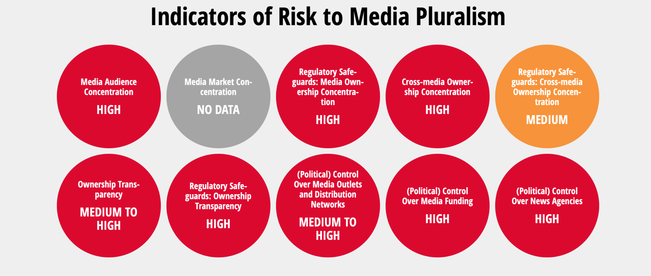
A closer look at... Brazil
Like other countries in the region more than 50 years ago, Brazil was marked by inequality, although there was some economic development. Consequently, media reflected this reality.
Throughout the last decades, Brazil has gone through a genuine process of democratization, but one where most elements of the elite could keep their wealth and power; there was political change, but society kept the same divisions and distinctions.

Slide 12
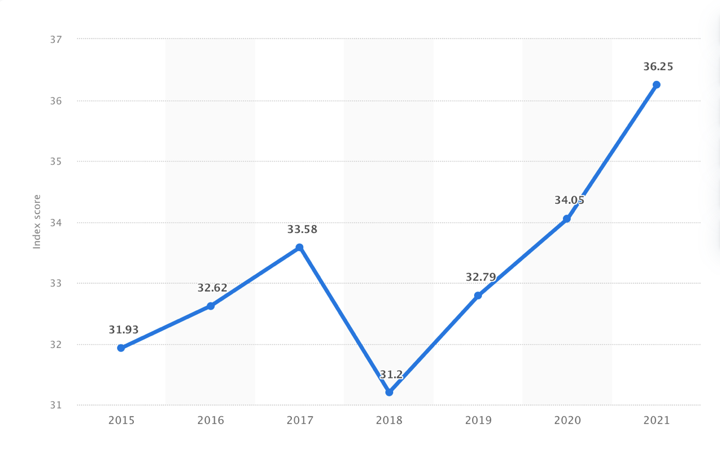
Freedom of speech in brazil
Freedom of speech has been getting increasingly worse and it is currently classified as a “difficult situation”, especially since 2018, when President Bolsonaro was elected, like this graph shows.

Slide 13
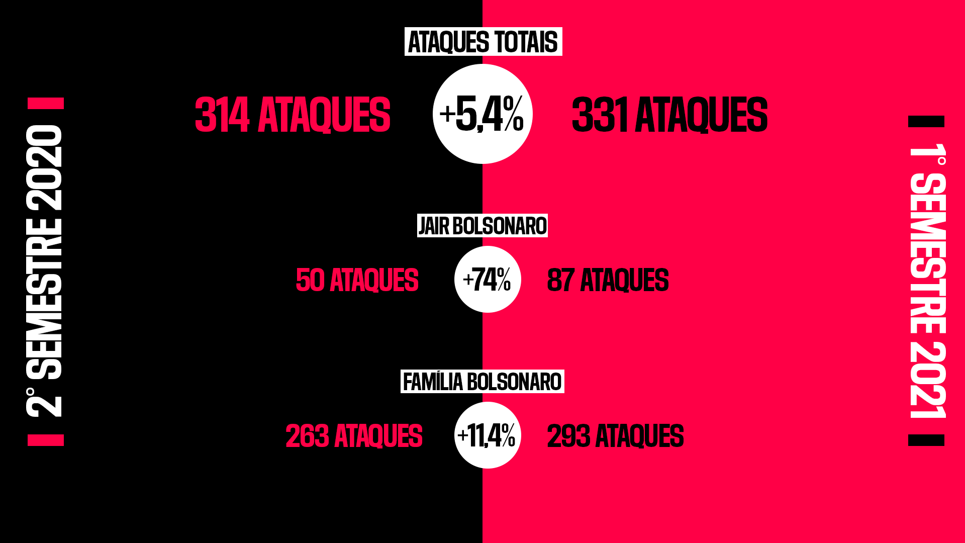
The media and the brazilian government
Since Jair Bolsonaro was elected President in 2018, the relationship between the government and the media has been really troubled. On his campaign for the Presidency, he already took advantage of social media to spread his ideas and intentions. According to a study from the Reporters without Borders, on the first six months of 2021, the number of attacks from the President increased 74% in comparison with the last semester of 2020, counting with 87 attacks to the Brazilian press.

Slide 14
Brazil and the fake news
Social media like Twitter and Facebook are the preferred means for Bolsonaro’s offensive words, where he blocks several journalists’ accounts frequently and was already banned a few times for disrespecting COVID recommendations or whenever he verbally assaults journalists online.
Bolsonaro has built his persona and collected supporters through the media and now Brazilians believe he won’t be re-elected in 2022.
Since he assumed the Presidency, the problem of fake news, which was already a problematic issue in Brazil, got much worse. The government tries purposely to spread inaccurate information, which has, in fact, also affected the country’s response to the pandemic.

Slide 15
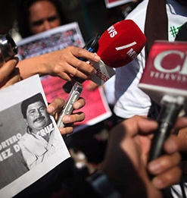
A closer look at... Mexico
Mexico differs from Brazil in many aspects regarding media and press transitions. First, there was a long-term civilian government with a formal process of periodic elections. However, the PRI (Institutional Revolutionary Party), used force and coercion to stay in power, leaving only in 2000 when they lost the presidential election.
Mexico came from a reality of the PRI trying to dominate the media landscape, to a reality where there’s a lot more pluralism and the media system can be considered a democratic one and there’s more improvement:
The political elite has no longer direct control over the content of the media
There is much less censorship
There is more room for criticism of the political elite

Slide 16
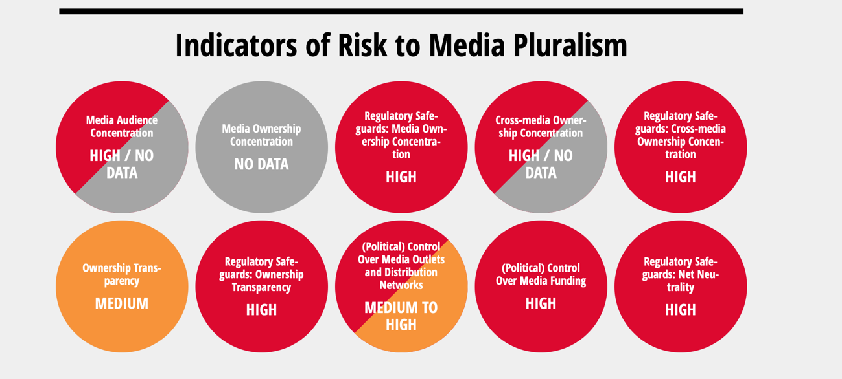
Media ownership in mexico
At the same time, and like Brazil, the ownership and control of the Mexican media, particularly regarding television, remains in almost the same people and continues to have a decent relation with the power elite.
Nowadays, Mexico’s media still faces many challenges. On most indicators of risk to media pluralism, the country either has no data or there’s a confirmed high risk.

Slide 17
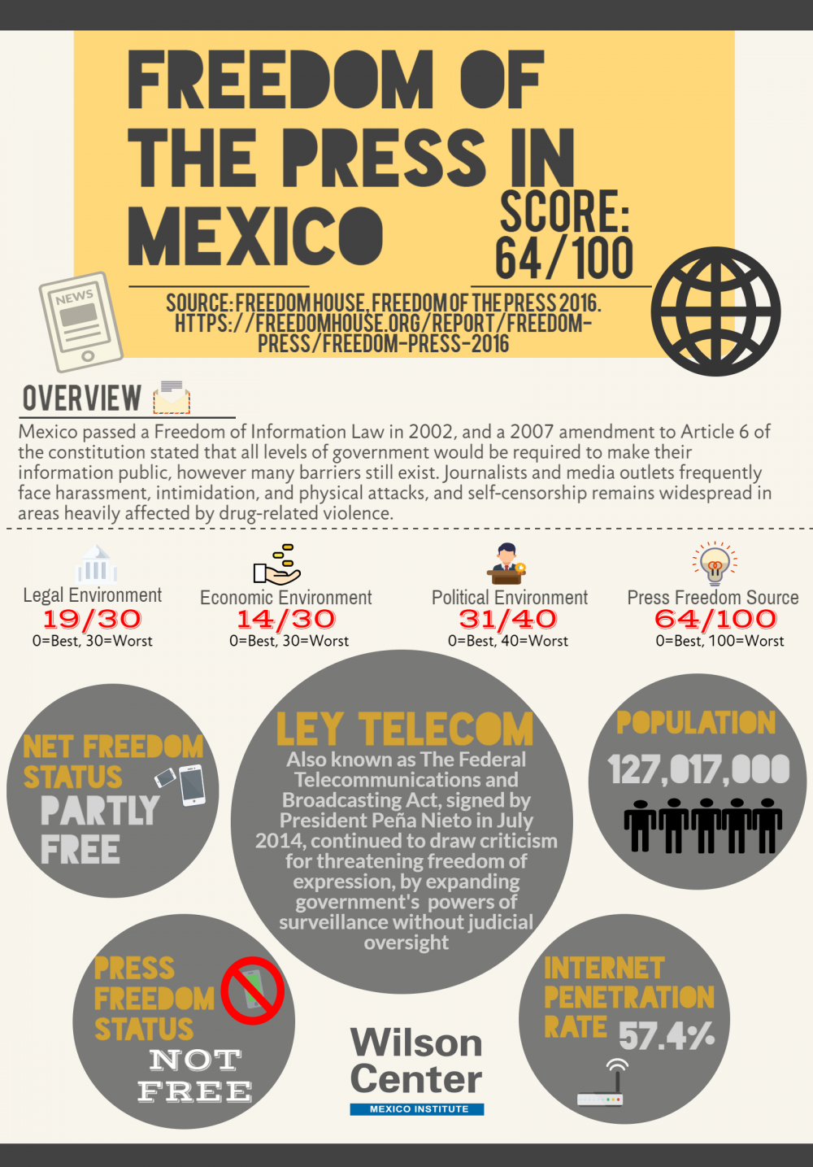
Freedom of press in Mexico
Although there was the approval of a Freedom of Information Law in 2002 and then an amendment in 2007, there are still many problems like: journalists and media outlets are frequently harassed, intimidated and attacked and the status of the freedom of press is not free.
According to the 2021 World Press Freedom Index, Mexico’s ranking is 143, which makes it one of the world’s most dangerous countries for the media. Some of the journalists who cover sensitive political stories or crime are warned, threatened and then killed, while others are abducted or can escape. Andrés Manuel López Obrador, the president since 2018, didn’t took any particular action or had declared some measures towards this violence against journalist and lack of freedoms.

Slide 18
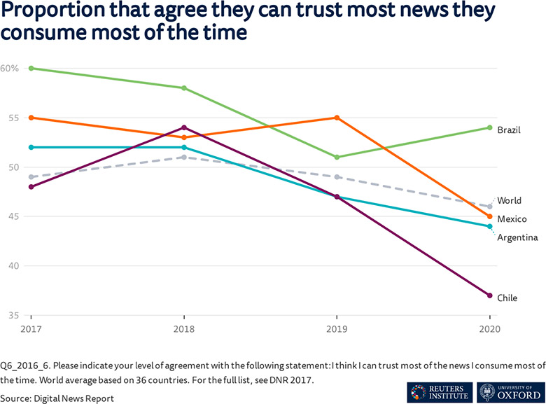
Do Latin Americans trust the media?
Large drops in trust in news between 2019 and 2020 are often linked to a broader socio-political context, like mass protests in Chile, because media became also targets during massive demonstrations against inequality.
Trust in news is often connected with trust in institutions, so there’s no surprise when there’s attacks on the media by politicians, for example, by Jair Bolsonaro, that this has contributed to decreases in trust.

Slide 19
Media in latin america today
Oppositional and alternative media decreased after the establishment of democracy in Latin America in general and have been like that ever since.
Internet takes a heavy role now as a new way of spreading and exchanging information with social media being a very popular option for users to catch up with the news. Between 50% and 60% of people surveyed in Brazil, Argentina, Colombia and Mexico said they see the news on social networks through links posted by people they know, so there’s a probability of those not being legitimate or even true.
Media are now more prepared to expose and investigate political scandals and corruption, since there’s no more control or censorship like it used to in the military regimes on most of the countries from this region.

Slide 20
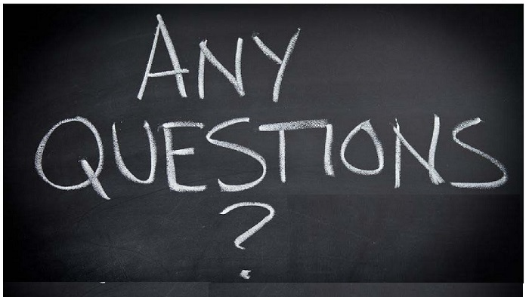

Slide 21
Sources
“Latin American media: under control of families, economic and political elites”. 2021. RSF. https://rsf.org/en/news/latin-american-media-under-control-families-economic-and-political-elites.
Mont'Alverne, Camila, Amy Ross Arguedas, Benjamin Toff, and Sumitra Badrinathan. 2021. "Trust In The Media In Latin America: The Same Old Story? | LSE Latin America And Caribbean". LSE Latin America And Caribbean Blog. https://blogs.lse.ac.uk/latamcaribbean/2021/02/02/trust-in-the-media-in-latin-america-the-same-old-story/.
"Imprensa Brasileira, Verdadeiro Saco De Pancadas Da Família Bolsonaro: Uma Tendência Que Se Intensifica Em 2021 | Reporters Sans Frontières". 2021. RSF. https://rsf.org/pt/relacoes/imprensa-brasileira-verdadeiro-saco-de-pancadas-da-familia-bolsonaro-uma-tendencia-que-se.
Watson, Amy. 2021. "Topic: News In Latin America". Statista. https://www.statista.com/topics/8083/news-in-latin-america/.
“Media Ownsership Monitor – Reporters without Borders.” Resource Centre on Media Freedom in Europe. https://www.rcmediafreedom.eu/Tools/Monitoring-tools/Media-Ownership-Monitor-Reporters-without-Borders.
Sparks, Colin. October 2011. “Media and Transition in Latin America.” Westminster Papers in Communication and Culture, 8(2):3. DOI: http://dx.doi.org/10.16997/wpcc.184.

