Slide 1
Israel and terrorism

Slide 2
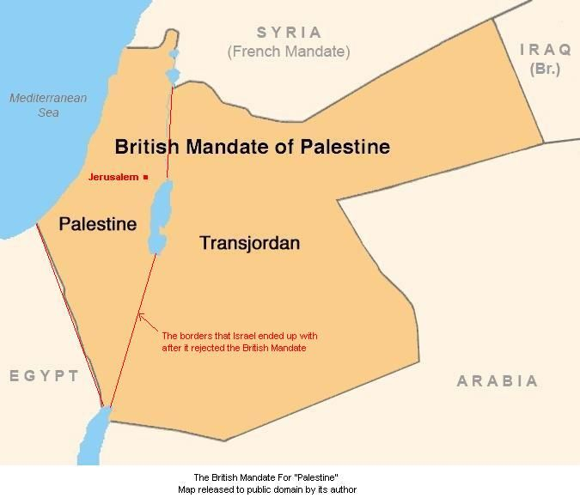
British mandate for Palestine following the end of Ottoman empire at the end of WW1
Mandate was granted by
UN in 1919 to secure
„national home for the jewish people“

Slide 3
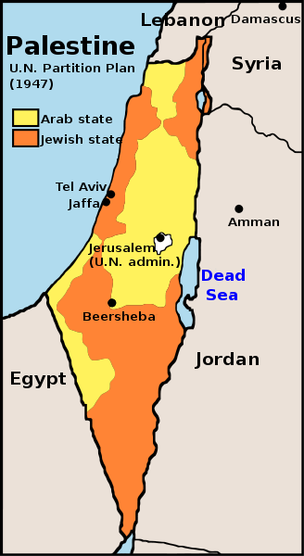
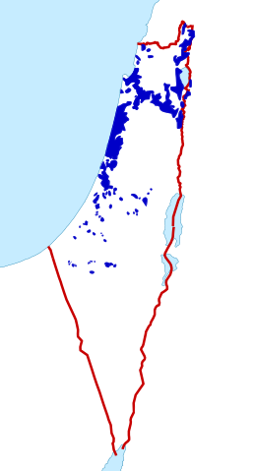
Tensions between sionist organization and arabic league Proposal of divison of Palestine into „jewish state“ and „arabic state“ by UN in 1947

Slide 4
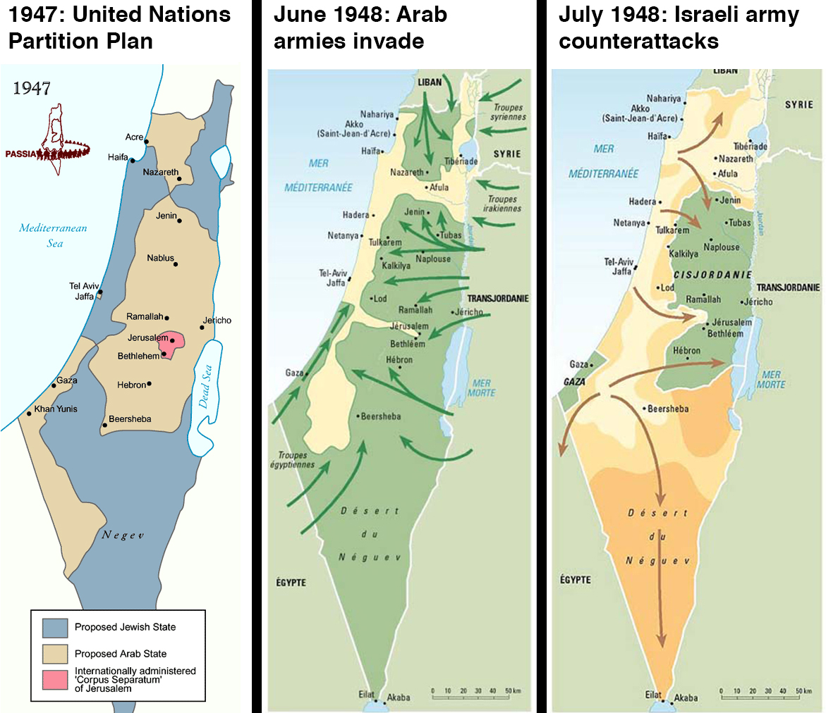
1948 - Arab-Israeli war
End of the british mandate
Israeli declaration of independence (14 may)
Military coalition of Arab states
entered Israel territory (15 may)

Slide 5
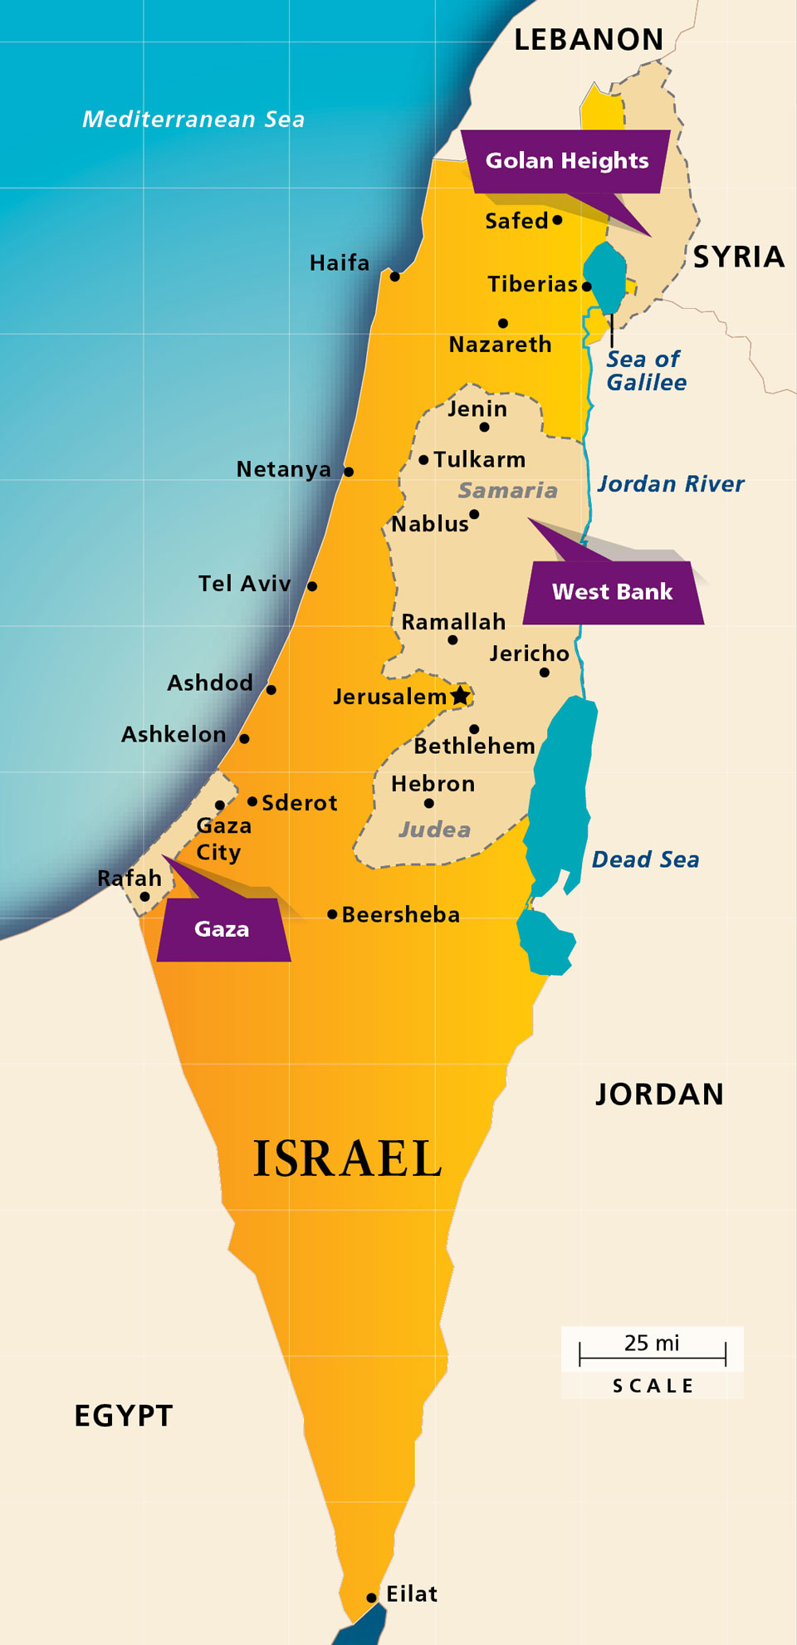
Current state of affairs
Divison of Israel:
Israel territory
West bank
Gaza strip
West bank and Gaza strip are considered „occupied territories“

Slide 6
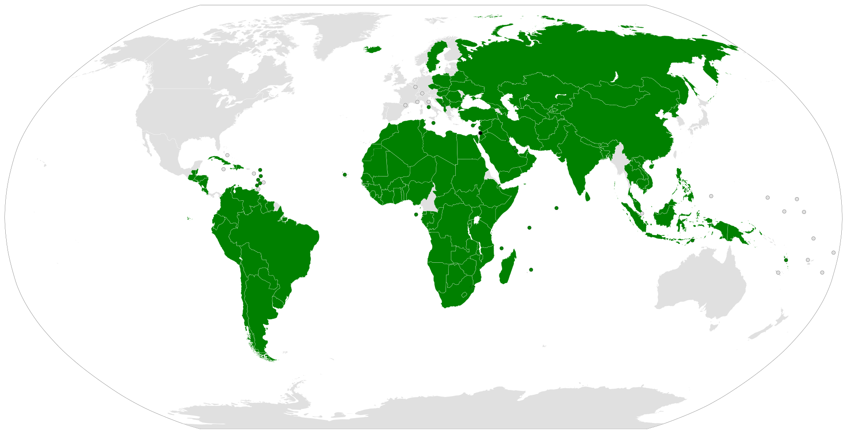
International recognition of Palestine

Slide 7
Fatah: West bank Negotiates with Israel Nationalistic party considered as non-terrorist
Hamas: Gaza strip Refuses to negotiate
Listed as a terrorist organization
(USA, EU, Canada, Japan, Egypt)

Slide 8
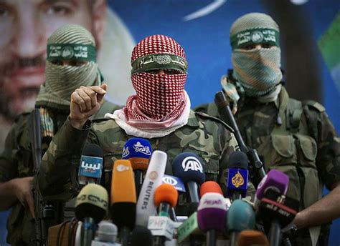
Practice of Hamas
Divided into two parts – civil and militant
Civil part - helping the poor in Gaza,
supports construction of schools
and social programs
Militant part – behind many attacks on Israel

Slide 9
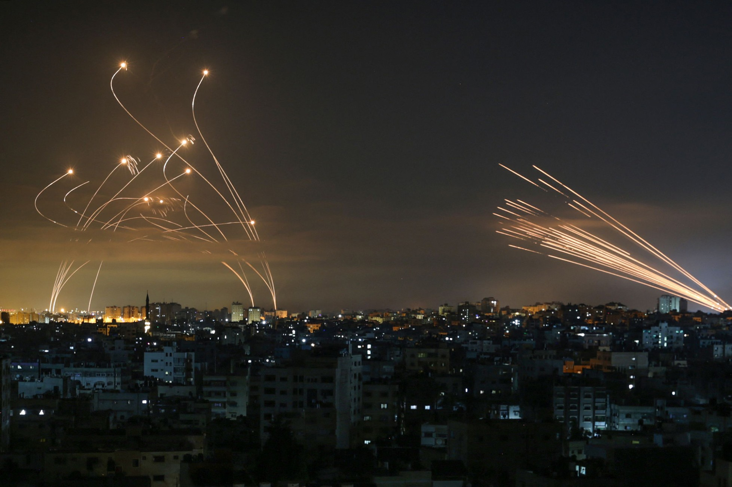
Ideology of Hamas
Wants to establish Palestinian state on all of the territory
Members of militant part do NOT distinguish
between Israeli army and civilians
Trying to undermine Israel by rocket launching from Gaza

