Slide 1
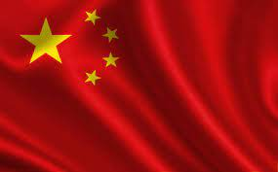
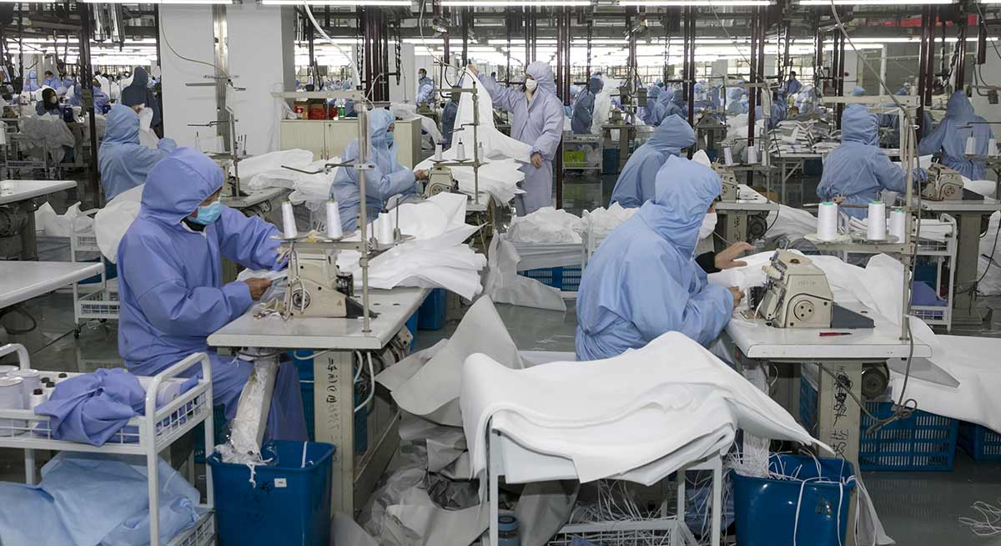
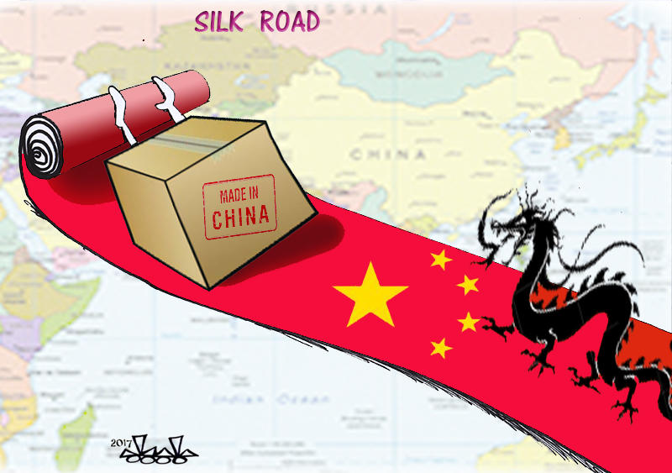
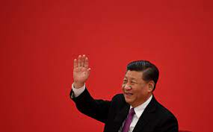
Virgile Bonnasse

Slide 2
Summary
What is China?
What are these objectives?
The tools of influence of power

Slide 3
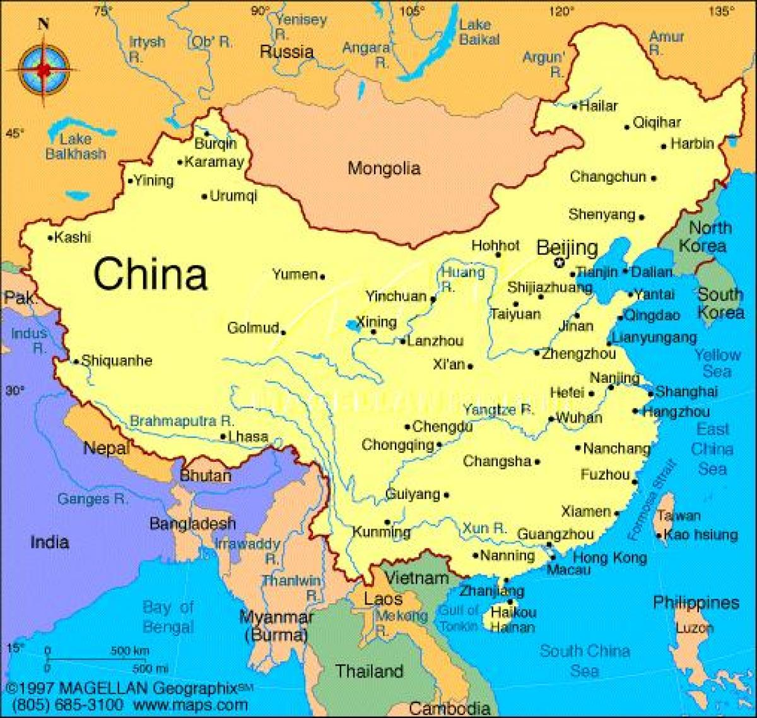

Slide 4
China is… an history
An imperial past
The « Middle Empire », the sinocentrism and political legitimacy

Slide 5
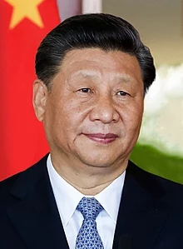
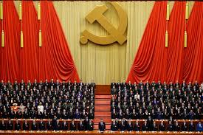
China is… a president
Xi Jinping, an authoritarian chief.
Xi Jinping, an eternal chief
The « chinese dream »
Is the « middle Empire » back?

Slide 6
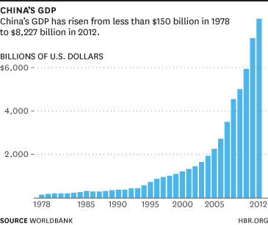
China is… A new model
Imperialist and liberalist…
…And communist
Risks about the ideological confrontation?

Slide 7
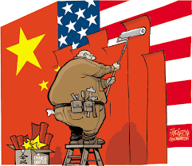
These goals
The leading world power ambitions
China in center of the world

Slide 8
The tools of influence
Economy and influence
Military ambitions, political expansion

Slide 9
Economy and influence: The chinese belt and Road Initiative

Slide 10
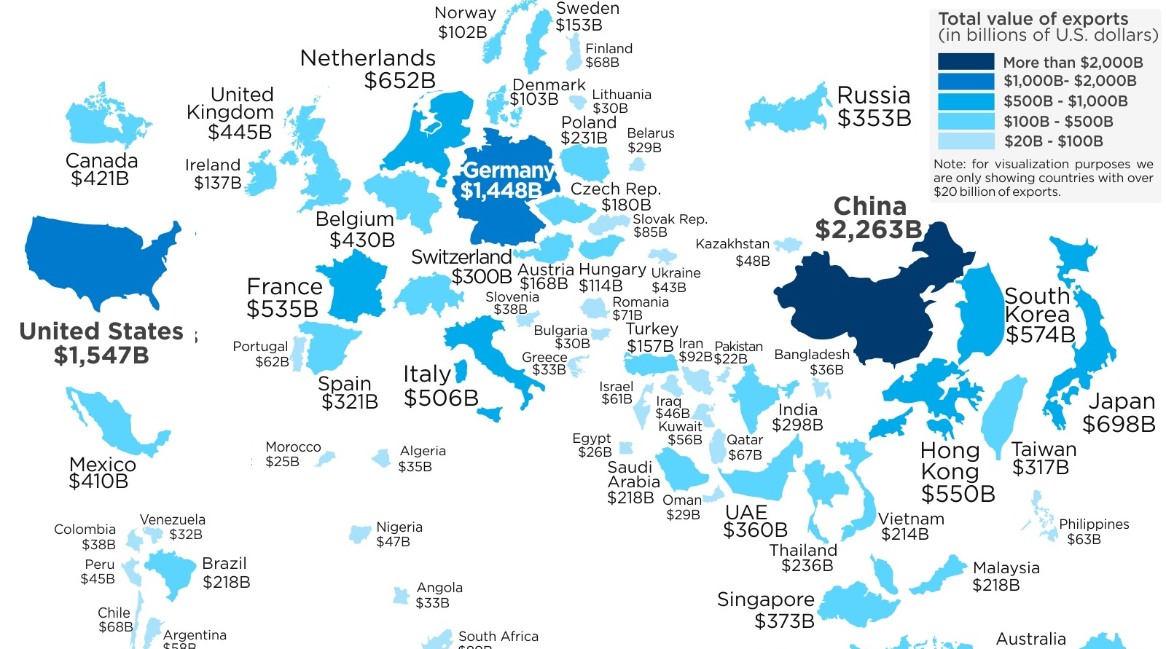
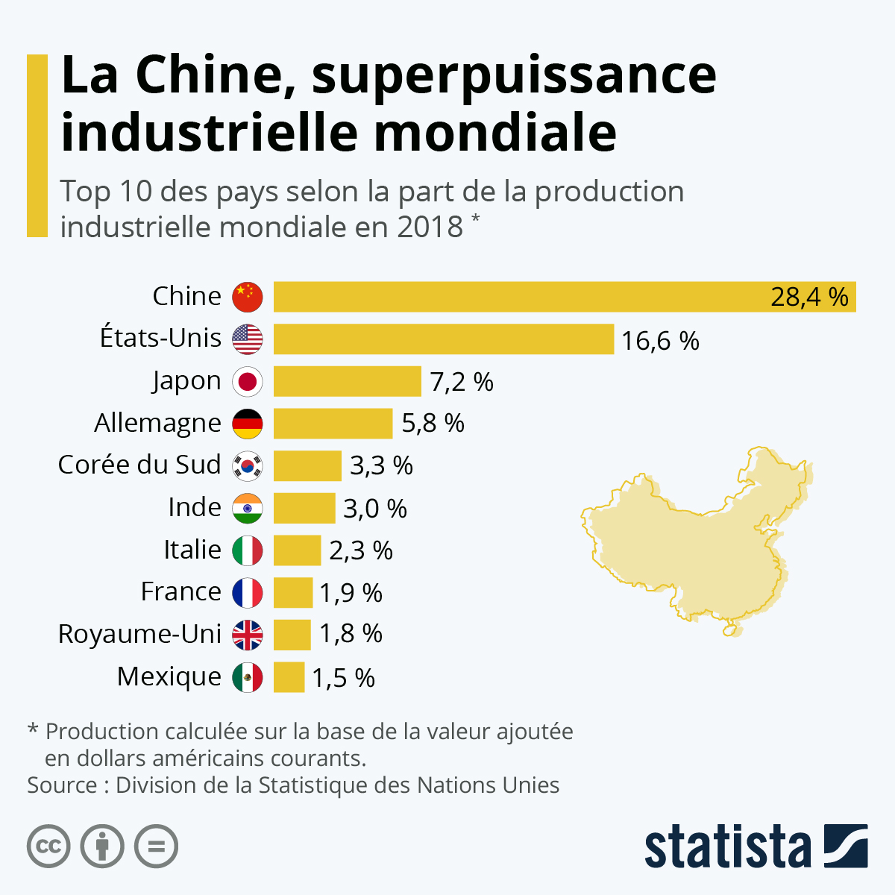
« Made in China »: the world’s industry

Slide 11
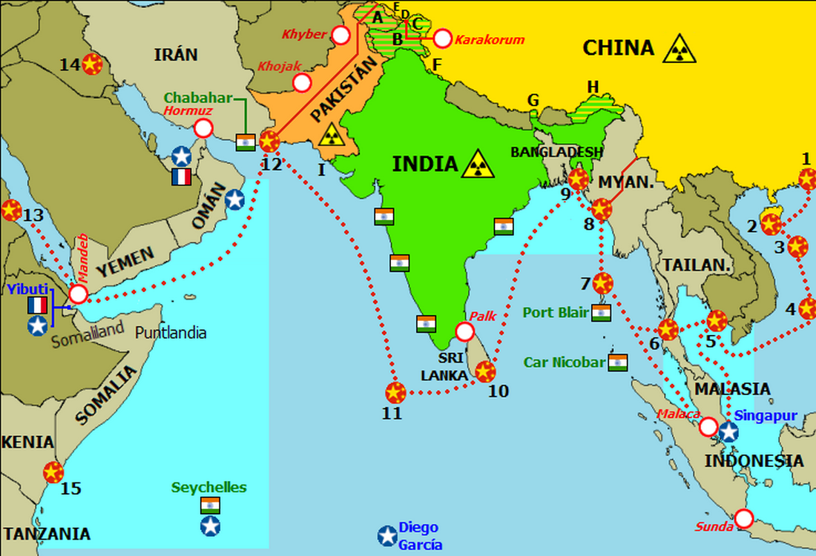
The political influence
A great presence on seas
Unification of China: tensions, how far?
China on international relations.

Slide 12
Limits of the power

Slide 13
Thanks you for your attention!

Slide 14
sources
French courses and basic knowledge
A lot of research and journalistic sites:
https://www.capital.fr/economie-politique/chine-logre-asiatique-a-aussi-ses-faiblesses-1392125
https://www.lci.fr/environnement-ecologie/cop26-chine-russie-bresil-jinping-bolsonaro-poutine-pourquoi-les-dirigeants-de-ces-pays-sont-ils-absents-du-sommet-pour-le-climat-2200663.html
Lessons (the map and belt road initiative)
https://www.letemps.ch/opinions/chine-saffirme-organisations-internationales
https://www.lopinion.fr/edition/international/marine-chinoise-fait-l-ocean-indien-terrain-jeu-141184
https://www.asafrance.fr/item/chine-l-evolution-inquietante-de-la-puissance-militaire-chinoise.html
https://fr.statista.com/infographie/20863/top-10-des-pays-selon-la-part-de-la-production-industrielle-mondiale/
https://www.lefigaro.fr/conjoncture/dossier/guerre-commerciale-chine-etats-unis-origine-resume
https://www.actionfrancaise.net/2017/03/17/chine-dictature-liberale-dun-etat-communiste/
https://www.courrierinternational.com/grand-format/cartographie-avec-les-nouvelles-routes-de-la-soie-la-chine-tisse-une-toile-mondiale
https://www.lalettregeopolitique.fr/2021/la-chine-l-empire-du-milieu/
https://www.histoire-pour-tous.fr/civilisations/1468-la-chine-imperiale.html
https://www.franceculture.fr/emissions/l-invite-e-des-matins/l-invite-des-matins-du-jeudi-14-octobre-2021
https://www.afri-ct.org/2008/la-chine-dans-la-mondialisation/

