Slide 1
Ethnicity as a conflict source in Africa – A case study of the genocide in Rwanda
By William Rahn

Slide 2
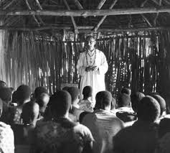
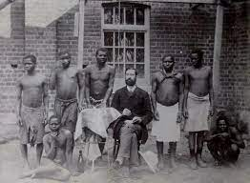
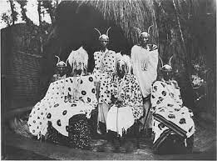
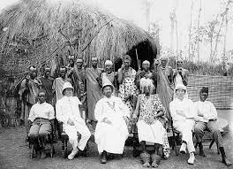
Precolonial Rwanda and the introduction of ethnicity during colonial rule
Originally inhabited by Twa settlers
Plethora of minor kingdoms united into Kingdom of Rwanda
German colony from 1884
Colonial rule through the use of local elites
Belgian control after World War 1
Direct colonial rule and the implementation of ethnic division

Slide 3
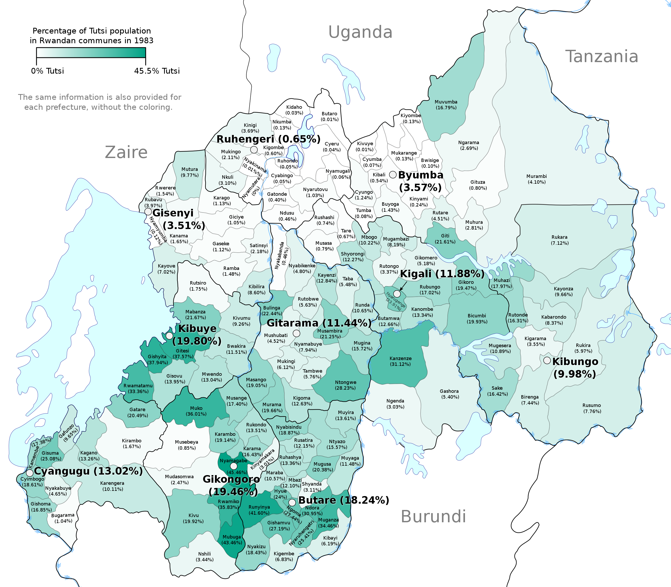
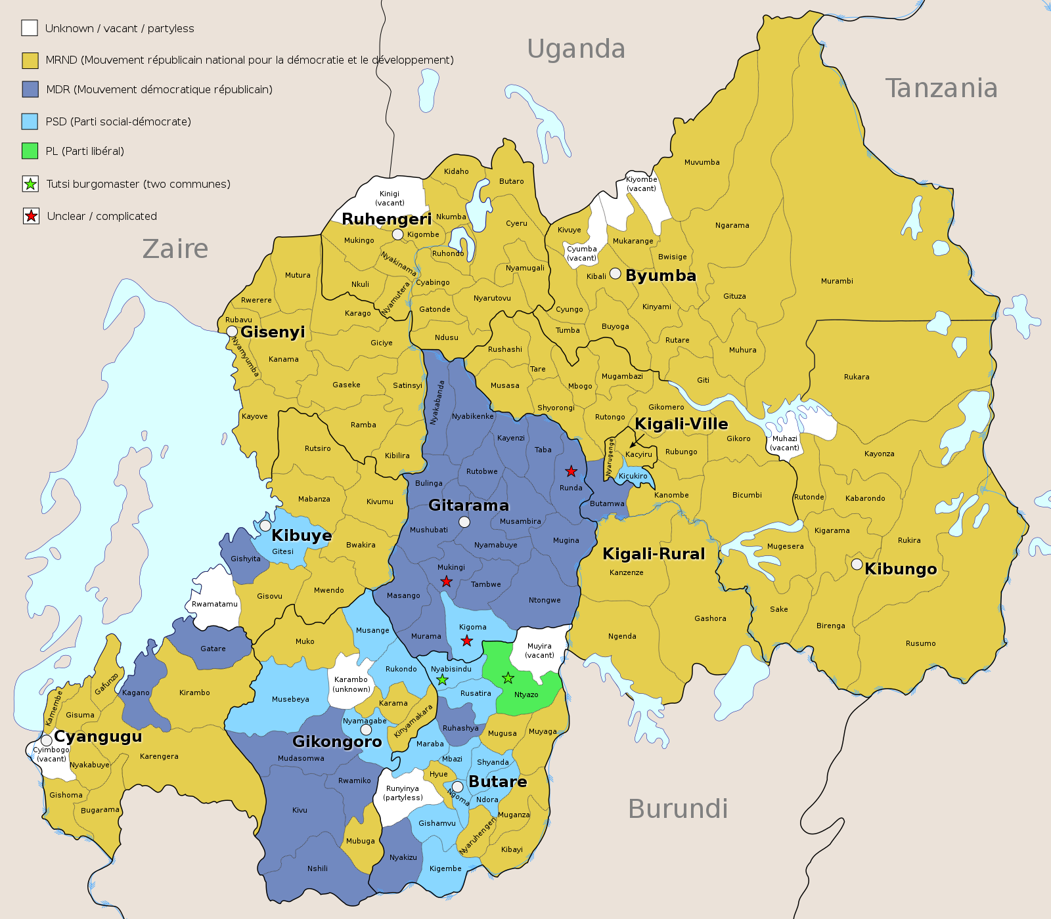
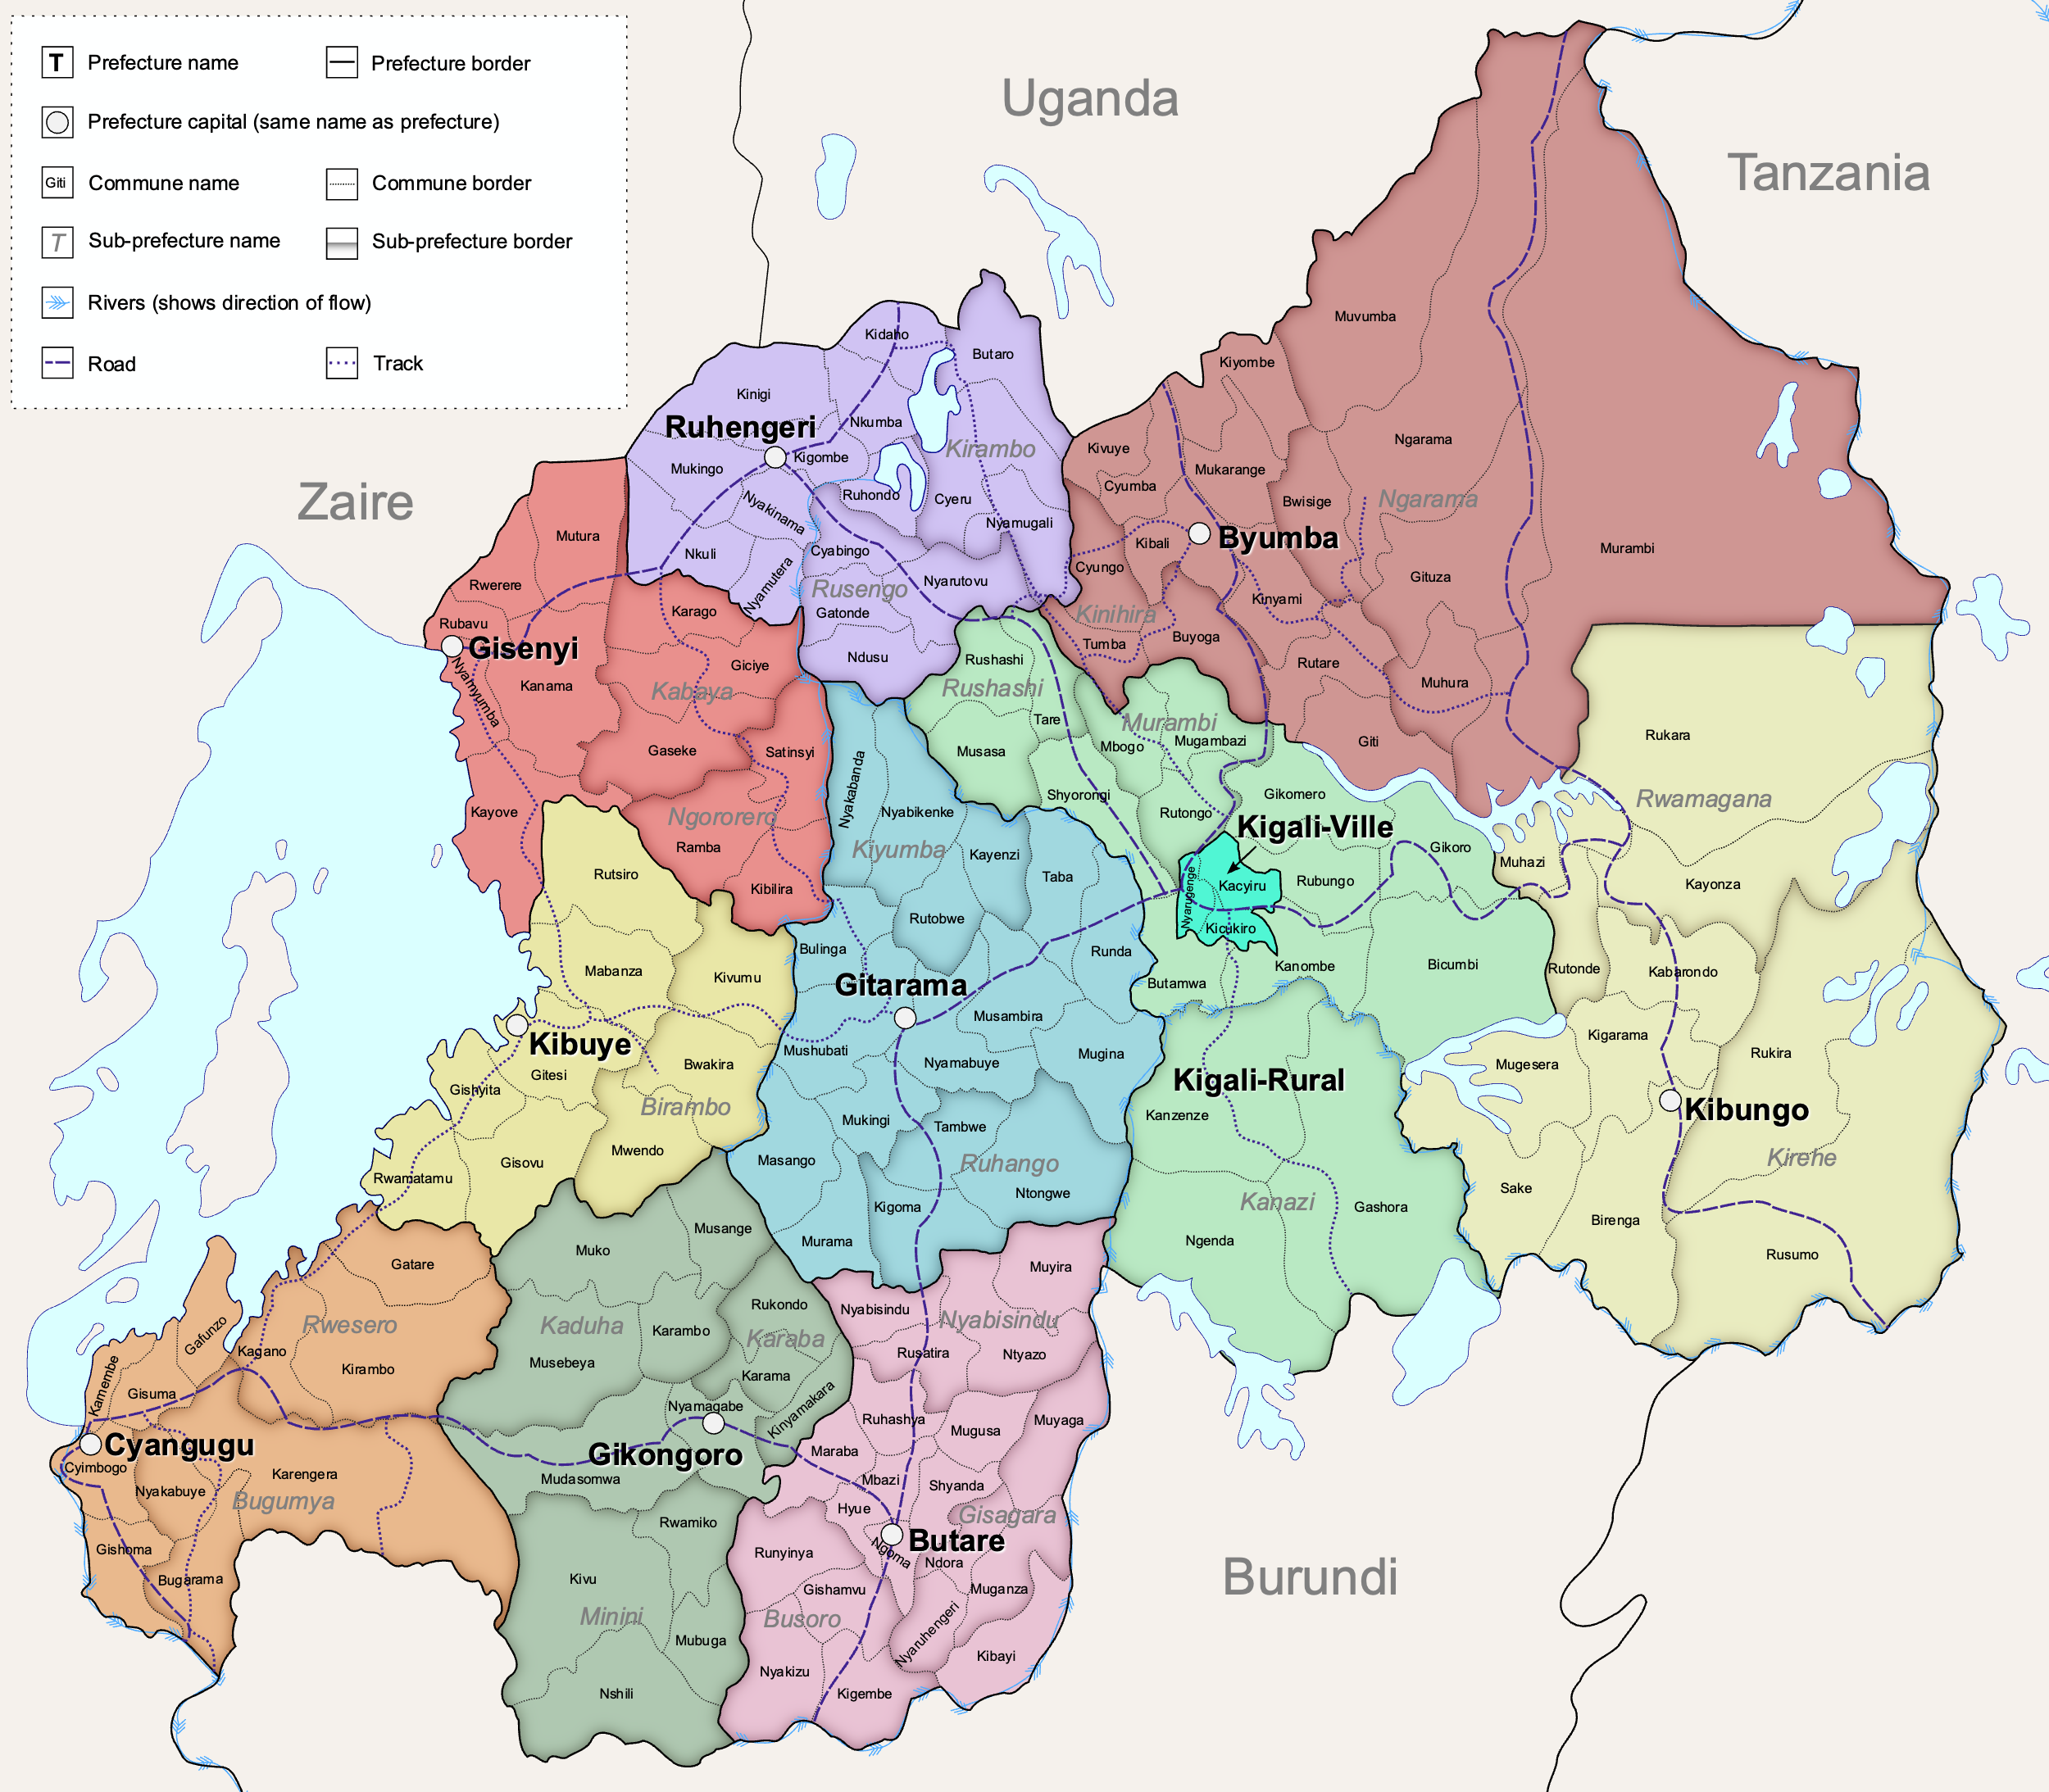
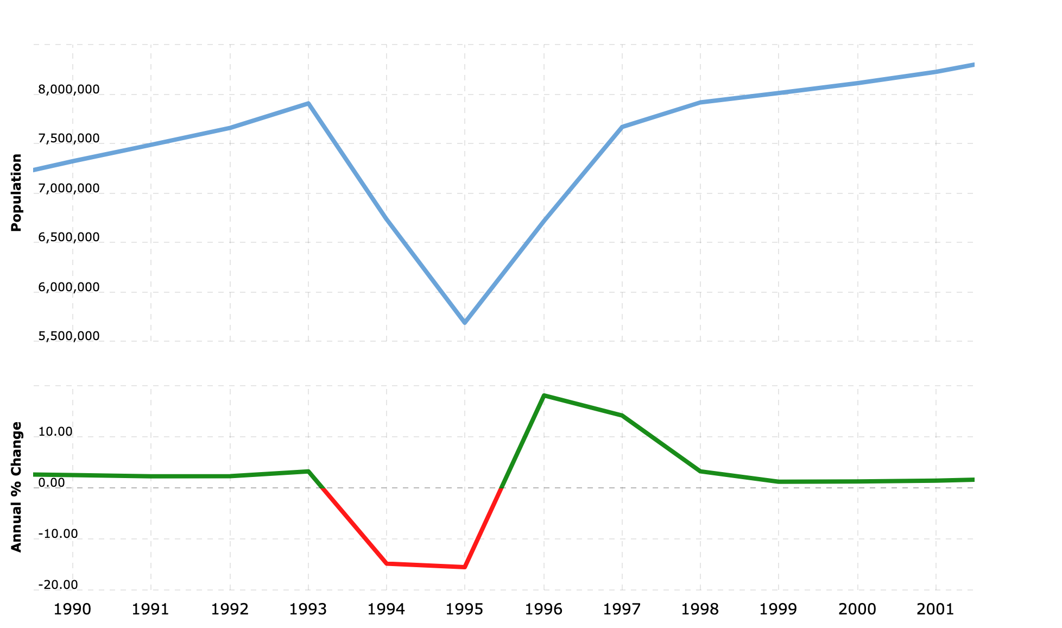
Ethnic composition of Rwanda
1993 population: 6,847,000
1995 population: 5,992,000
Hutu: 84%
Tutsi: 14%
Twa: 2%
600k IDPs (7%)

Slide 4
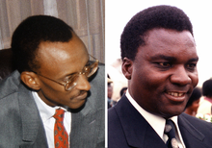
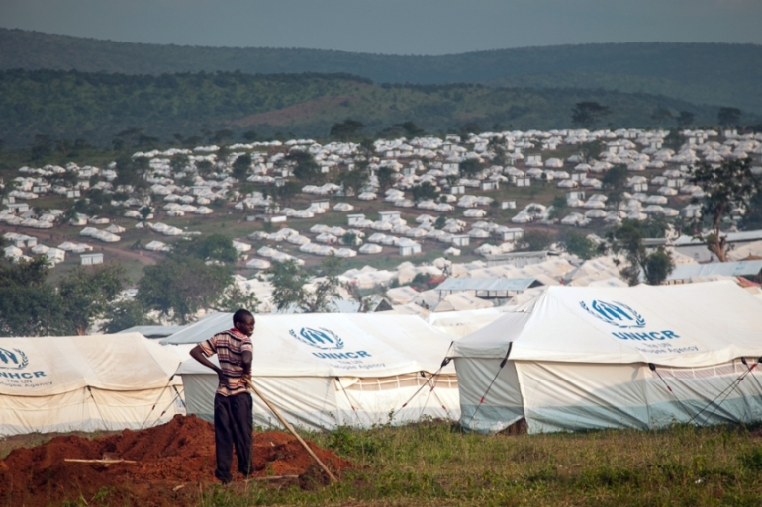

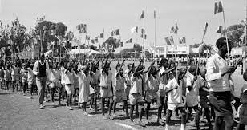
How ethnicity fueled a political divide
Precolonial rule shaped the political landscape, Tutsi held more power
1957 Hutu scholars wrote “Bahutu manifesto”, movement for equal treatment
1959, minor violence based on ethnicity, fear based politics
1959 – 1961, Rwandan Hutu Revolution, Tutsi lost power and decolonisation period
60 – 70s, anti Tutsi sentiment grew stronger, Tutsi exodus
90s, Pogroms, Civil War, Hutu Power and growing fear
Similarities between 50s and 90s
Paul Kagame (RPF) and Juvenal Habyariamana (government)

Slide 5
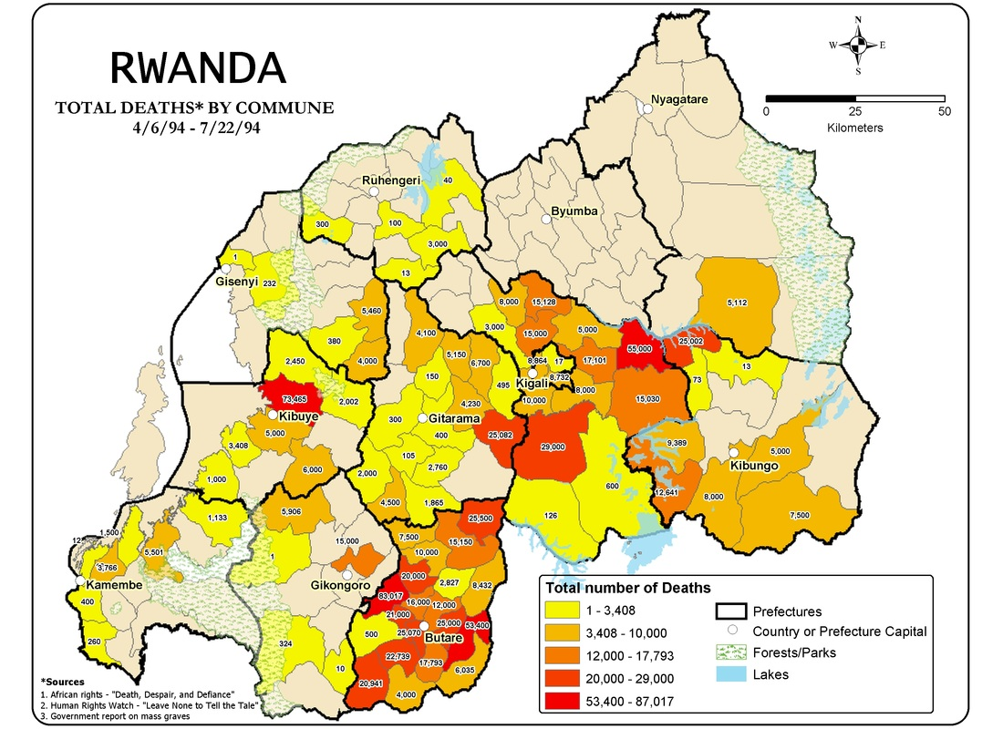
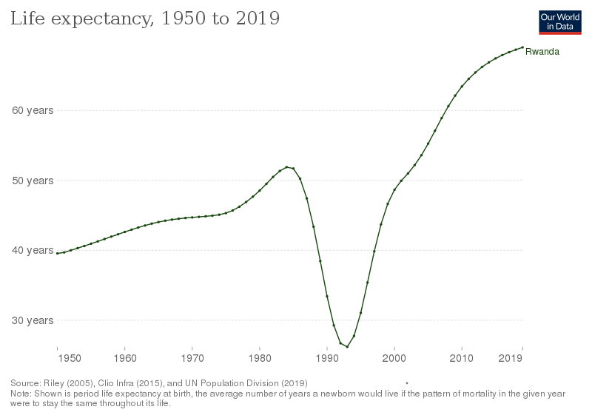
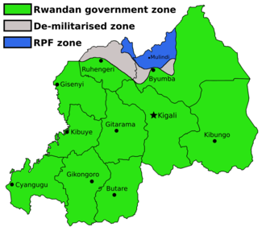
Civil war and genocide
Mobalization of Hutu groups prior to genocide
The central role of media in conflict regions
1994, Rwandian and Burundi presidents plane is shot down
Human Rights Watch group estimates 500,000 deaths + IDPs
The Rwandan Patriotic Front (RPF) counteroffensive

Slide 6
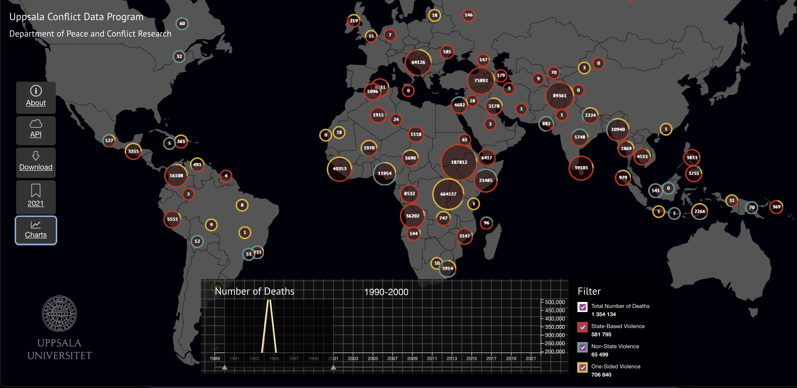

Slide 7
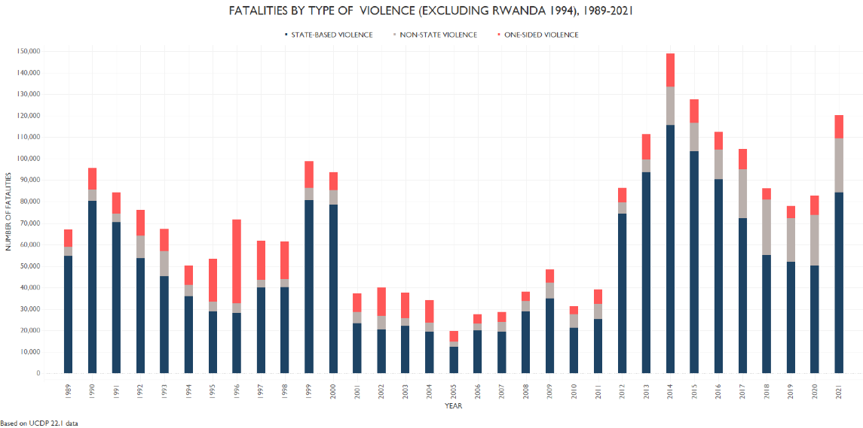

Slide 8
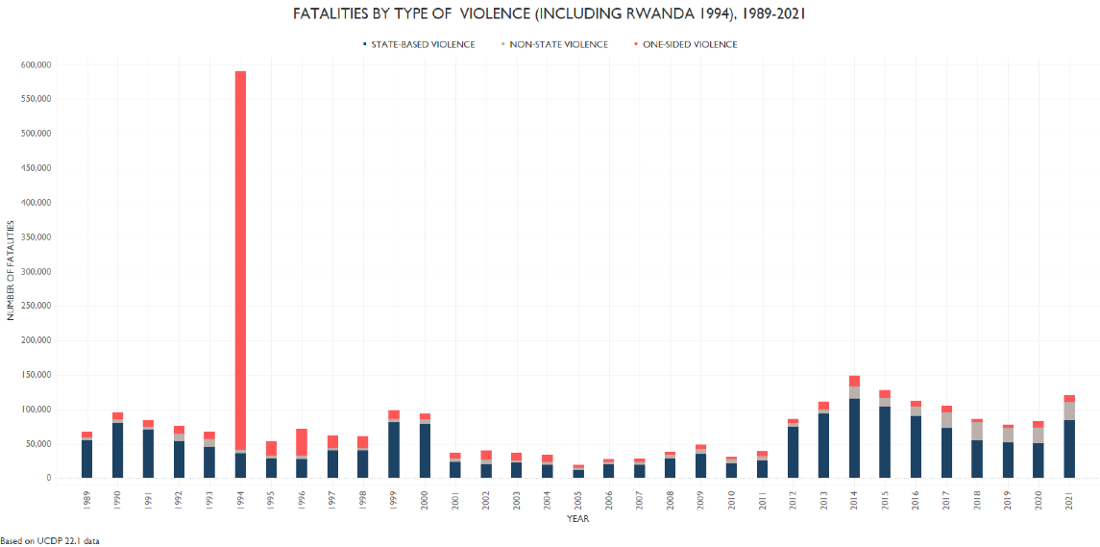

Slide 9
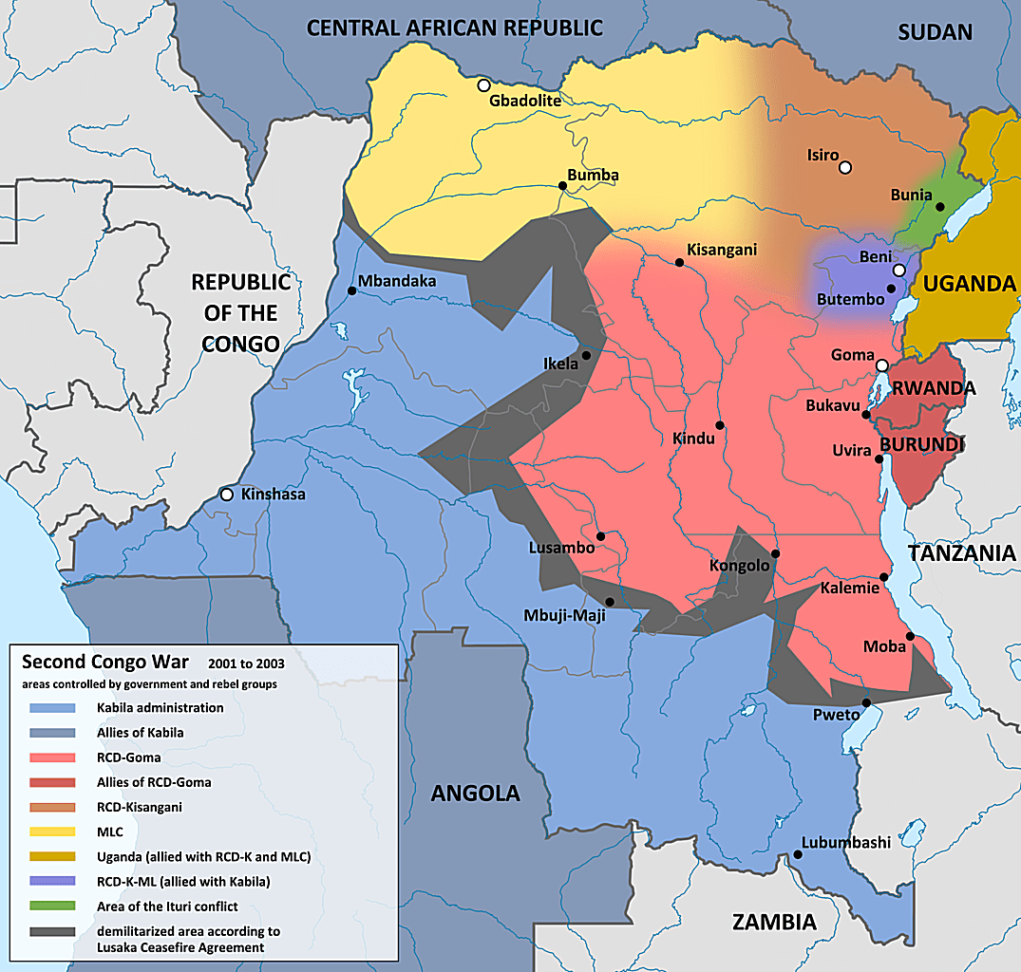
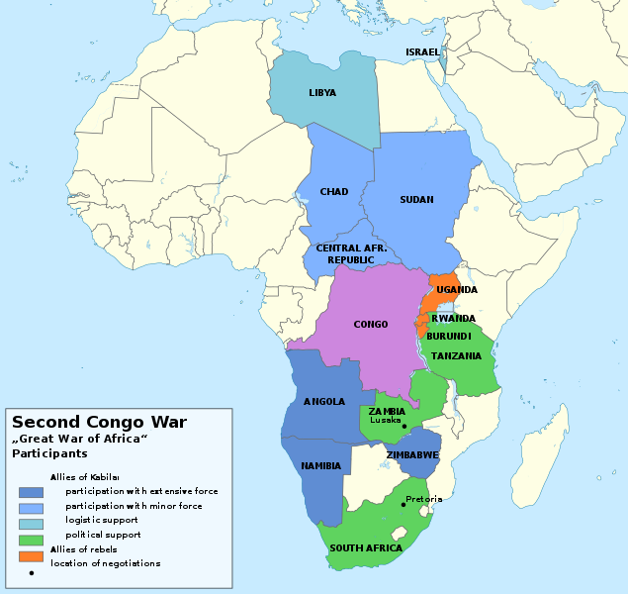
How ethnicity is a root cause to tension in the Great Lake region
Over 2.1 million Rwandans displaced in the region after the genocide (UNHCR)
Establishment of rebel groups in neighbouring countreis (Tutsi and Hutu)
RPF supports Tutsi rebellion against Mobuto (Zaire)
Uganda, Rwanda and Burundi support Kabilas coup in Zaire (First Congo war)
SADC members Angola, Chad, namibia and Zimbawe enters the conflict
Second Congo War, RPF attacks DRC, 5.8 million deaths (1998 – 2008)
2002, Sun City Agreement and Luanda Agreement, unstable peace
Refugee camps /diasporas

Slide 10
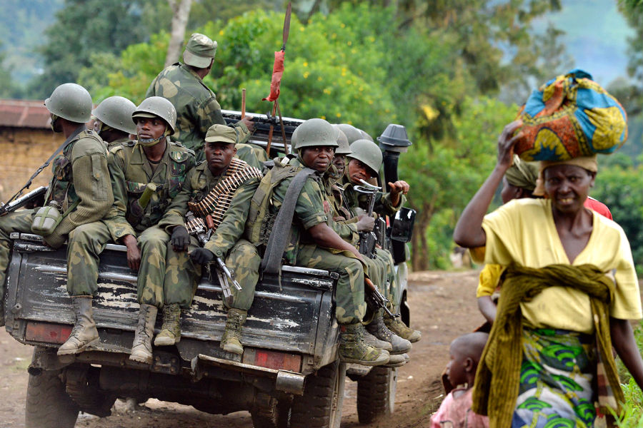
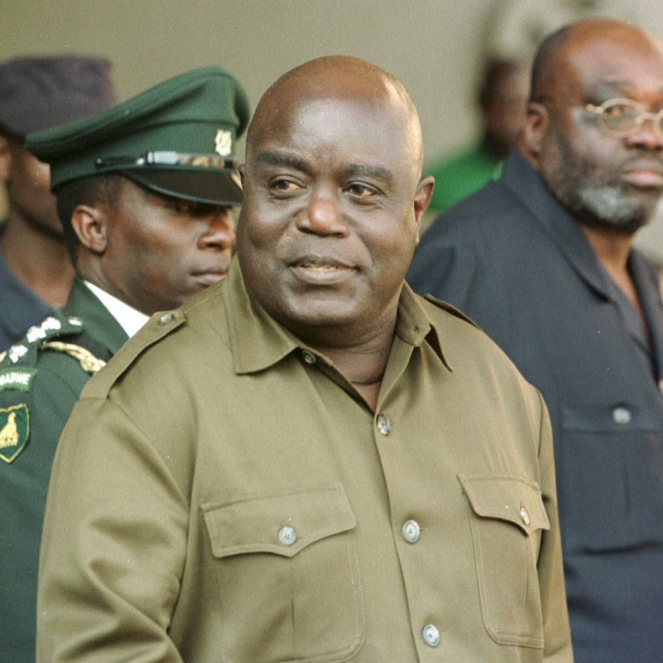
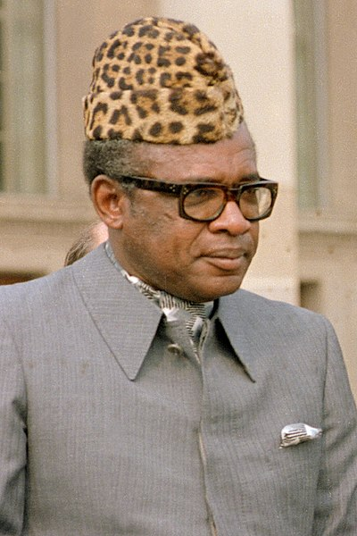
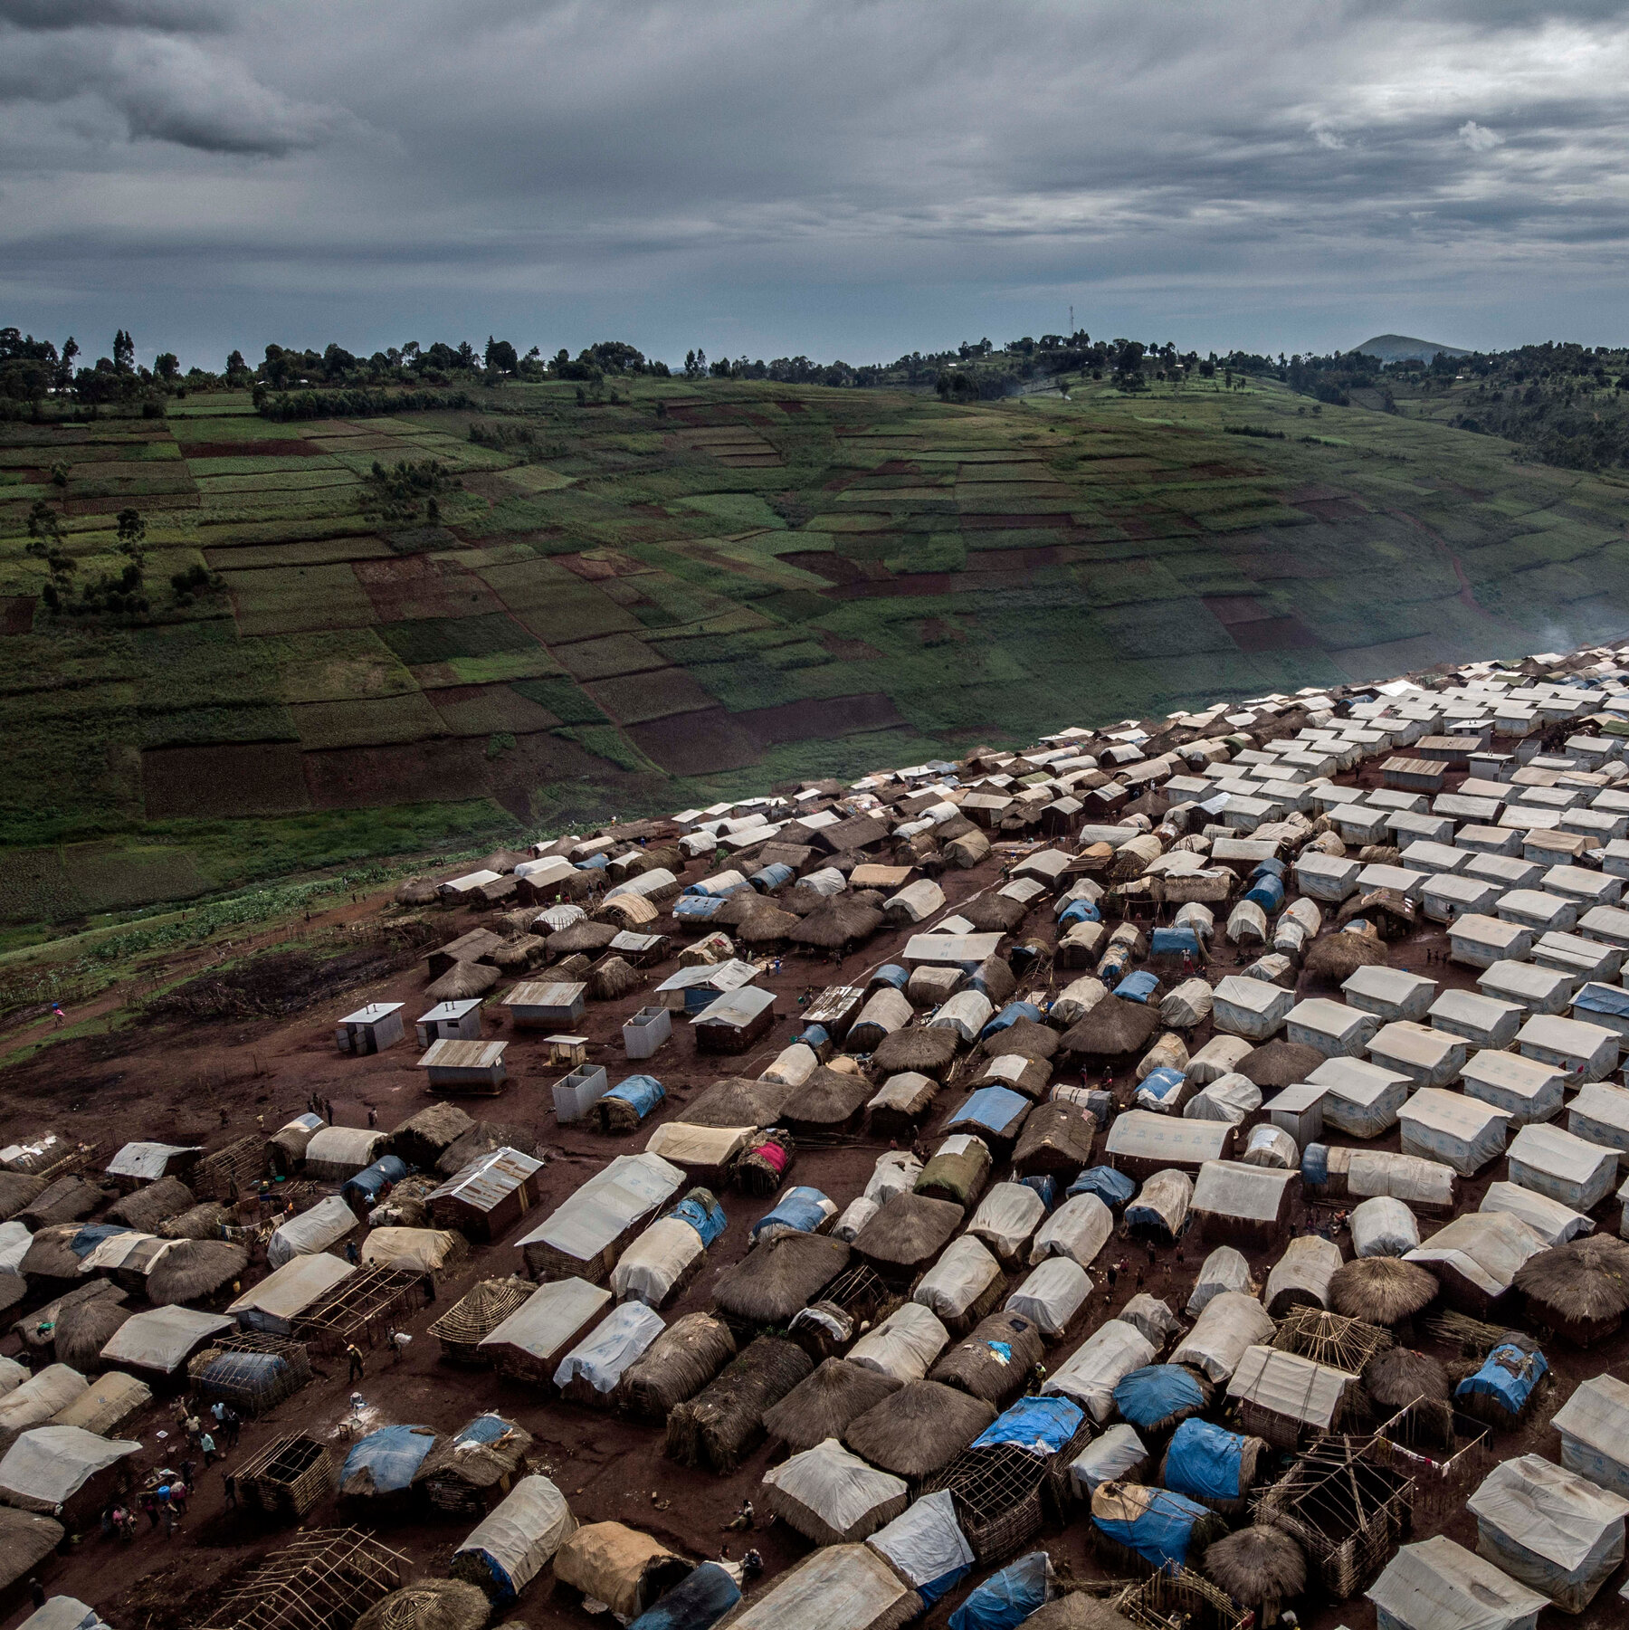
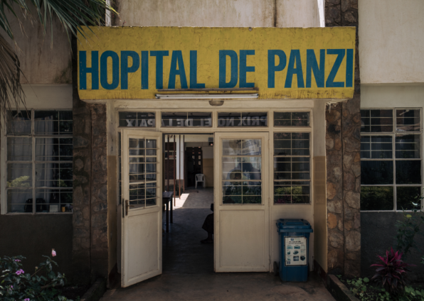
Fragile state detour: The unfortunate state of Congo
A troubled history
Lack of centralization and instutionalization
Why fragile state create conflict regions
The struggle between autocracy and democracy
De facto situation for civilians in Congo
The panzi hospital

Slide 11
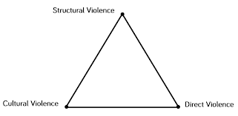
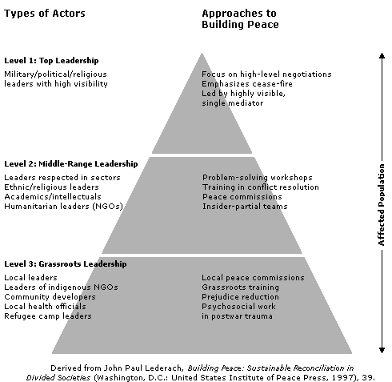
Summary
Ethnicity is a major factor in the Global South
Is prevelent in politics, economy, military and society
The UN (& West) lacks tools and ambition
How peace can be achieved
Johan Galtung, triangles and different types of peace
John Paul Lederacht, cultivation and peace building

Slide 12
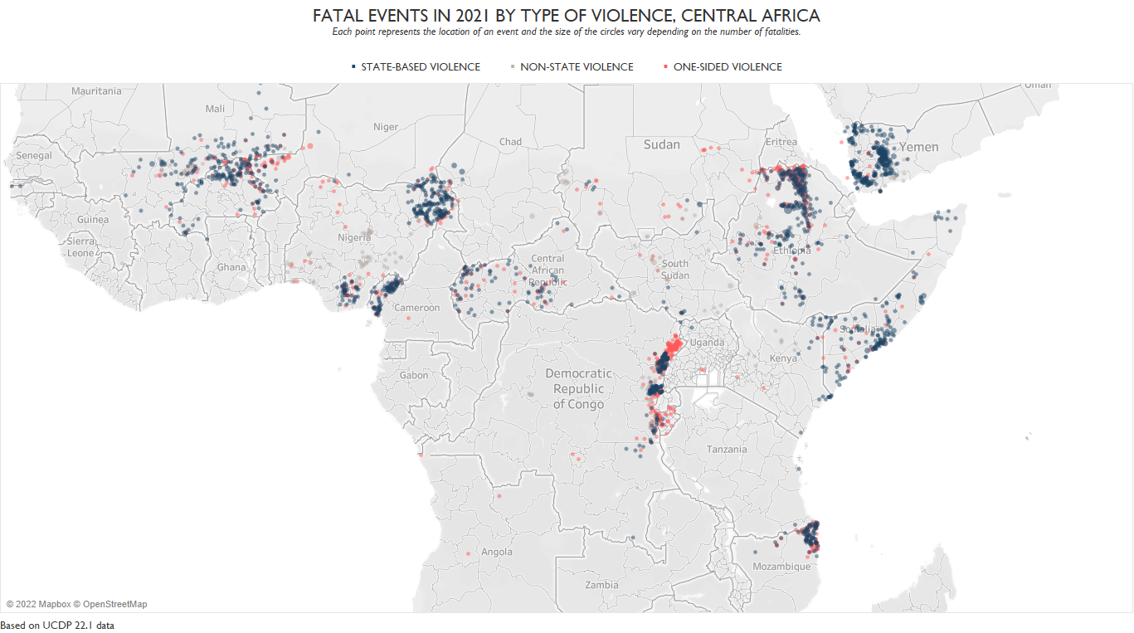
Reference list
https://www.macrotrends.net/countries/RWA/rwanda/population
https://www-jstor-org.proxy.ub.umu.se/stable/4187200?seq=4#metadata_info_tab_contents
https://www.annualreviews.org/doi/pdf/10.1146/annurev.polisci.9.062404.170648 - The heart of the African conflict zone democratization, ethnicity, civil conflict and the great lakes crisis
https://www-jstor-org.proxy.ub.umu.se/stable/pdf/422339.pdf?refreqid=excelsior%3A7794e451d9ad399010467946b51ba831&ab_segments=&origin=&acceptTC=1 – Ethnicity and Power in Burundi and Rwanda
https://www.jstor.org/stable/4187200 Ethnicity and the politics of history in Rwanda
https://ucdp.uu.se/country/517 UCDP Rwanda
https://asq.africa.ufl.edu/chege_97/ The Great Lake Crisis
https://countryeconomy.com/demography/population/rwanda?year=1995 Population statistics
https://cdn.sida.se/publications/files/sida3689en-a-strategic-conflict-analysis-for-the-great-lakes-region.pdf SIDA, Strategic conflict Analysis
The Second Congo War – William Rahn

