Slide 1
Processes of Modernisation
1455 1650 1774 Literacy
1517 1648 1781 Secularization
1759 1765 1884 Industrialization
1784 1833 1859 1868/9 Commodification
1781 1848 Urbanization
1893 1906 1918 Democratization

Slide 2
Time-Space Distanciation
SEPARATION
EMPTY TIME END SPACE
DISENBEDDING MECHANISM
  EXPERT SYSTEMS (Railways to Internet)
  SYMBOLIC TOKEN (Money, Language)

Slide 3
The Institutional Dimensions of Modernity
Anthony Giddens
Surveillance
Military power
Industria-lisation
Capitalism

Slide 4
Social differentiation
Media of power/N. Luhmann
State Government
Family and Intimacy
Public Sphere
Market
Love, Solidarity
Money
Knowledge, Soft Skills
Reputation, Trust

Slide 5
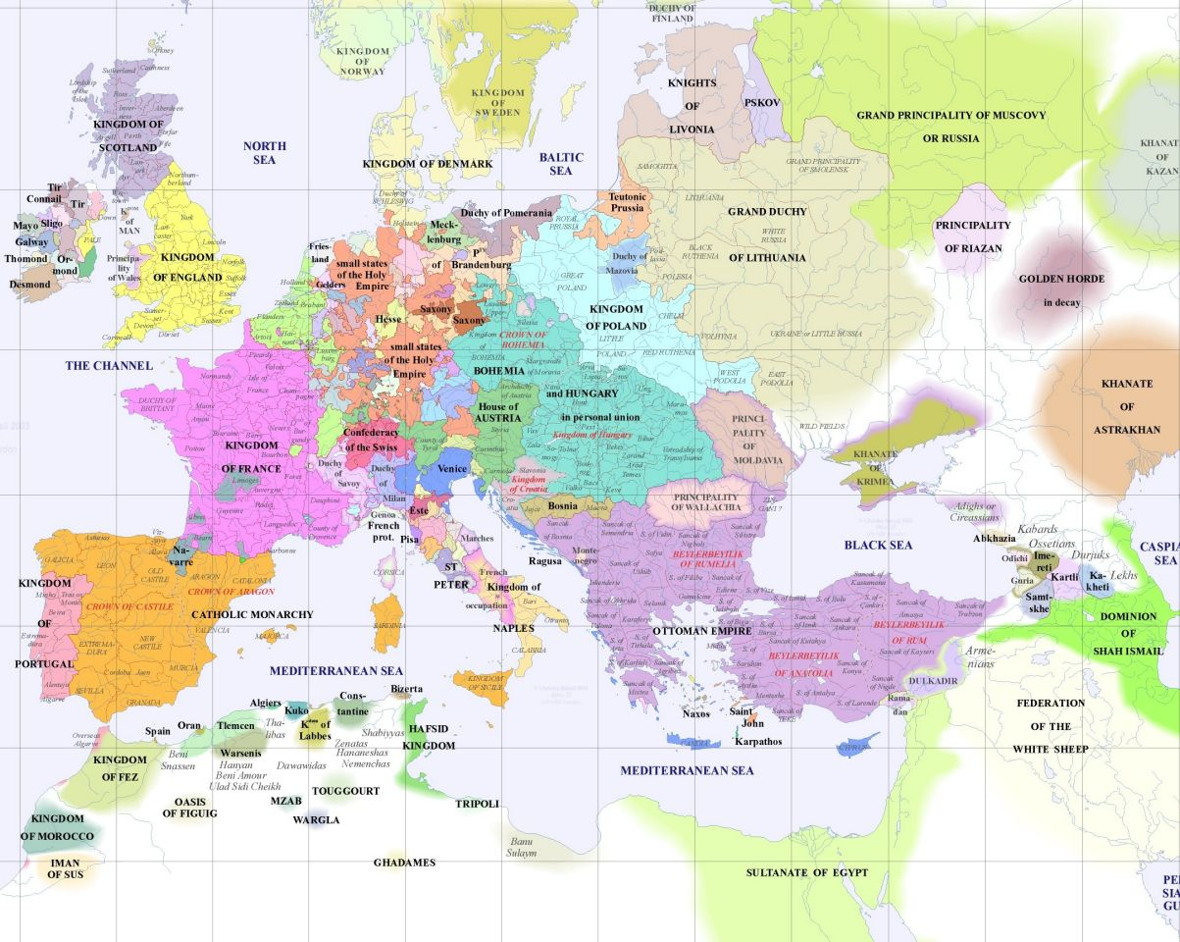
Europe
1500

Slide 6
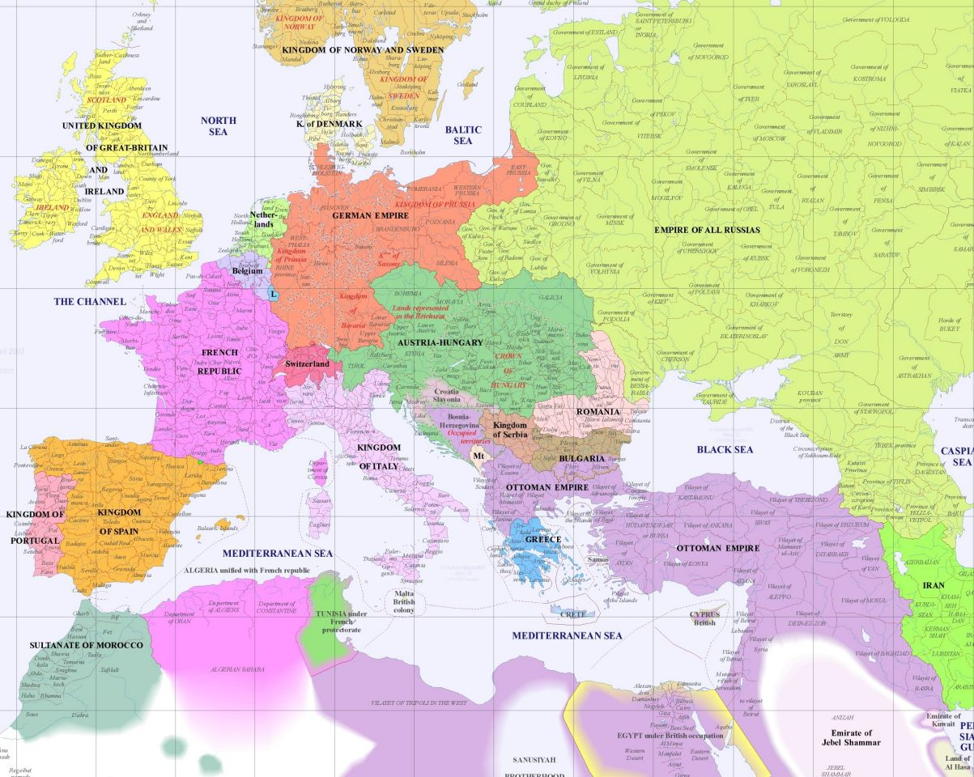
Europe
1900

Slide 7
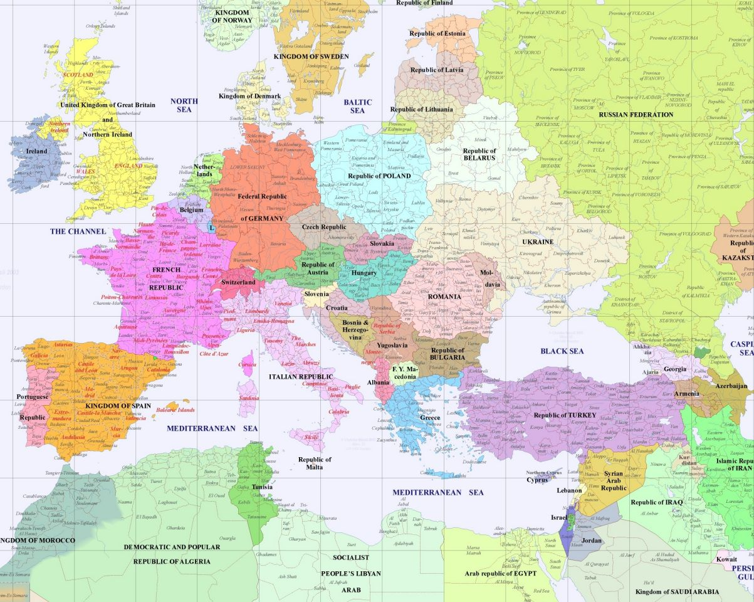
Europe
2000

Slide 8
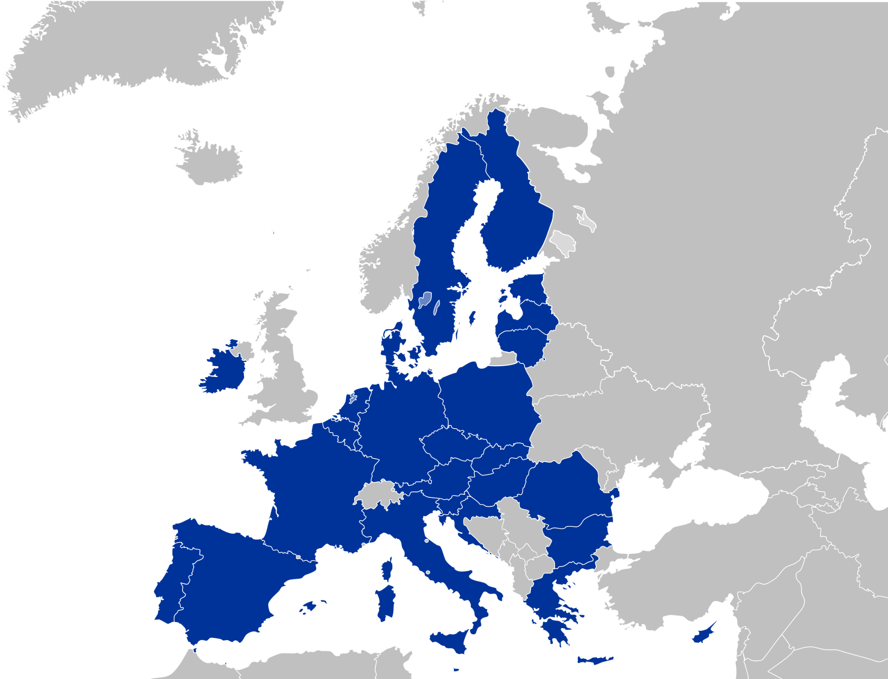
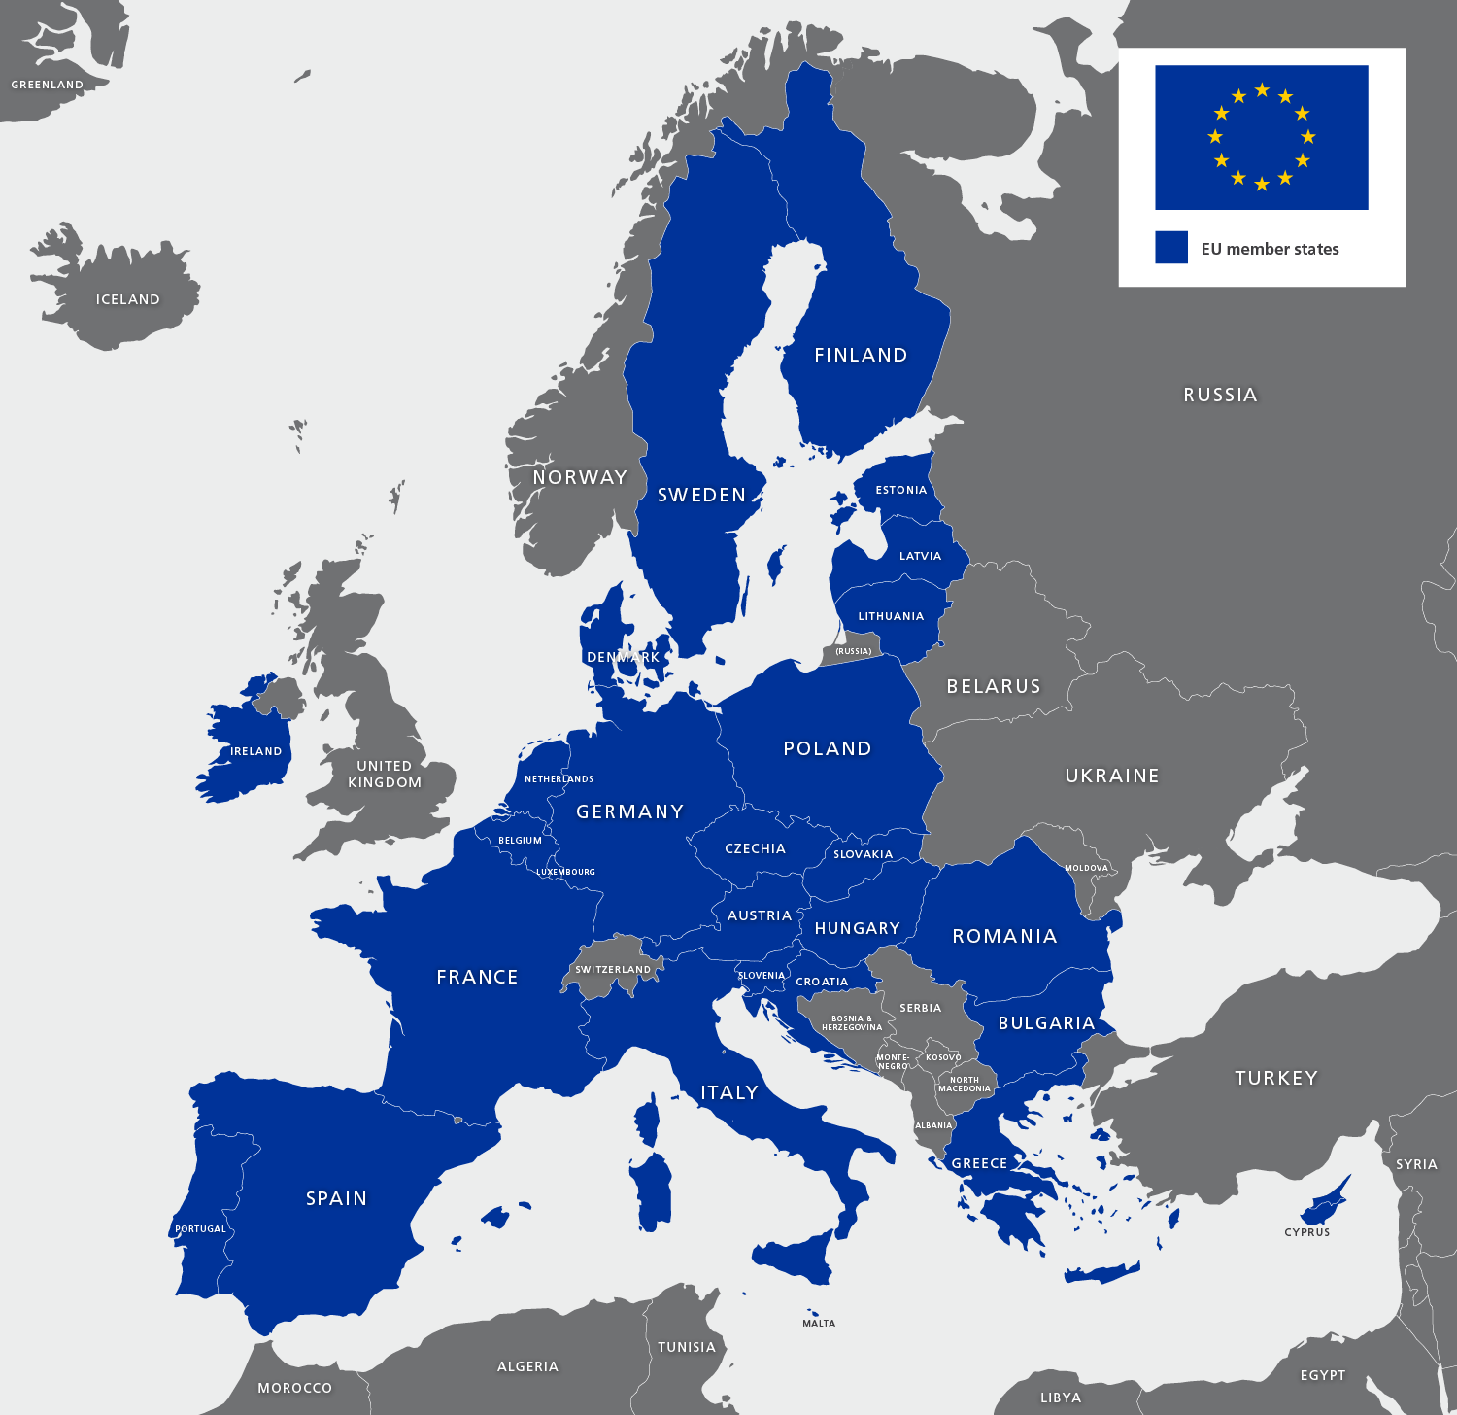
European
Union
2023

Slide 9
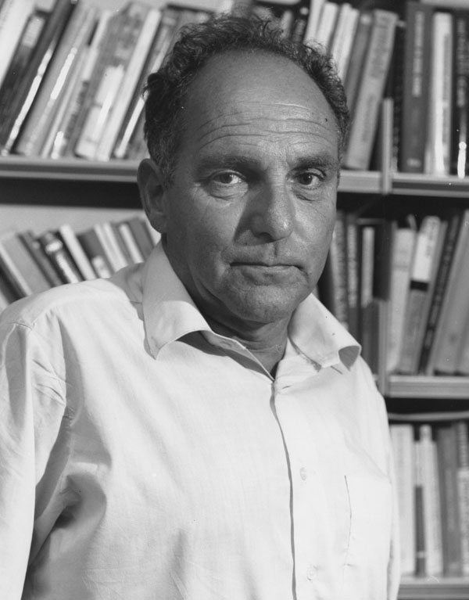
Ernest Gellner (1925 – 1995)
Nations and Nationalism (1983)
Modern forces inevitably have been working towards the confluence of political and cultural borders, towards merging political and cultural units.
Marriage between a state and culture

Slide 10
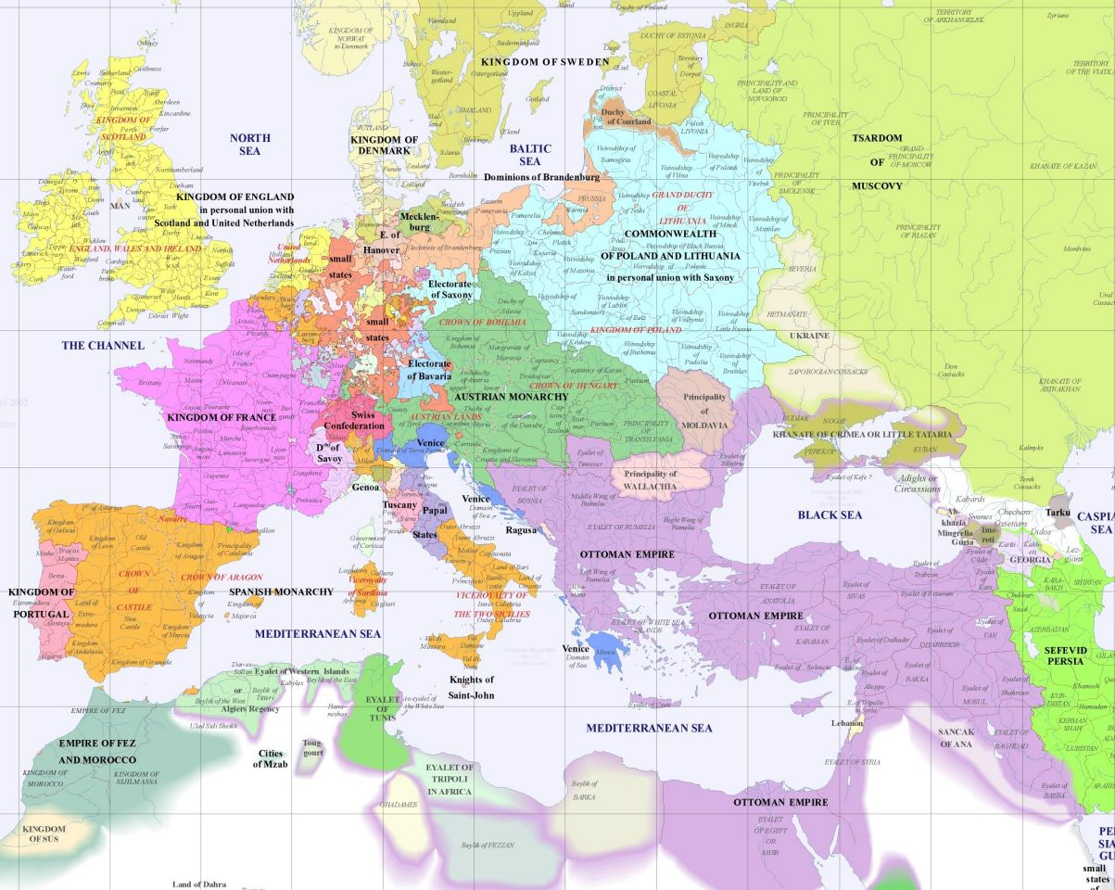
2 basic types of nation-forming processes in Europe (Europe 1700)
Integrated state-nation societies
{7 states} F, E, D, P, S, Sp., D
tradition of statehood
complete social structure (national elites)
tradition of literary language (language of administration & national elites)
Stateless societies
{more than 30 ethnic groups)
living within multiethnic states or empires
non-dominant ethnic groups

Slide 11
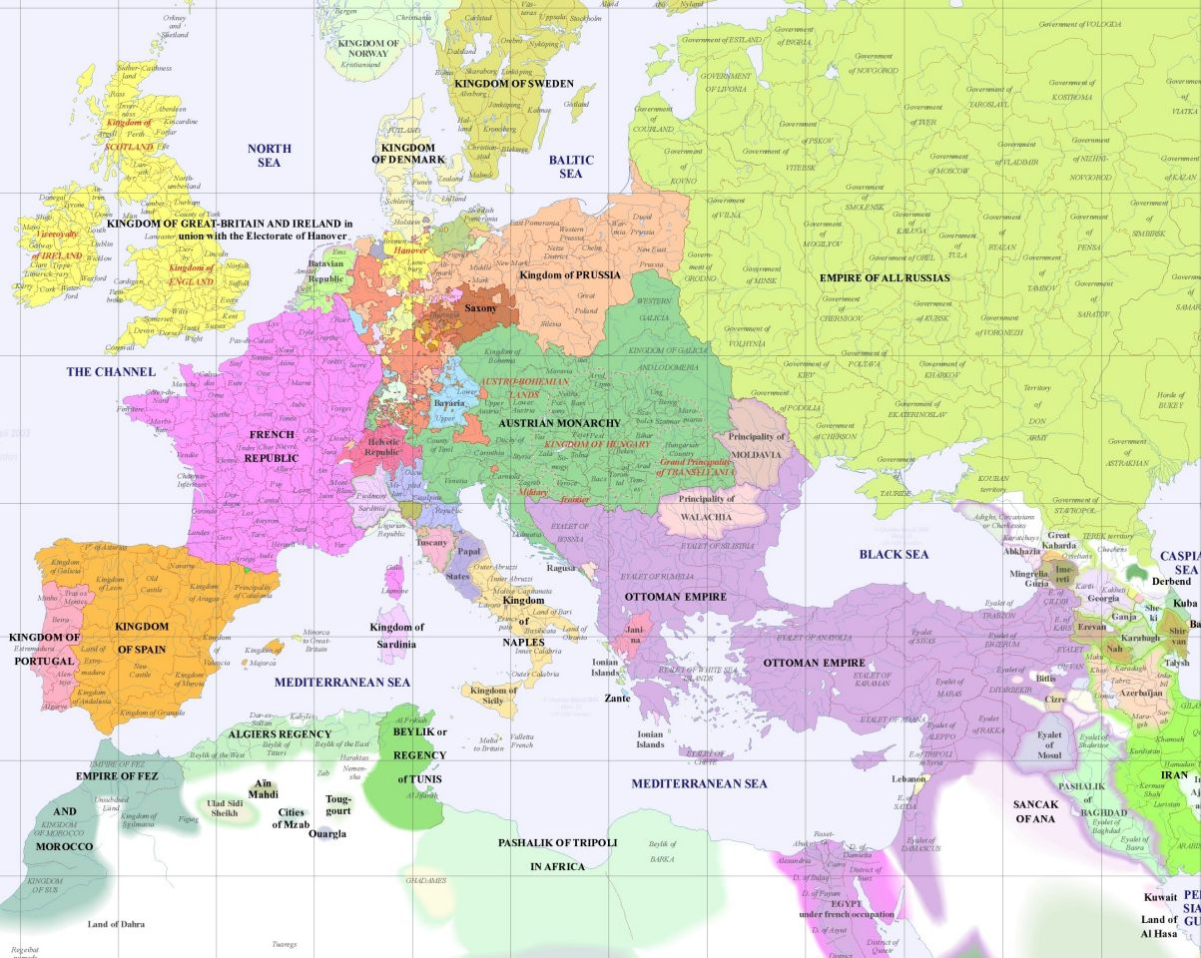
Gellner – 4 time zones (West – East direction)
„Modern forces inevitably have been working towards the confluence of political and cultural borders, towards merging political and cultural units.“
1st ZONE (Europe 1800)
Marriage of state and culture has been achieved during early modernity (age of enlightenment)
States survived from the Middle Ages
Continuity of independent statehood
7 states – politically and culturally integrated
The process of integration lasted centuries
Transformative state nationalism

Slide 12
2nd ZONE (Europe 1900)
Marriage of state and culture has been achieved in the second half of 19th century
Germany: 1871 Bismarc
Italy: Risorgimento – the period of liberation and political unification of Italy 1866/1870 (Mazzini, Garibaldi)
No state continuity but other preconditions existed - culturally integrated, political fragmentation, high culture
Integrative (ethnic) nationalism
Forerunner of 3rd ZONE:
Greece: independence war
1821-1829 (1832)
Bulgaria, Serbia, Romania 1878

Slide 13
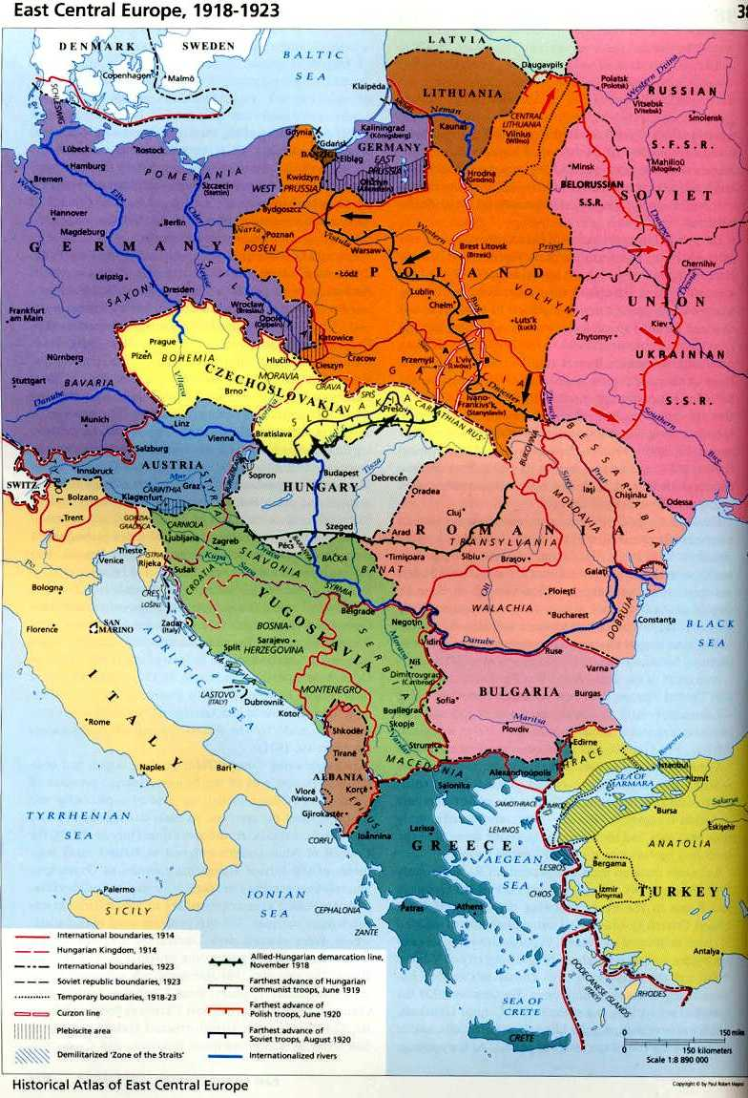
3rd ZONE (Europe 1918)
Political + cultural fragmentation, many dialects, it was not always obvious what was a new language and what was only regional dialects (Slavonic languages), linguistic lines were very blurred.
Many of these states became independent after 1st world war – principle of self-determination.
No statehood but remnant {partly remaining} and functioning institutions in multi-ethnic state {Habsburg Empire} – C, H, P, Norway
Disintegrative (ethnic) nationalism

Slide 14
4th ZONE (Europe 2000+)
No tradition of independent statehood at all {Slovakia, Slovenia, Finland, Estonia}
Orientation towards cultural/folklore history.
The spread of bolshevism repressed the national emancipation movements
USSR: Ukraine, Baltic States, Armenia, Georgia, etc.
Yugoslavia: Slovenia, Croatia, Monte Negro, Macedonia, Bosnia, Kosovo …
Czechoslovakia: Slovakia …

Slide 15
Stages of Transitions (Ernest Gellner)
Viennese situation (1815): 1. ZONE
Age of Irredentism: 2. ZONE
  GERMANY 1871, ITALY 1866, 1870 (RISORGIMENTO)
Versailles (Wilson) System: 3. ZONE
  1918, self-determination
Ethnic Cleansing: 4. ZONE
  1945/46, 1989 – 1992 (USSR, Czechoslovakia, Yugoslavia)
Attenuation (?)

