Slide 1
Gellner – 4 time zones (West – East direction)
„Modern forces inevitably have been working towards the confluence of political and cultural borders, towards merging political and cultural units.“
3 initial conditions of nation formation
Continuity of Independent Statehood
Dis-continuity of Independent Statehood
  (+ no/some remnant institutions)
No Tradition of Independent Statehood

Slide 2
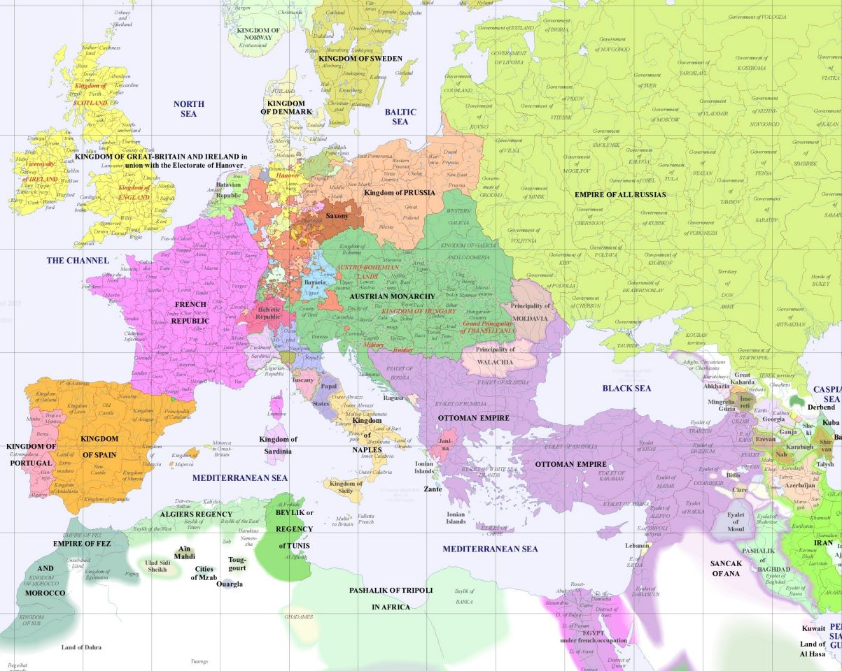
1st ZONE (Europe 1800)
Marriage of state and culture has been achieved during early modernity (age of enlightenment)
States survived from the Middle Ages
Continuity of independent statehood
7 states – politically and culturally integrated
The process of integration lasted centuries
Transformative state nationalism

Slide 3
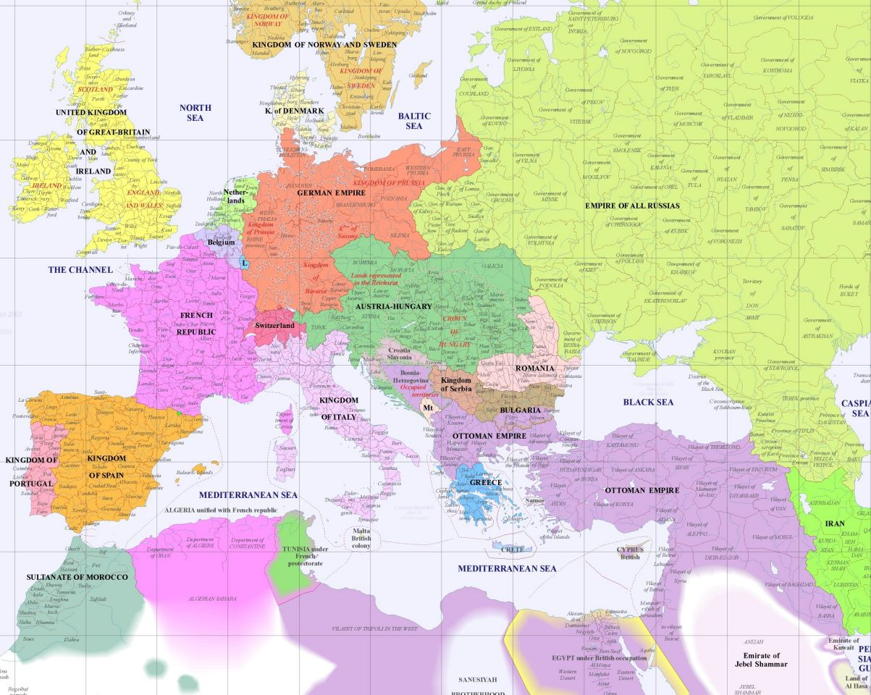
2nd ZONE (Europe 1900)
Marriage of state and culture has been achieved in the second half of 19th century
Germany: 1871 Bismarc
Italy: Risorgimento – the period of liberation and political unification of Italy 1866/1870 (Mazzini, Garibaldi)
No state continuity but other preconditions existed - culturally integrated, political fragmentation, high culture
Integrative (ethnic) nationalism
Forerunner of 3rd ZONE:
Greece: independence war
1821-1829 (1832)
Bulgaria, Serbia, Romania 1878

Slide 4
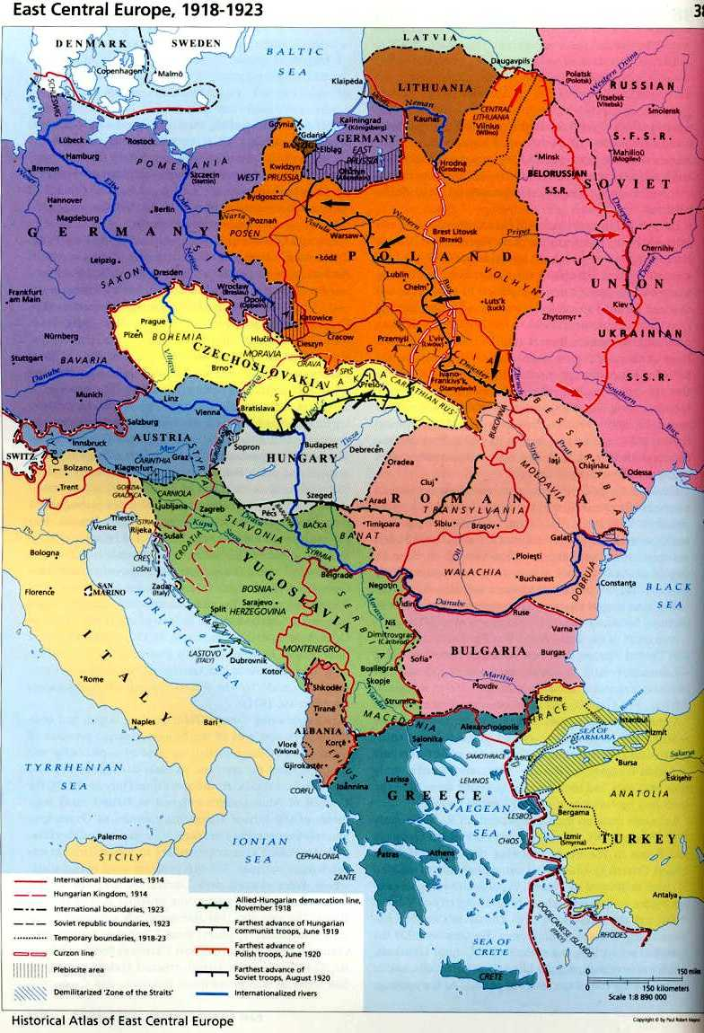
3rd ZONE (Europe 1918)
Many of these states became independent after 1st world war – principle of self-determination
Political + cultural fragmentation, many dialects, it was not always obvious what was a new language and what was only regional dialects (Slavonic languages), linguistic lines were very blurred… but GE – Czech linguistic border
No statehood but remnant {partly remaining} and functioning institutions in multi-ethnic state {Habsburg Empire} – Cz, Hu, Pl, Norway (1905)
Disintegrative (ethnic) nationalism

Slide 5
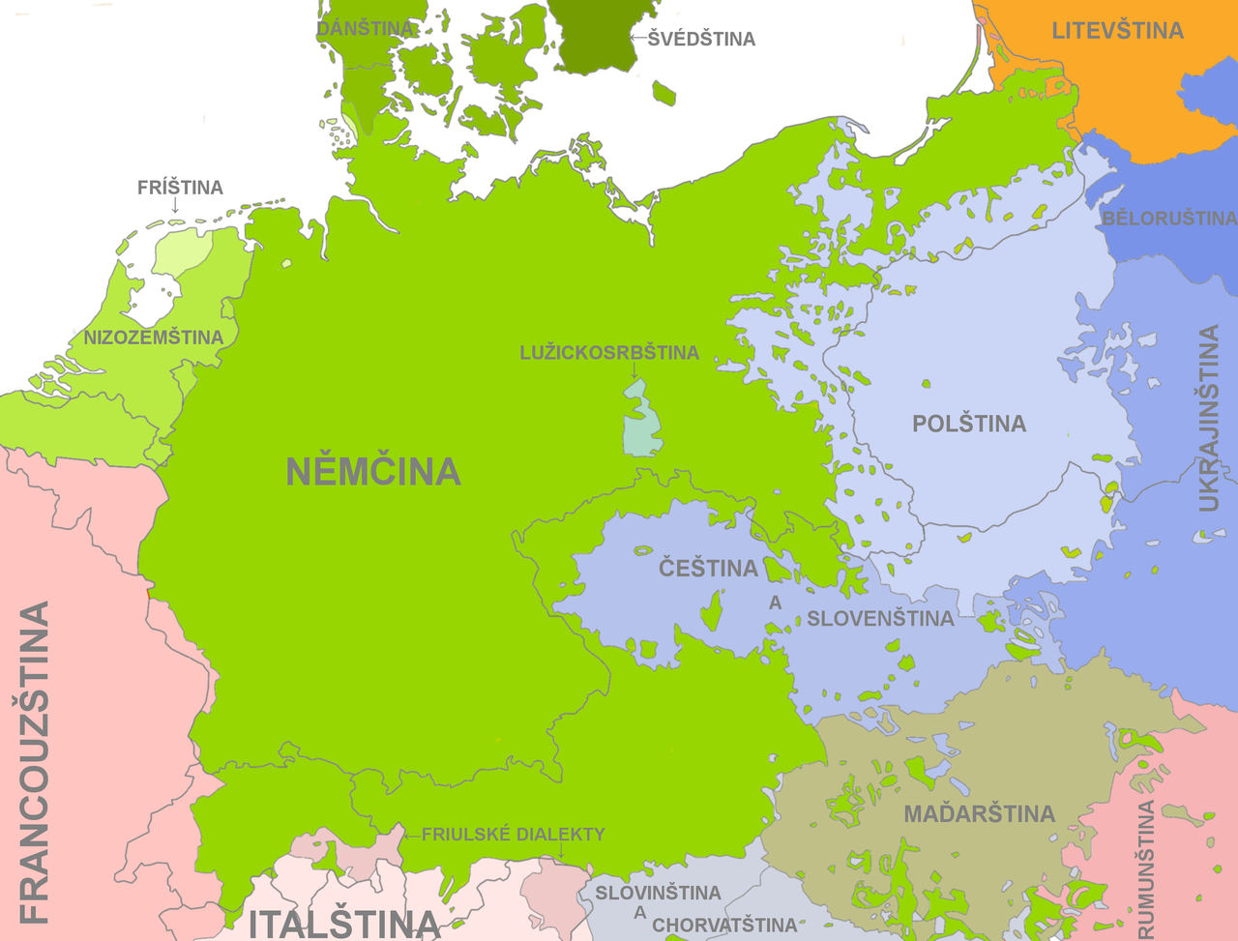
LANGUAGES BEFORE WWI

Slide 6
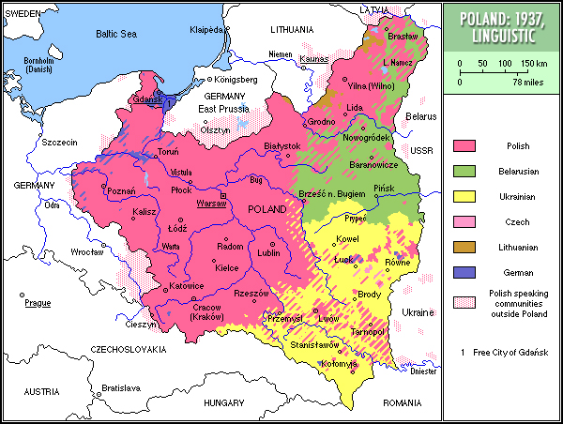

Slide 7
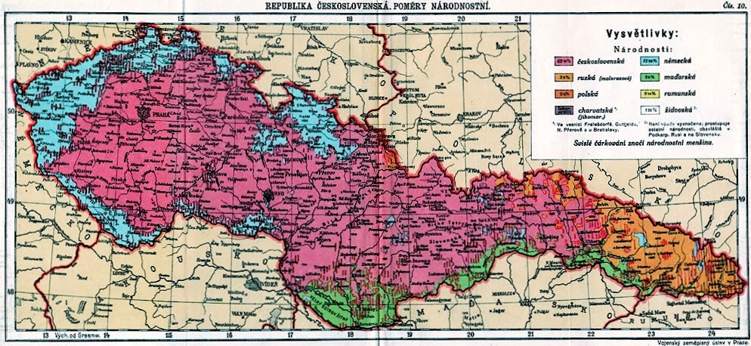

Slide 8
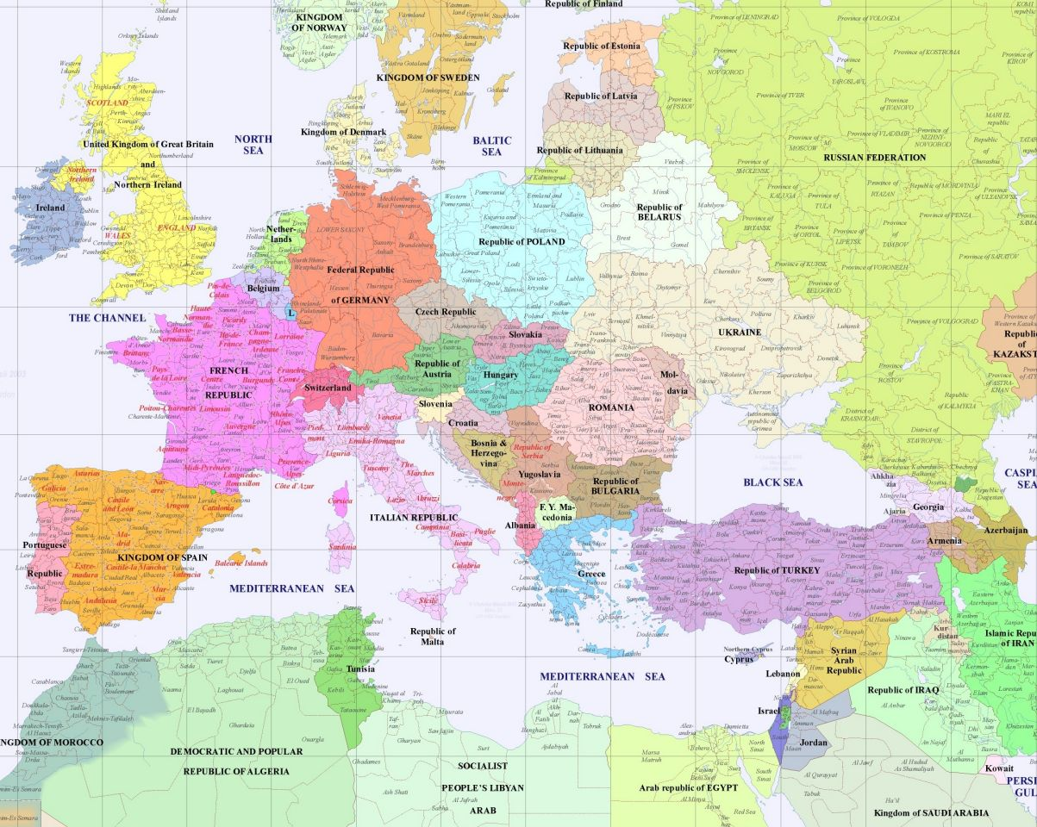
4th ZONE (Europe 2000+)
No tradition of independent statehood at all {Slovakia, Slovenia, Finland, Estonia}
Orientation towards cultural/folklore history.
The spread of bolshevism repressed the national emancipation movements
USSR: Ukraine, Baltic States, Armenia, Georgia, etc.
Yugoslavia: Slovenia, Croatia, Monte Negro, Macedonia, Bosnia, Kosovo …
Czechoslovakia: Slovakia …
Disintegrative (ethnic) nationalism

Slide 9
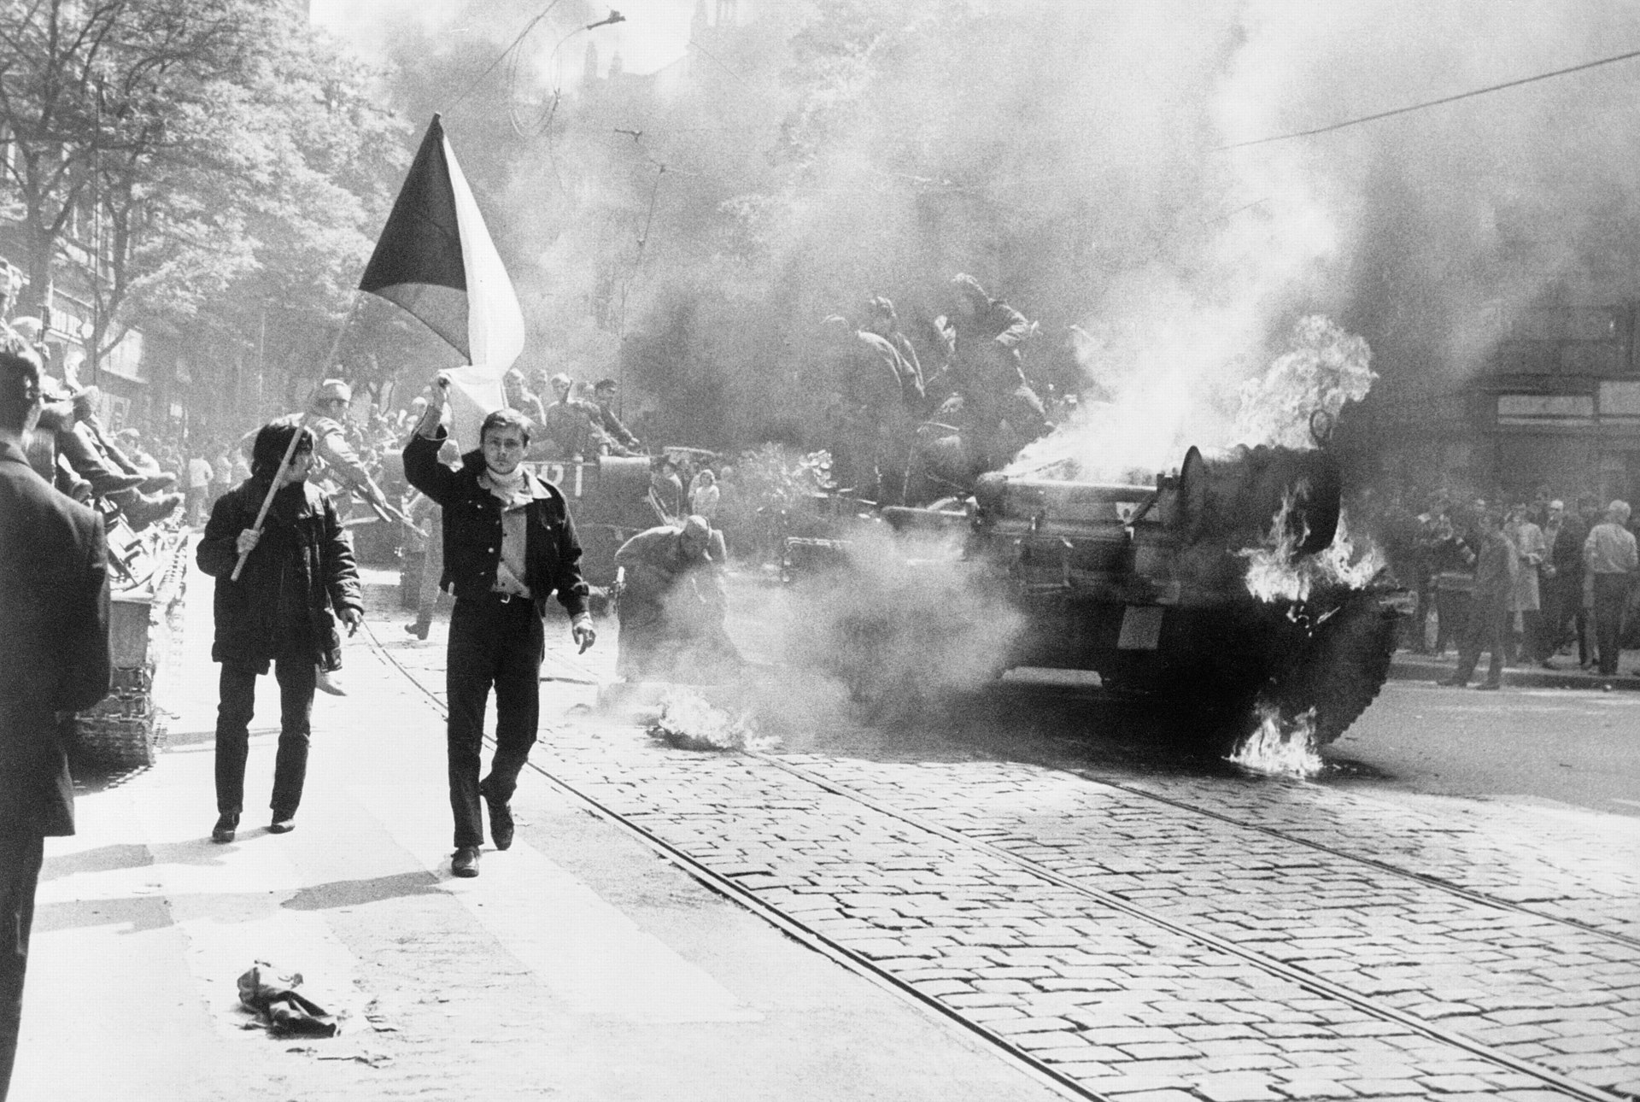
Central Europe: Fiction or Reality?
Turbulent Politics and Changing Borders

Slide 10
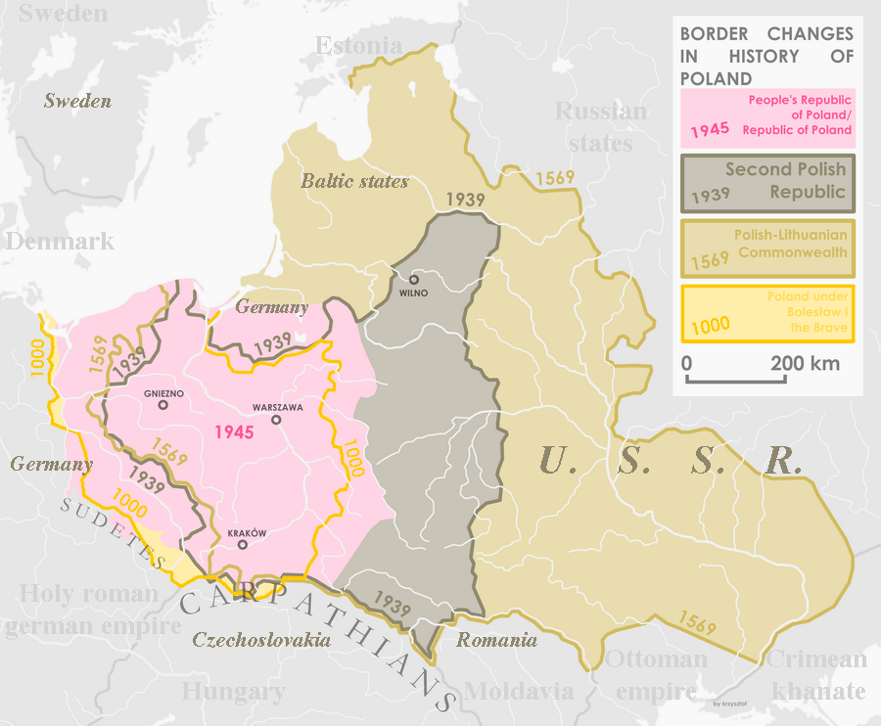

Slide 11
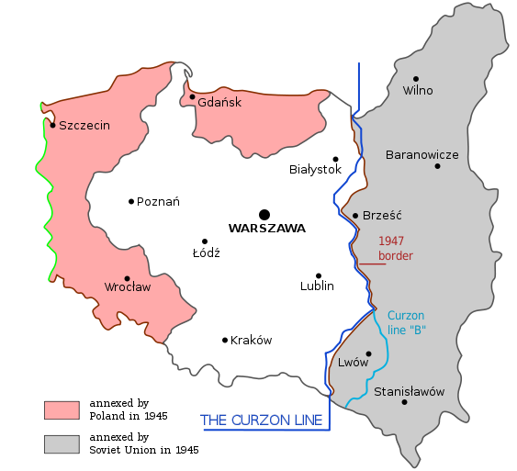

Slide 12
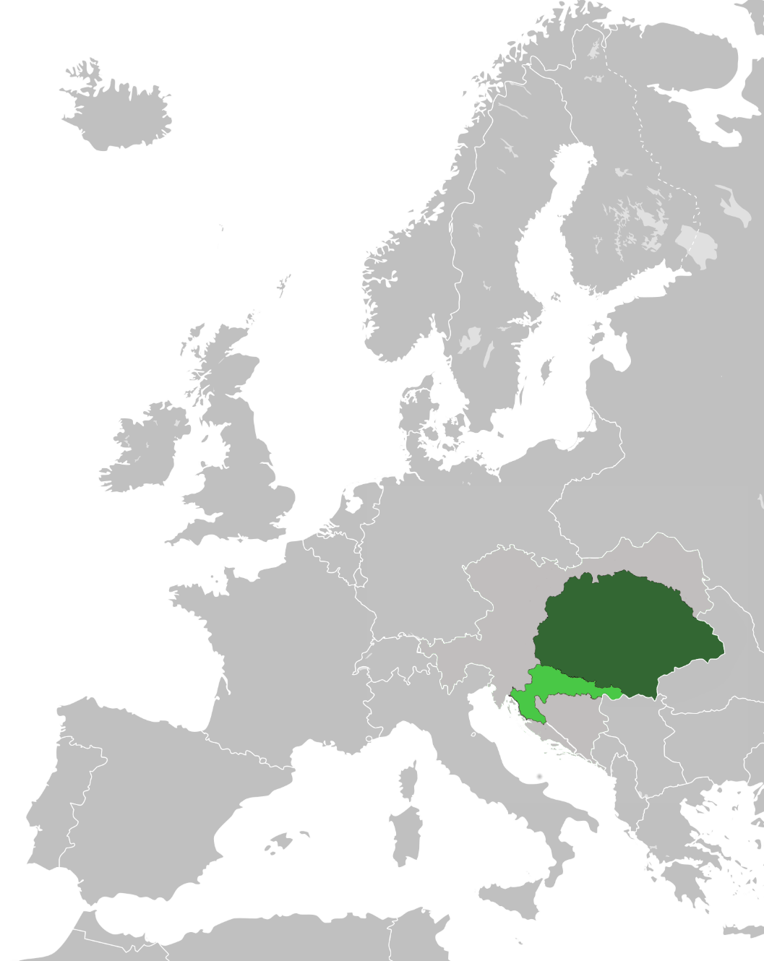
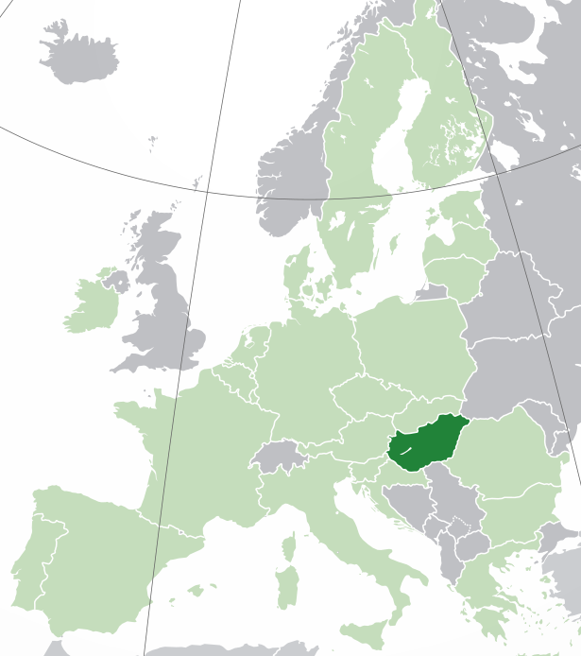
Hungary Prior 1918
Hungary Post 1918

Slide 13
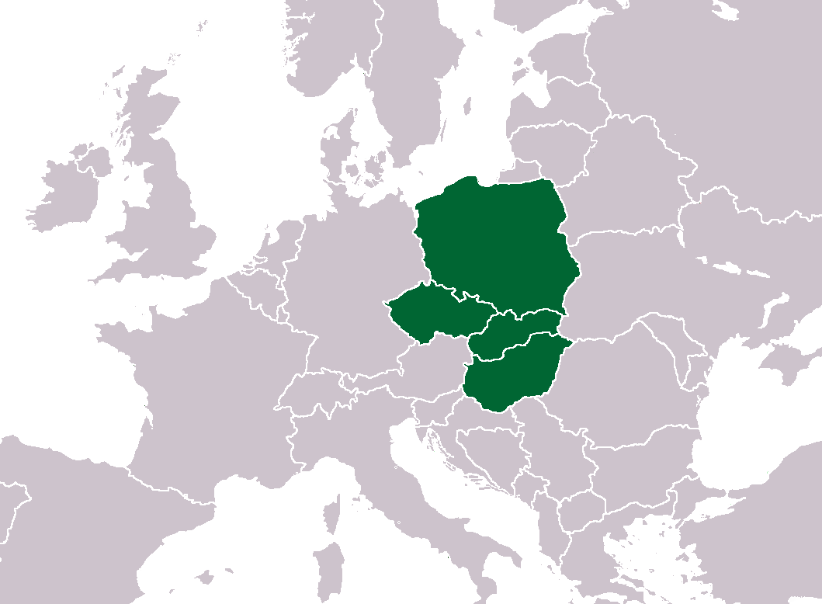
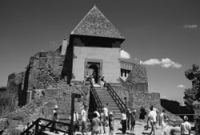
Visegrád Group 1991
Reference to the
Congress of 1335

Slide 14
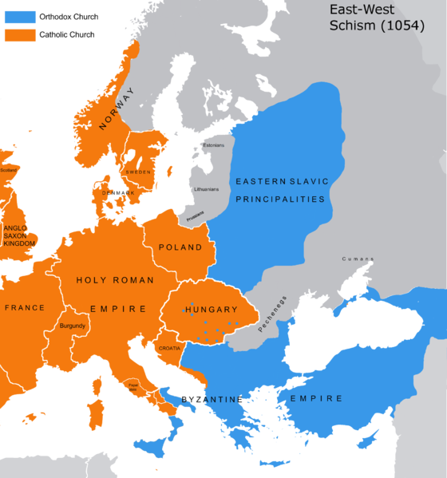
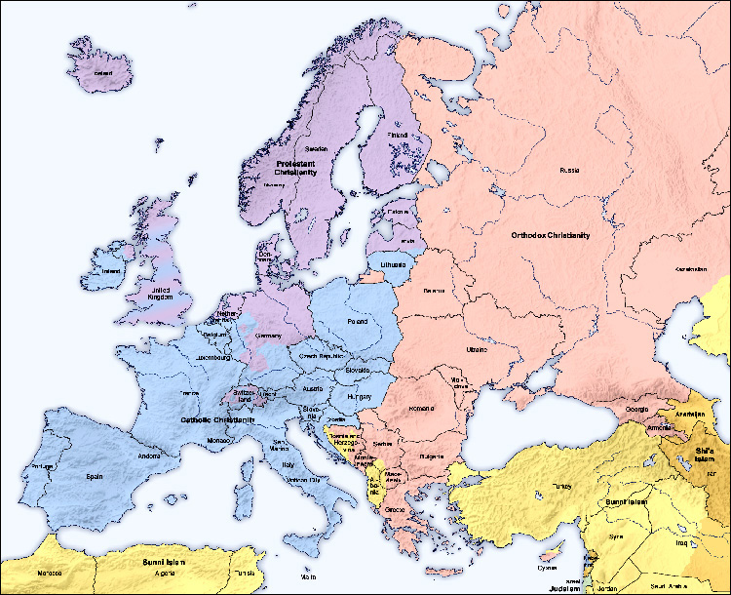

Slide 15
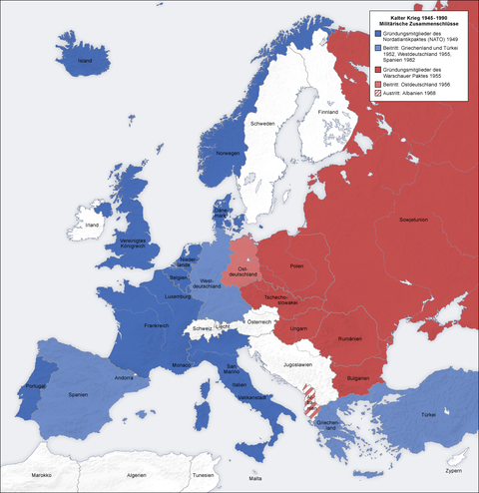
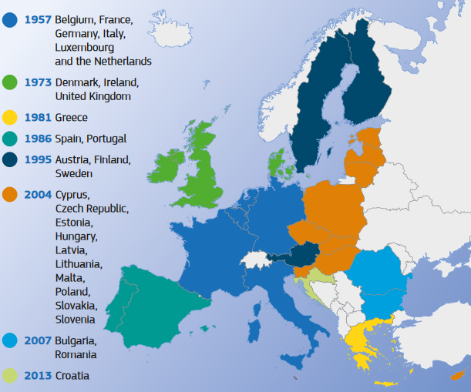

Slide 16
Post-communists Predicaments
Destruction of Public Sphere
Political Culture Consequences (political orientation/identities; no opposition; state as an enemy – us x them, disdain for political elites)
Social Consequence (fragmentation, anomy x conformity)
Adoration of Privacy
Fear, Intolerance, Distrust
Bonding Social Capital, Clientelism (Patronage)
Loss of Civic Virtues

Slide 17
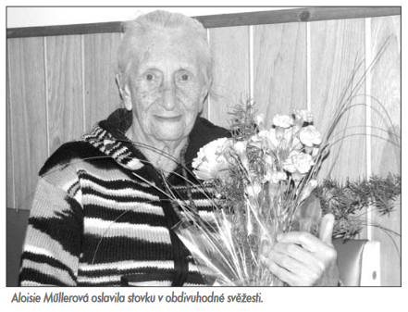
Aloisie Müllerová (*1909 – †2011)
Aloisie Sommerová (Ludvík Sommer, shopkeeper, her father died in the WWI)
1909 (born in Hapsburg Empire in Moravia)
1918 (10 years old – Czechoslovakia)
1938 (30 years old – 1st break up of Czechoslovakia)
1939 (Annexation – Protectorate Böhmen und Mahren)
1945 (36 year old – Renewal of Czechoslovakia)
1948 (Communist Coup)
1968 (60 years old – Prague Spring)
1989 (80 years old – Velvet Revolution)
1993 (2nd Break up Czechoslovakia)
2004 (95 years old, Czechia joined the EU)

Slide 18
Monarchism
WWI
Democracy
Fascism + WWII
Communism – Stalinism (Cult of Personality)
Communism – Socialism with Human Face
Democratic transformation
Break up of Czechoslovakia
European Union

Slide 19
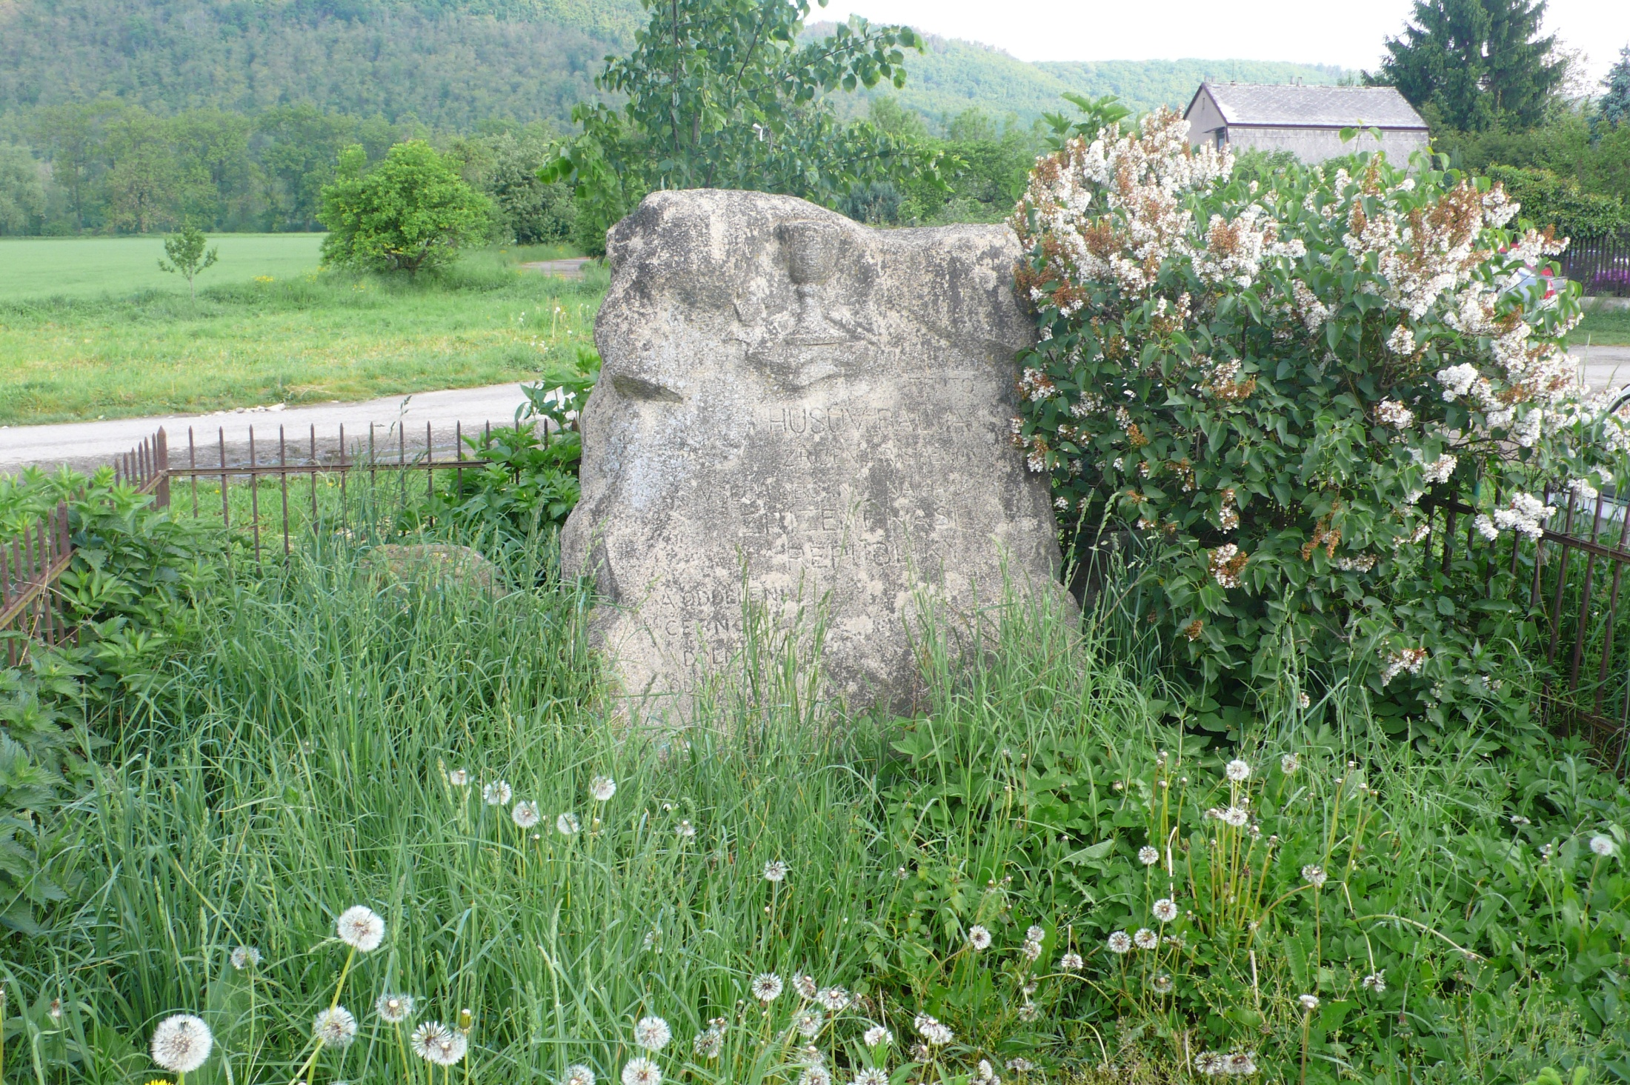

Slide 20
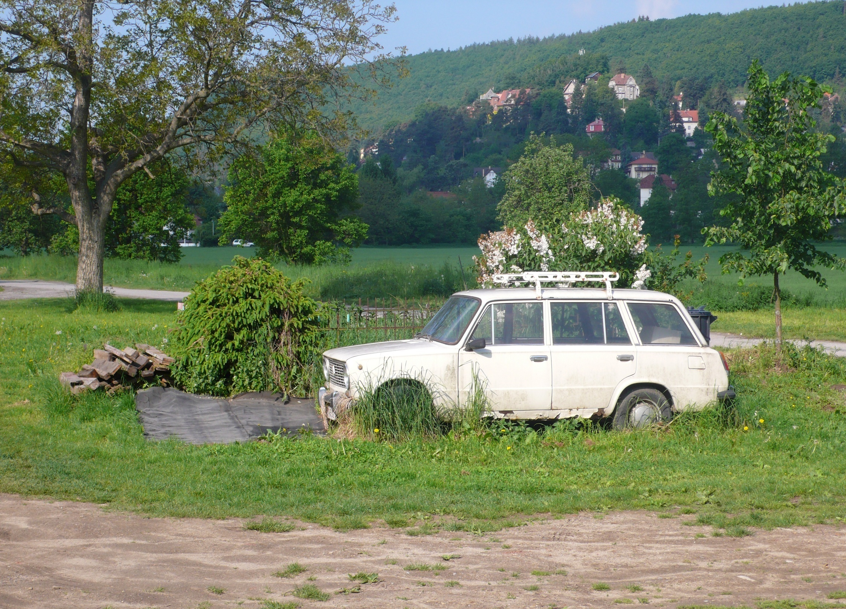

Slide 21
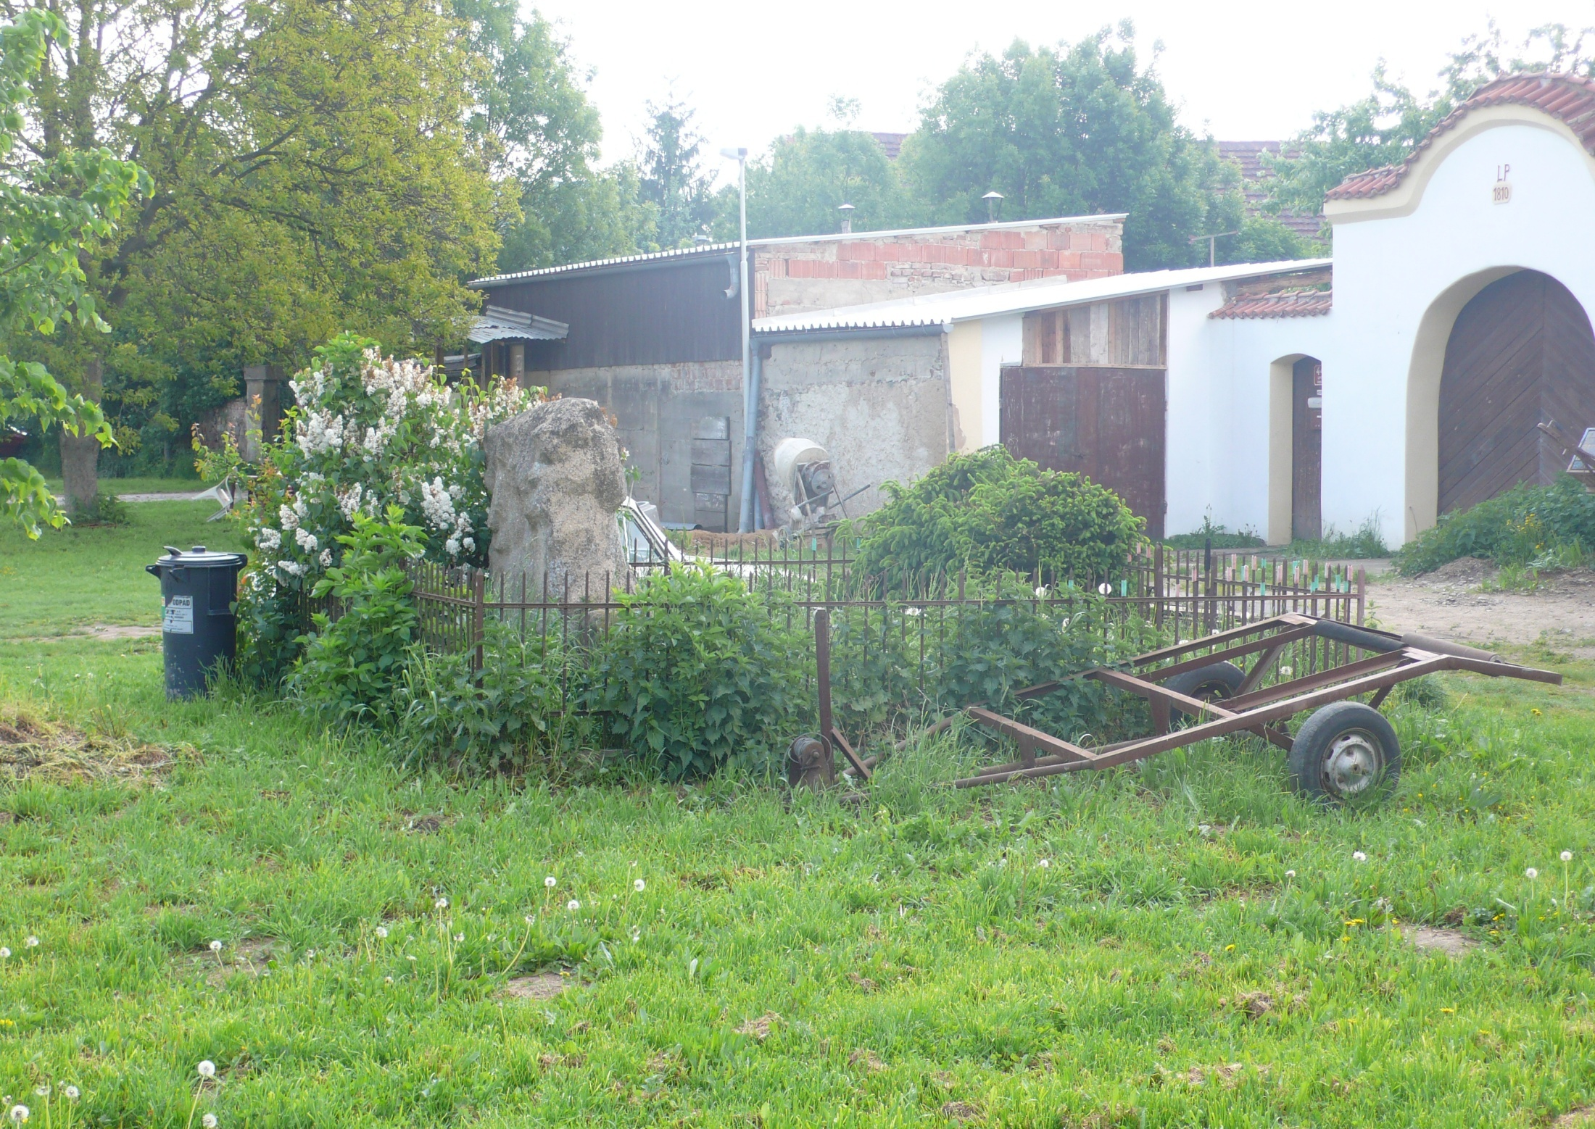

Slide 22
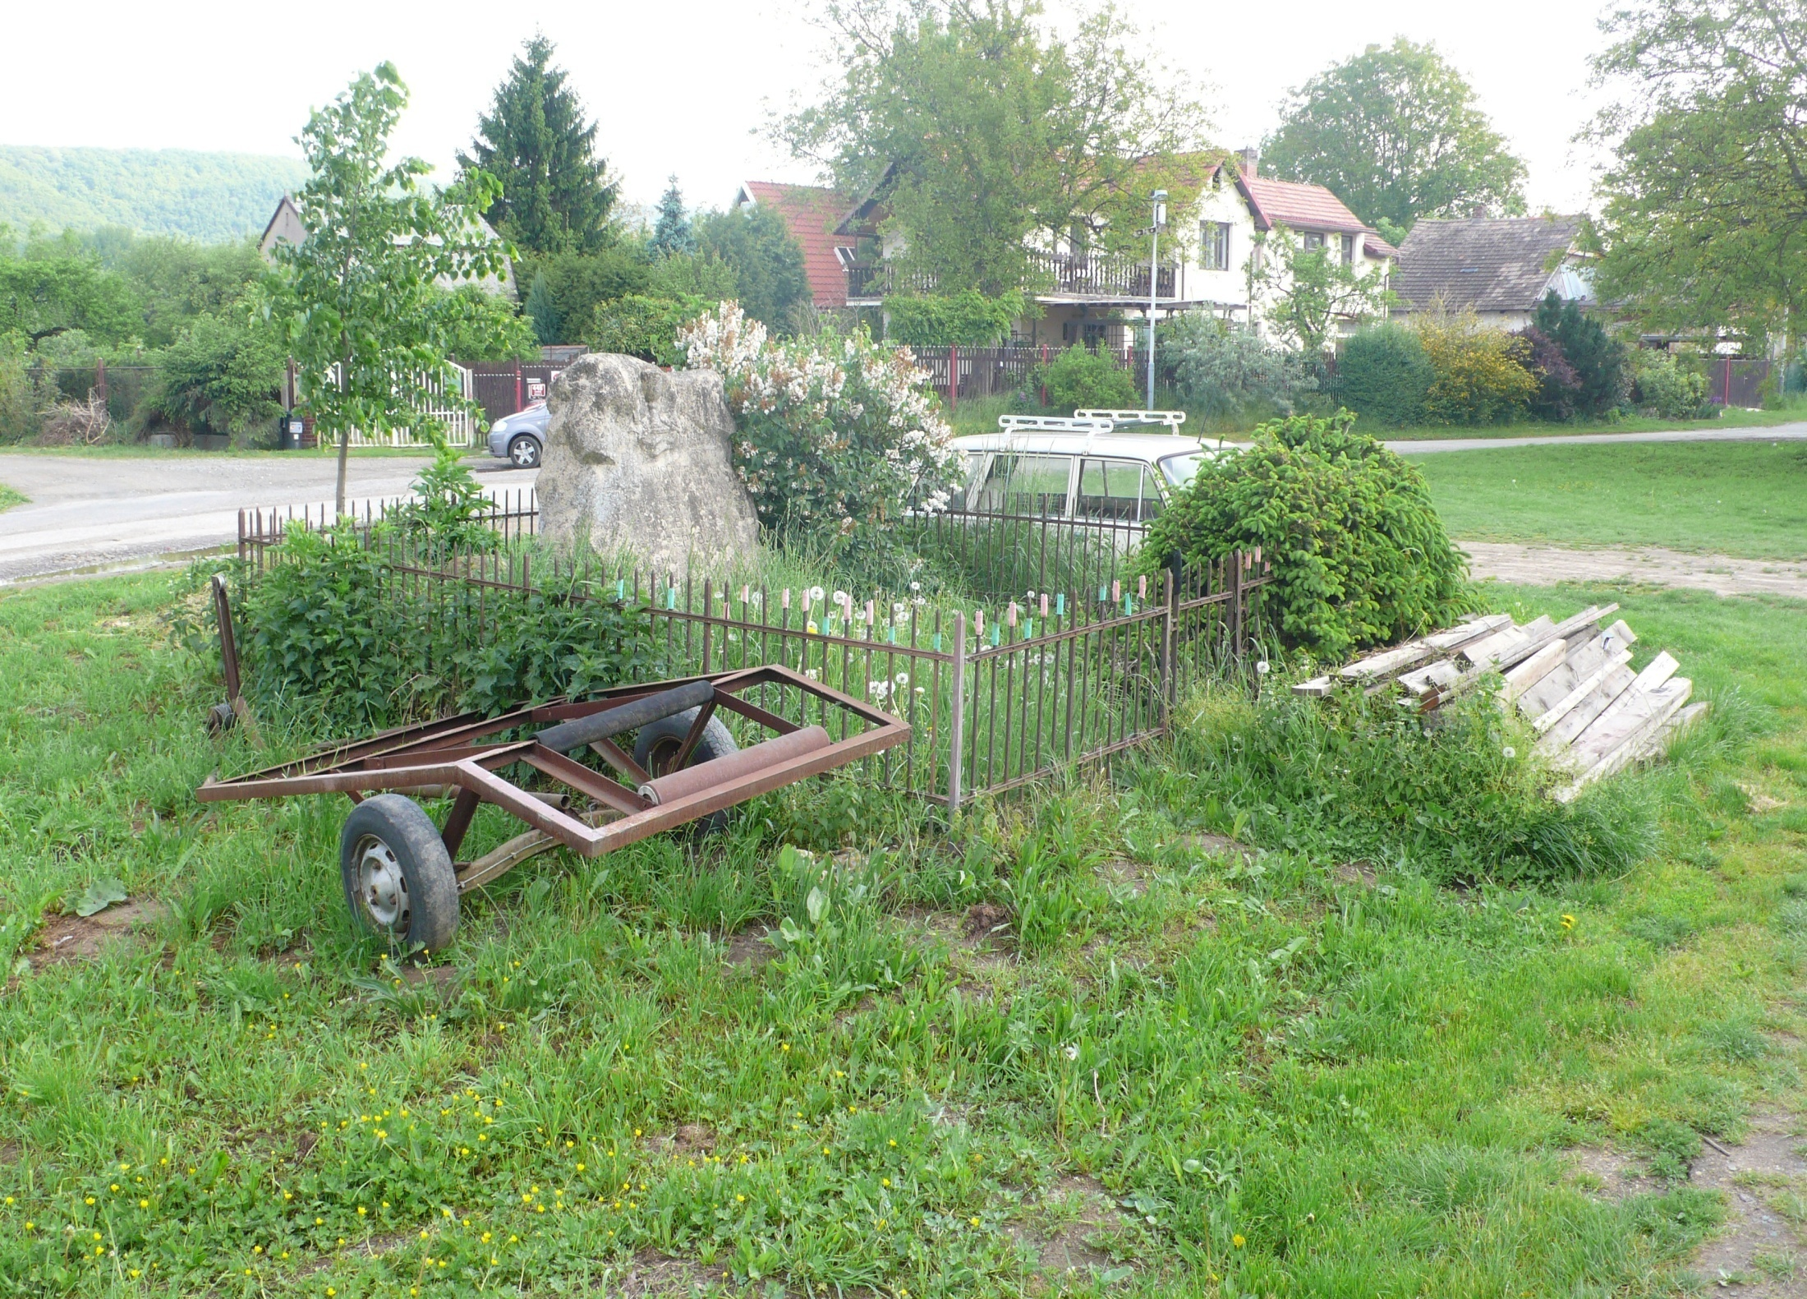



Slide 23
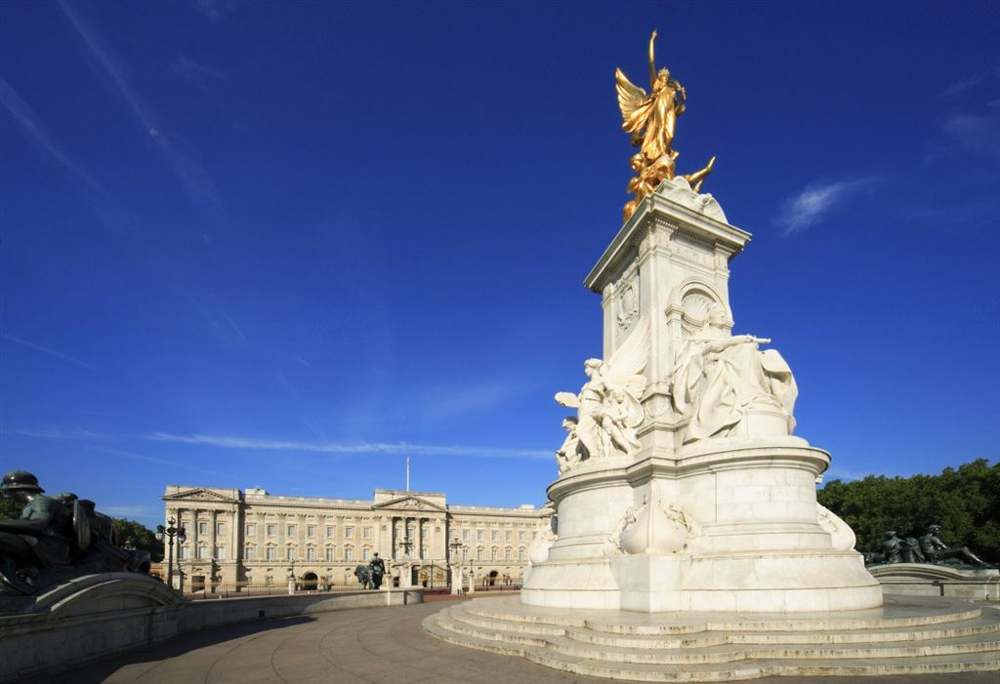
IMPERIAL Queen Victoria

Slide 24
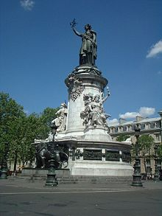
Place de la République Paris

Slide 25
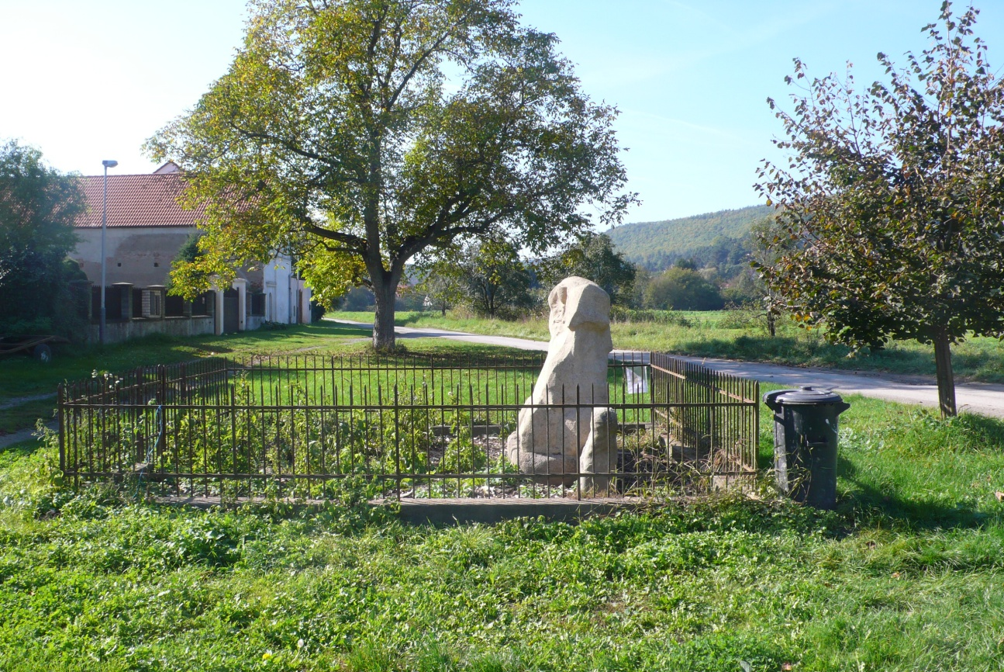

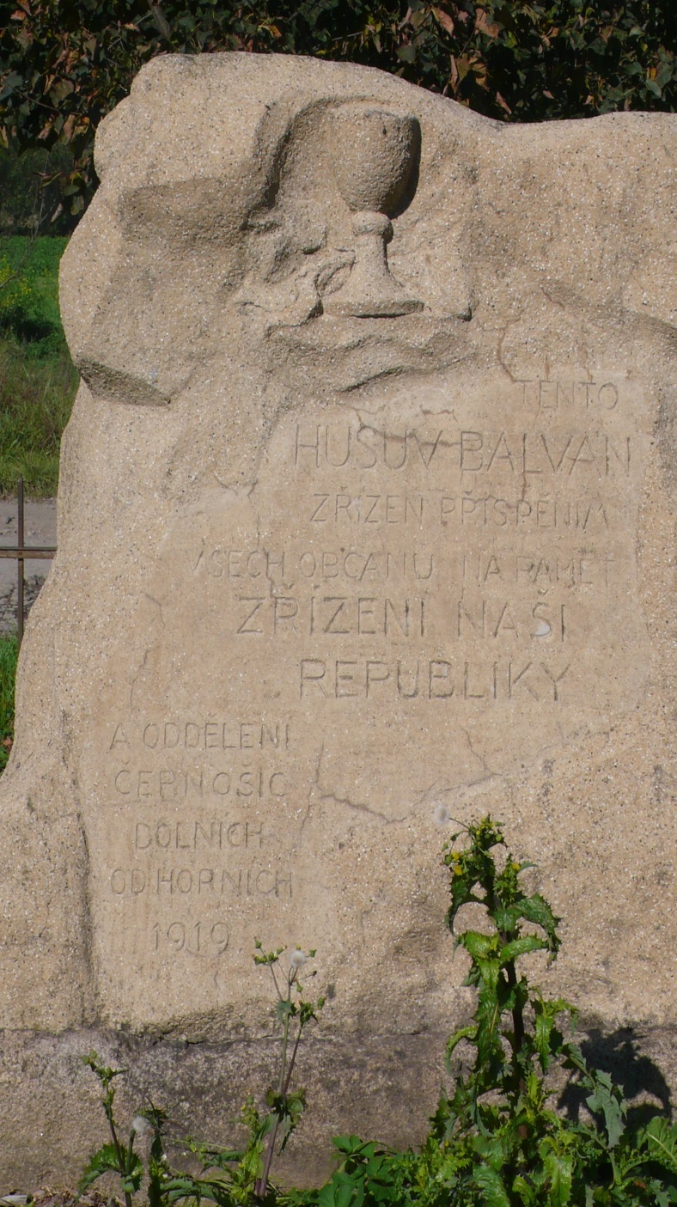
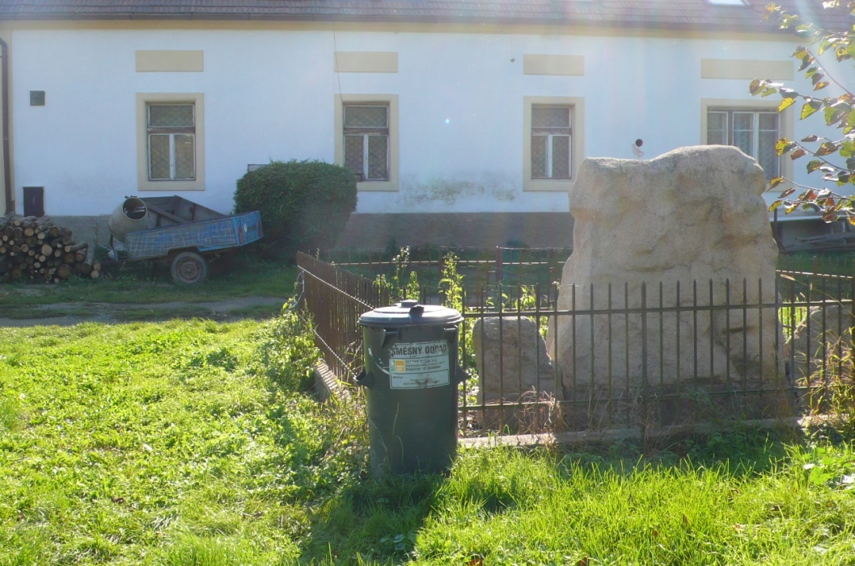
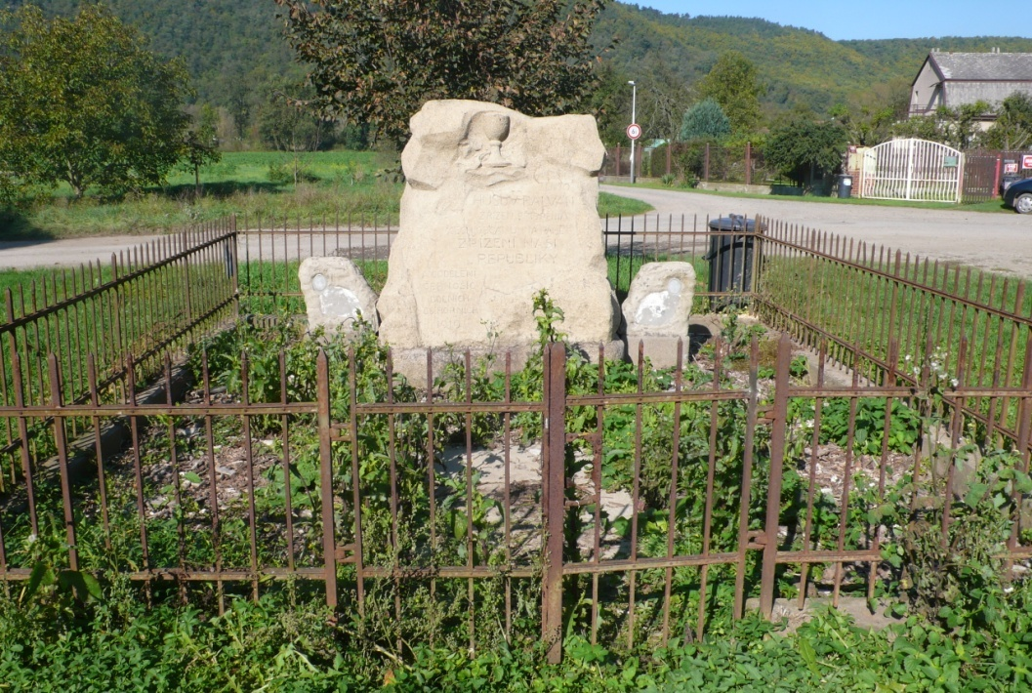

Slide 26
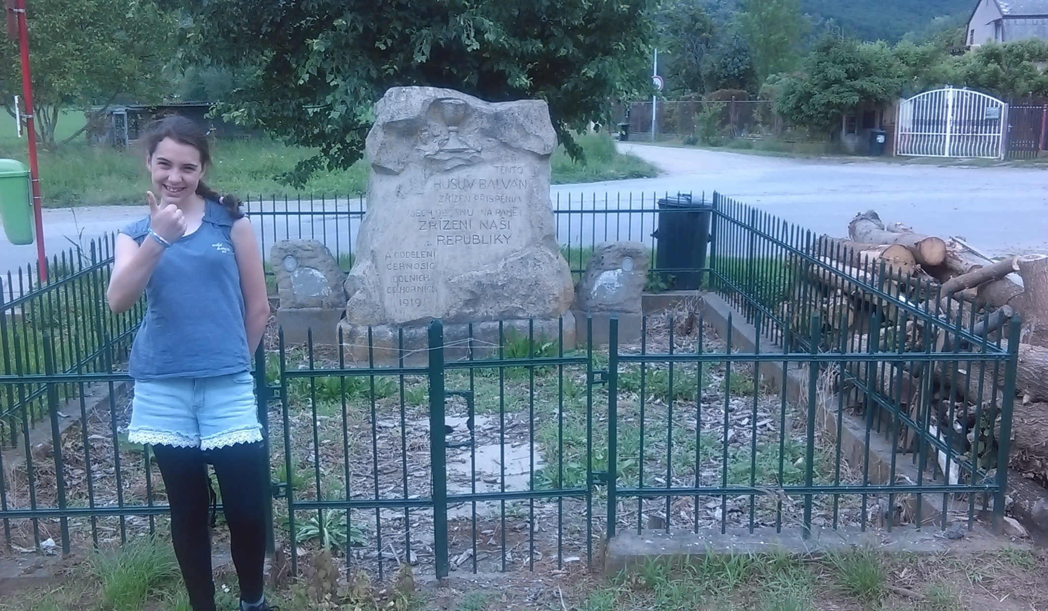

Slide 27
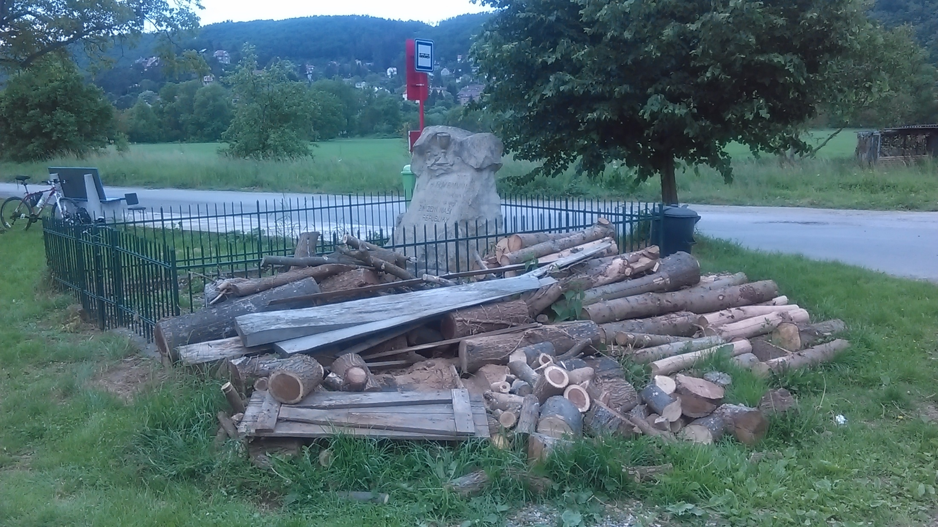

Slide 28
Central Europe? Summary
Peripheral but a solid part of the Western Christianity
Peripheral but a solid part of the Western Europe (until ?)
Legacy of Multiethnic Empires (Vienna, Berlin, Moscow)
Communist and Post-communist Legacy
  Including experience of transformation
  Destruction of public sphere, adoration of privacy
Open massive resistance against the Soviet rule
  East Germany 1953
  Hungary 1956
  Czechoslovakia 1968 (Prague Spring)
  Poland (1956, 1980 – Solidarity)

