Slide 1
Yugoslavian war and the aftermath
Diana-Valvanuz Villalva Sardón
Eric Cerdán Martínez
Laura Cárcamo Porres

Slide 2
Index
1
3
Introduction: Consolidation of Yugoslavia
Current relation between the new nations and the EU
2
4
Break up of Yugoslavia
Conclusion

Slide 3
5
References

Slide 4
Introduction: Consolidation of Yugoslavia
1

Slide 5
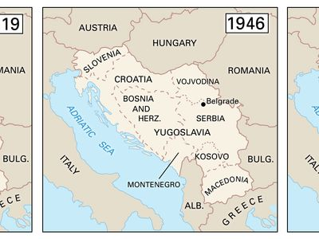
Origins : Introduction I
Yugoslavia was a federated country, situated in the west-central part of the Balkan Peninsula
It existed from 1918-2003
After WWI the Kingdoms of Serbs, Croats and Slovens formed an Alliance
Montenegro, Bosnia and Herzegovina were also former kingdoms

Slide 6
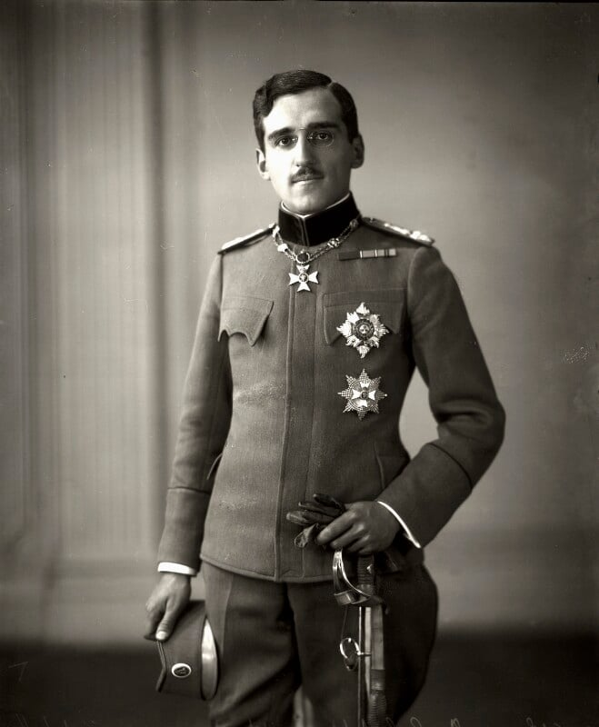
Origins : Introduction II
They main problem of this states was the ethnic and religious differences
Conflicts of interests and political manners of how to rule
The unitarist solution prevailed, and in the year 1921 a constitution was born establishing a highly centralized state, under the Serbian Karadjordjevic´ dynasty.
1929: royal dictatorship and new Kingdom of Yugoslavia
Croats: Federal structure
Serbs: unitary state

Slide 7
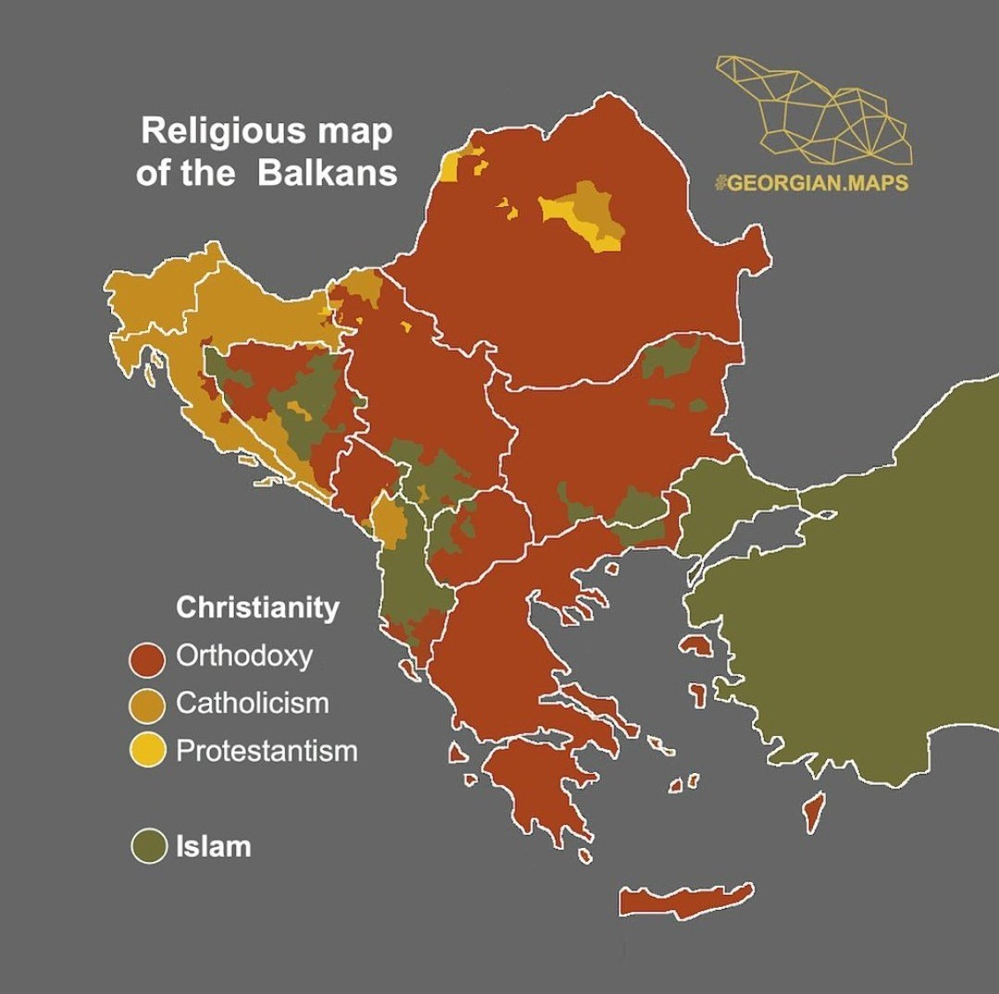
The Balkans: an explosive area
Bad manegement of their diversity
Three religions: catholicism, orthodox christians and muslims
Axis invation, along with some regimes, soviet control and finally the leadership of Joseph Broz Tito
1945: Federal People’s Republic
SFRY: Socialist Federal Republic of Yugoslavia
Slovenia, Croatia, Bosnia and Herzegovina, Montenegro, Macedonia and Serbia ( Vojvodina and Kosovo)

Slide 8
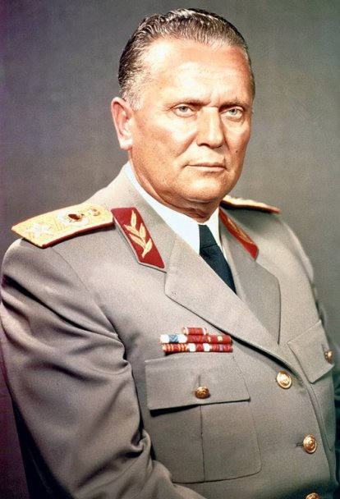
Joseph Broz Tito
President from 1953-1980
Supremum commander of the Yugoslav People’s Army
Introduced the Second Yugoslavia: socialist federation
Ideas: workers should manage the production and embodied the creation of the first worker’s council 1950
Descentralizing and liberal forces in Croatia and Serbia were purged
He established the “liberation committees, that made the Chetniks go isolated
He anexionated Istria and the Julian Alps
He promoted a non-communist government
Soviets broke their connection with his government

Slide 9
End of Yugoslavia
1989: Slobodan Milosevic abolished Kosovo’s autonomy by imposing a political regime and a nationalism ideology
He revoked the equality of rights by imposing majority voting, benefiting the serbs
Milosevic revoked the autonomies of Kosovo and Vojvodina
Slovenia and Croatia went independent
Bosnia war 1992: bosniak muslims, orthodox serbs and catholics croats fought against each other for 3 years
Masacre of muslims in Srebrenica 1995
Dayton Peace Agreement: gave the autonomies to Bosnia-Herzegovina
1997 Montenegro got its Independence
2003 Yugoslavia finally disolve

Slide 10
Break up of Yugoslavia
2

Slide 11
OVERVIEW OF THE BREAKUP OF YUGOSLAVIA
Roots of Breakup: Cultural, religious, and nationalist divisions set the stage for Yugoslavia's dissolution.
Triggers: Tito's death, constitutional changes, and the collapse of communism were pivotal events.
Milošević's Role: Slobodan Milošević exploited a weakened central state, using Serbian ultra-nationalism to gain control.
Declaration of Independence: Slovenia and Croatia declared independence in 1991, leading to conflicts.
Yugoslav Army's Intervention: Yugoslavia briefly intervened in Slovenia, confirming its separation.
Serb Minority in Croatia: The Serb minority in Croatia declared independence, sparking violence.
Bosnian War: Bosnia's declaration of independence in 1992 triggered a devastating war.
International Recognition: Croatia, Slovenia, and Bosnia gained international recognition.
Formation of New Yugoslavia: Serbia and Montenegro formed a new Yugoslavia, unrecognized globally.
Casualties in Bosnia: The Bosnian war resulted in a significant loss of lives.
Kosovo Conflict: Kosovo faced violence in 1998–1999, leading to NATO intervention.
Milošević's Ouster: Milošević lost power in 2001.
Kosovo's Independence: Kosovo declared independence in 2008, recognized by the US and many European states.

Slide 12
IMPORTANCE OF THE EUROPEAN UNION INVOLVEMENT IN THE BREAKUP OF YUGOSLAVIA. RECOGNITION AND DIPLOMACY. EU MEMBER STATES' RESPONSE TO DECLARATIONS OF INDEPENDENCE. DIPLOMATIC EFFORTS AND MEDIATION ATTEMPTS.
Breakup of Yugoslavia fueled by cultural, religious, and nationalist tensions.
Slobodan Milošević exploited divisions to consolidate power.
Conflicts in Slovenia, Croatia, and Bosnia led to declarations of independence and a devastating war.
EU responded with sanctions, including an oil embargo and trade restrictions, to pressure Yugoslavia.
Post-war, EU adopted a multifaceted approach for stability, reconstruction, and fostering good relations.
Initiatives like the Stability Pact and Stabilization and Association Agreements incentivized reforms.
EU's commitment to the region evident in regular assessments, pre-accession assistance, and membership prospects.
Thessaloniki summit in 2003 marked a significant step with a clear reference to potential EU membership for Balkan countries.
EU's role evolved from crisis response to a comprehensive strategy for stability and integration in the Balkans.

Slide 13
PRE-BREAKUP RELATIONS. INITIAL RELATIONSHIP BETWEEN YUGOSLAVIA AND THE EUROPEAN UNION
Yugoslavia, the first socialist state to engage with the EEC (later EU), didn't achieve full EEC membership.
The Yugoslav dissolution in the early '90s led to EU guilt for failing to prevent a humanitarian crisis.
The crisis prompted the EU to establish the Common Foreign and Security Policy.
Pre-conflict, Yugoslavia was a major EEC trade partner with duty exemptions for industrial imports.
Post-war, the EU focused on Balkan stability, providing aid, and motivating reforms for potential membership.

Slide 14
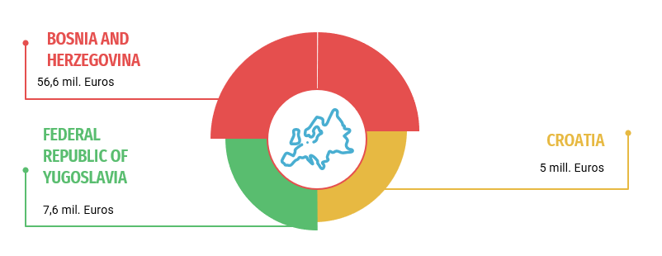
ECONOMIC AND HUMANITARIAN AID. EU'S ECONOMIC ASSISTANCE AND HUMANITARIAN AID AFTER THE CONFLICT
In 2000, the European Commission, via ECHO, provided €69 million in humanitarian aid for the Yugoslavian conflict.
The aid targeted Bosnia and Herzegovina (€56.5 million), Former Federal Republic of Yugoslavia (€7.6 million), and Croatia (€5 million).
Efforts focused on aiding refugee return, providing tools for home repair, and supporting income generation.
ECHO aimed to address primary needs, facilitate return, and seek permanent solutions for refugees.
The aid also extended to the health sector, food assistance, and social support in Bosnia and Herzegovina.

Slide 15
THE POST-WAR EU’S POLICY TO THE BALKAN STATES: INSTRUMENTS AND FRAMEWORK
The EU's post-war policy towards the Balkans, notably Croatia, Slovenia, Bosnia and Herzegovina, and Serbia, has been more effective in shaping political and economic developments.
Diplomatic and developmental efforts have been pivotal in implementing peace processes, aiding state-building, and supporting reconstruction in the former Yugoslav states.
The Royaumont Process, initiated after the Dayton Agreement, focused on regional challenges, offering financial and technical support conditional on good neighborliness.
Recognizing deficiencies, the EU introduced the 'Stability Pact for South Eastern Europe,' addressing concerns of social, political, and economic instability.
The pact, along with other instruments, provided a specific and comprehensive approach, offering membership commitments akin to successful models for Central and Eastern European Countries.
The EU's enlargement strategies, combined with economic influence, incentivized Balkan states to undertake necessary reforms and diplomatically resolve bilateral issues.
The EU's multifaceted approach has significantly influenced the domestic and foreign policies of the Balkan region, fostering progress and stability.

Slide 16
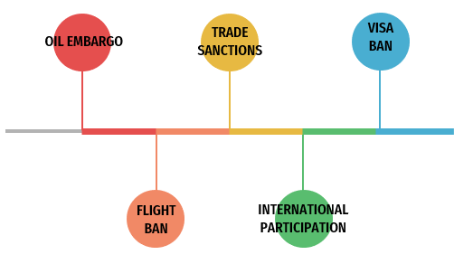
SANCTIONS OF THE EU IN YUGOSLAVIA
Oil Embargo: Initiated on May 1, 1999, by the EU to counter Yugoslav government violations and repression.
Trade Sanctions: Imposed since 1992, lifted in 1995, with an "outer wall" restricting access to funding and finance.
Visa Ban: Enforced from June 1, 1999, targeting 800 associates of Milošević, aligned with the U.S. visa ban.
Flight Ban: Implemented on May 10, 1999, excluding Kosovo and Montenegro, suspended a year later.
International Participation: Fourteen non-EU nations adopted the sanctions regime, and on October 9, 2000, EU Foreign Ministers considered easing trade and financial sanctions, excluding those against Milošević and associates.

Slide 17
Current relation between the new nations and the EU
3

Slide 18
Copenhagen criteria
1
2
3
4
Institutions that ensure democracy
Rule of law, human rights and minority protection
Operational economic market capable of navigating competition and market dynamics
Capability to adopt and efficiently implement membership obligations

Slide 19
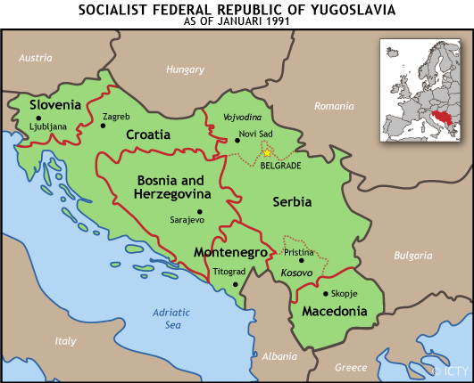
icty.org

Slide 20
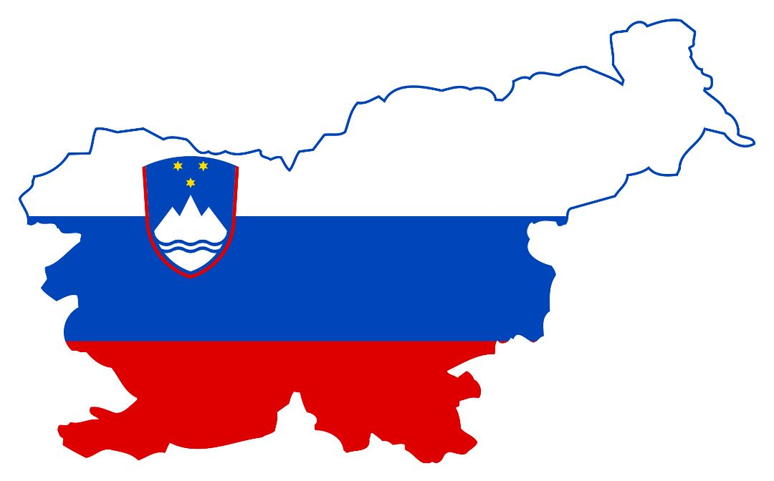
Slovenia
Process started in 1996
European Union in May 2004
Eurozone in 2007
60%
The Moon is a satellite

Slide 21
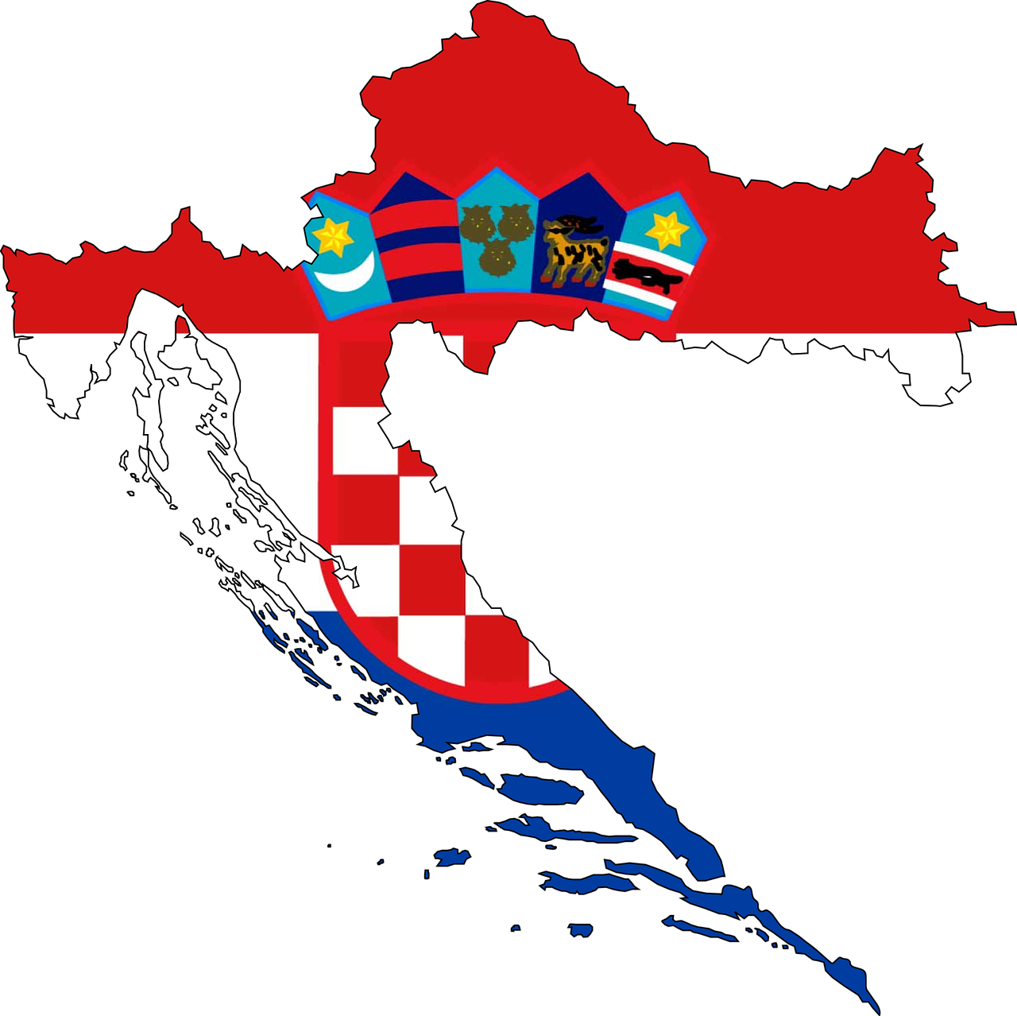
Croatia
More problems: distrust, economic issues, etc…
President Franjo Tudjman
Applied 2003
Accession negotiations in 2005
European Union in July 2013
60%
The Moon is a satellite

Slide 22
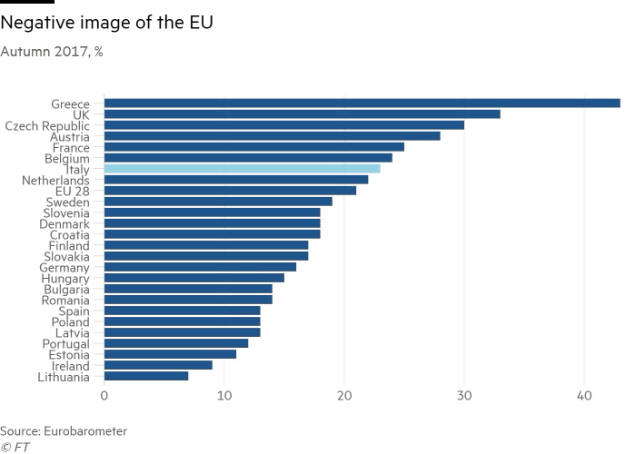

Slide 23
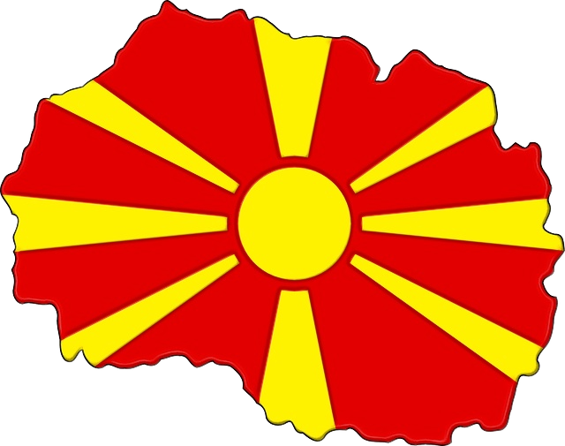
North Macedonia
Stabilization and Association Agreement (SAA) in 2005
Independence without violence
Disputes with Greece
Accession negotiations in 2020
Still in process due to disparities
60%
The Moon is a satellite

Slide 24
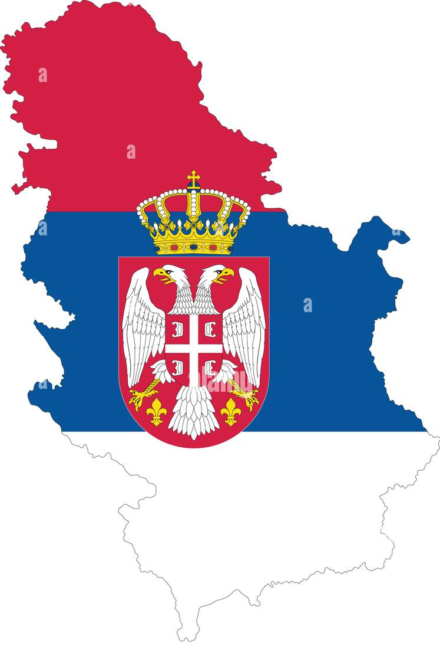
Serbia
Tried to keep Yugoslavia together
Public Opinion divided
Accession negotiations in 2014
Stabilization and Association Agreement (SAA) in 2012
60%
The Moon is a satellite

Slide 25
Kosovo
Independence in 2008
SAA in 2015
Not recognized by Spain, Cyprus, Greece, Slovakia and Romania
60%
The Moon is a satellite

Slide 26
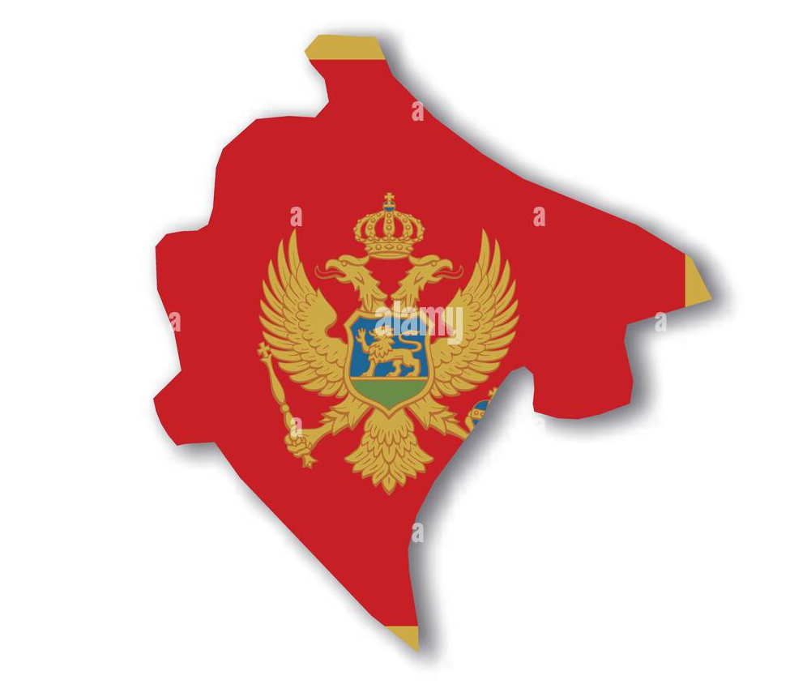
Montenegro
Independence in 2006
Applied in 2008
Started Accession Process as well
60%
The Moon is a satellite

Slide 27
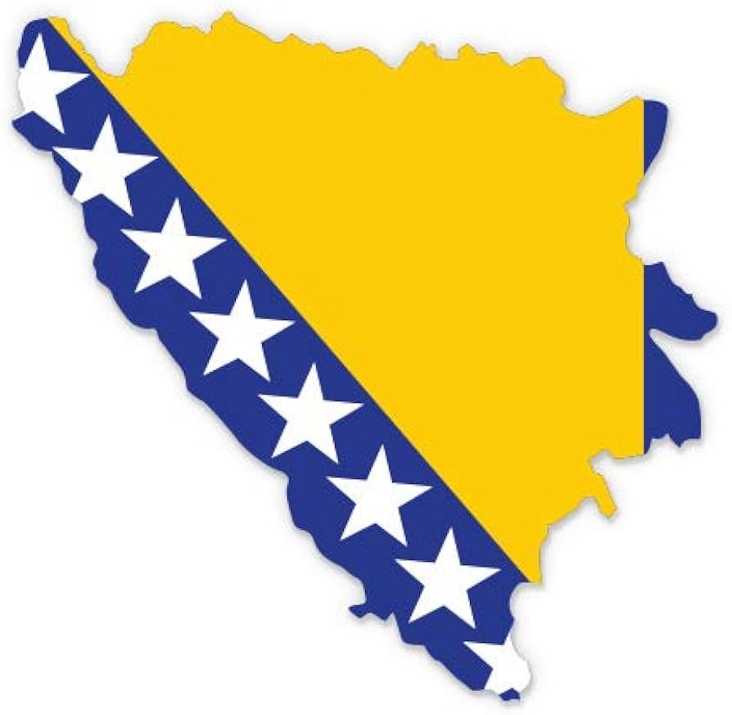
Bosnia-Herzegovina
SAA in 2008
Complex political system
A lot of ethnics = consensus
60%
The Moon is a satellite

Slide 28
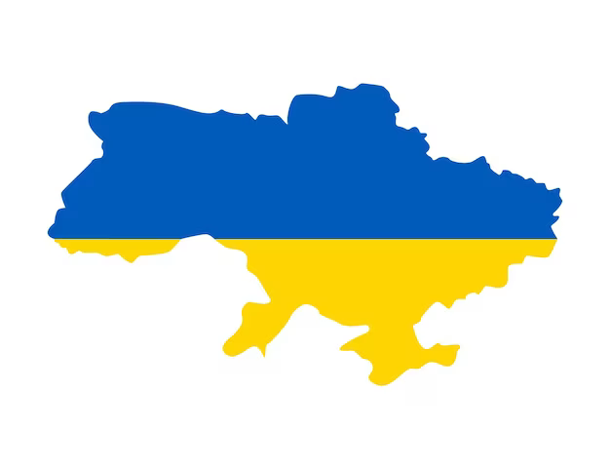
Why is it different with Ukraine?
VS.
60%
The Moon is a satellite
EU was not so developed
More involved IIOO

Slide 29
Conclusion
4

Slide 30
References
5

Slide 31
References
Conditions for membership. (2012, 6 junio). European Neighbourhood Policy and Enlargement Negotiations (DG NEAR). https://neighbourhood-enlargement.ec.europa.eu/enlargement-policy/conditions-membership_en
Papić, Ž. (1994). Nationalism, patriarchy and war in ex-Yugoslavia. Women’s History Review, 3(1), 115-117. https://doi.org/10.1080/09612029400200048
Mrak, M., Rojec, M., & Silva-Jáuregui, C. (Eds.). (2004). Slovenia: From Yugoslavia to the European Union (2.ª ed.). https://books.google.es/books?hl=es&lr=&id=RJ6PHRLKGxoC&oi=fnd&pg=PR9&dq=slovenia+and+european+union&ots=c9y7vhqCYq&sig=qHxgHMFAVs8YomCUGiNUKuVGVgA#v=onepage&q=slovenia%20and%20european%20union&f=false

Slide 32
Pero M. and Davor P. (Eds.). (2016). Croatia and the European Union: Changes and Development (6.ª ed.). https://books.google.cz/books?hl=en&lr=&id=3Li1CwAAQBAJ&oi=fnd&pg=PP1&dq=croatia+and+european+union&ots=Vfv3vLKe8A&sig=z1r2Q871Bvf_sV3TZg6YXQ4py0g&redir_esc=y#v=onepage&q=croatia%20and%20european%20union&f=false
Jović, D. (2006). Croatia and the European Union: a long delayed journey. Journal of Southern Europe and the Balkans, 8(1), 85-103. https://doi.org/10.1080/14613190600595598
European Union, Trade in goods with Albania. (2023, 19 abril). Webgate. Recuperado 27 de noviembre de 2023, de https://webgate.ec.europa.eu/isdb_results/factsheets/country/details_albania_en.pdf
Italy’s political crisis: How eurosceptic are the voters? (s. f.). Financial Times. https://www.ft.com/content/e1ae85c2-631b-11e8-90c2-9563a0613e56
The vain mediation attempts of the European community and the United Nations - Subject files - CVCE website. (s. f.). https://www.cvce.eu/en/collections/unit-content/-/unit/df06517b-babc-451d-baf6-a2d4b19c1c88/d4fd90c9-36d1-4130-8bc7-b36771dd0e43

Slide 33
Cusumano, E. EU Military Intervention: The Past and the Future.
The EU’s sanctions and their contribution to peace - Peace in Progress magazine. (2022, 7 abril). Peace in Progress magazine. https://www.icip.cat/perlapau/en/article/the-eus-sanctions-and-their-contribution-to-peace/
United Nations High Commissioner for Refugees. (s. f.). ReFWorld | Sanctions against the Federal Republic of Yugoslavia. Refworld. https://www.refworld.org/docid/3ae6a6ee14.html
Radeljic, B. (2016). Europe and the collapse of Yugoslavia: The role of non-state actors and European diplomacy. Bloomsbury Publishing.
Steinberg, J. (1992). The role of European institutions in security after the Cold War: Some lessons from Yugoslavia (p. 16). Santa Monica, Calif.: Rand.

Slide 34
Marcelo Néstor Musa (2019). Yugoslavia. Recuperado de Enciclopedia de Historia (https://enciclopediadehistoria.com/yugoslavia/). Última actualización: octubre 2023.
Marcos Ferreira Navarro (2015). Crisis y conflictos en el siglo XX: Yugoslavia Dialnet-CrisisYConflictosEnElSigloXXYugoslavia-6357012.pdf
Wood, M. (2019). A brief history of the Balkans. Sovereign Limits.com A Brief History of the Balkans (Yugoslavia) | Sovereign Limits
Las claves de la desintegración de Yugoslavia. swissinfo Las claves de la desintegración de la antigua Yugoslavia - SWI swissinfo.ch
John.R Lampe (2023). Yugoslavia. Britannica.com Yugoslavia | History, Map, Flag, Breakup, & Facts | Britannica

